Slide 1
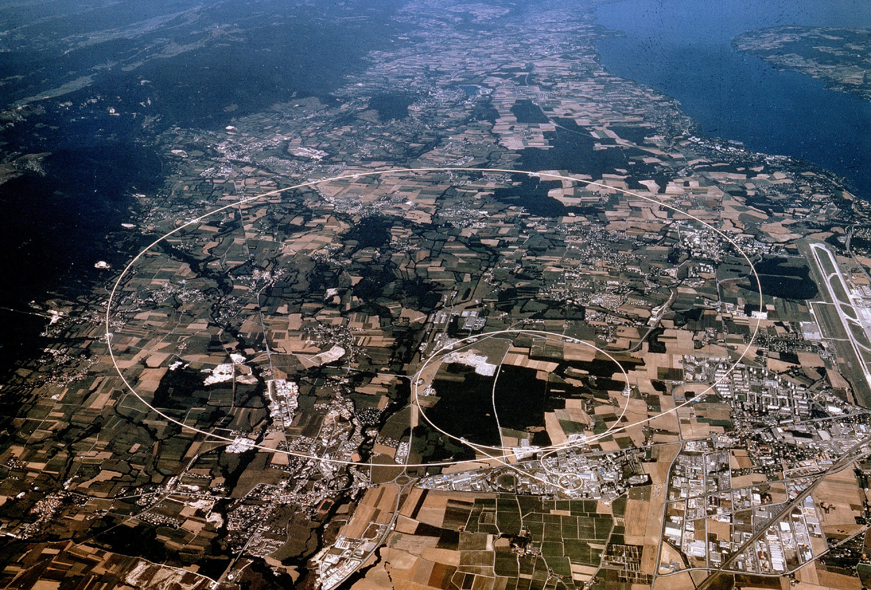
Naturalness and LHC Data
(Part I)
Albert De Roeck
CERN, Geneva, Switzerland
Antwerp University Belgium
UC-Davis California USA
NTU, Singapore
22nd October 2016

Slide 2
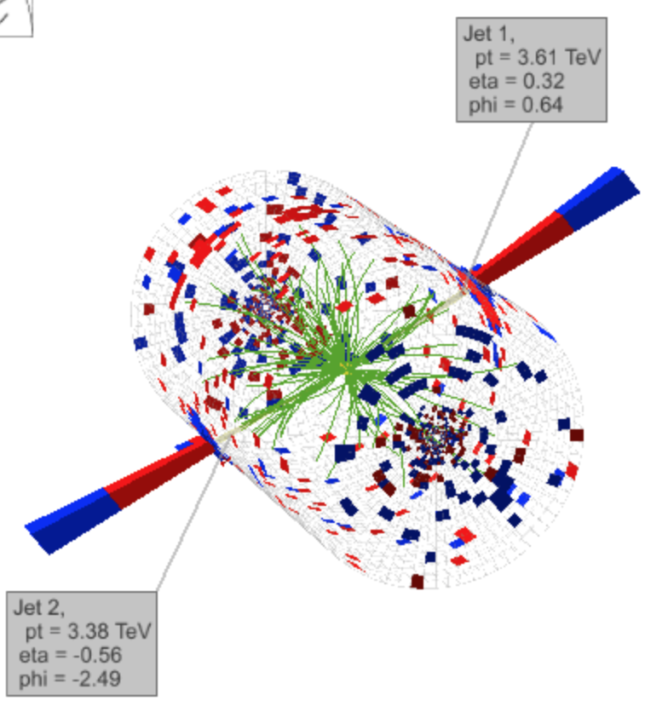
Outline
Introduction
SUSY searches for stop,
sbottom and gluinos
Top partner searches and
heavy resonances
Properties of the Higgs
Extra Dimensions
Other channels (-> A.
Haas tomorrow)
Summary/Outlook
Data from ATLAS and CMS
Similar results from both
experiments

Slide 3
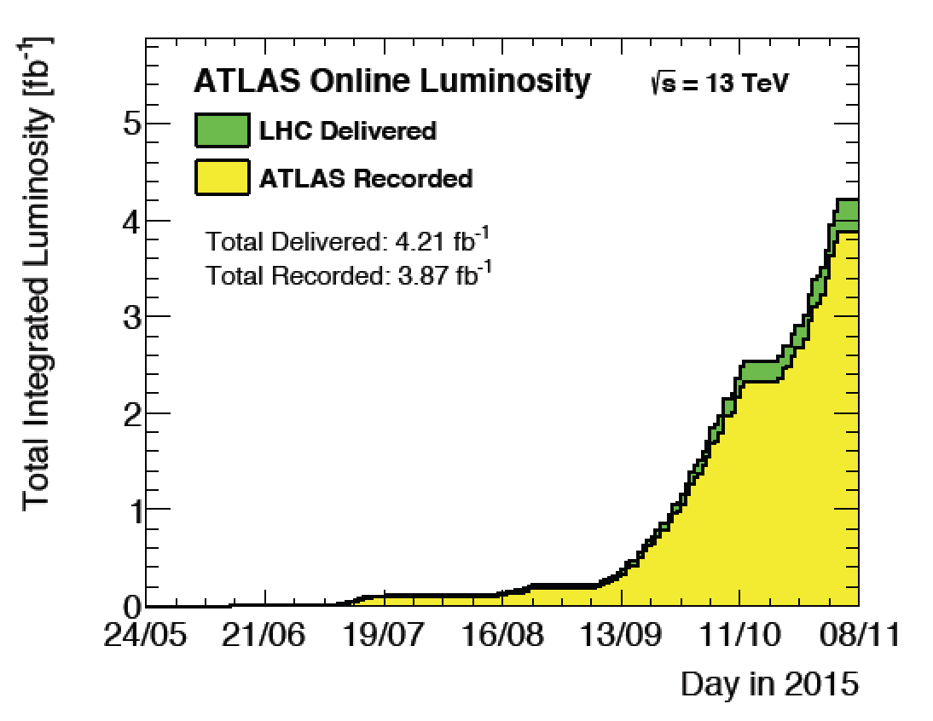
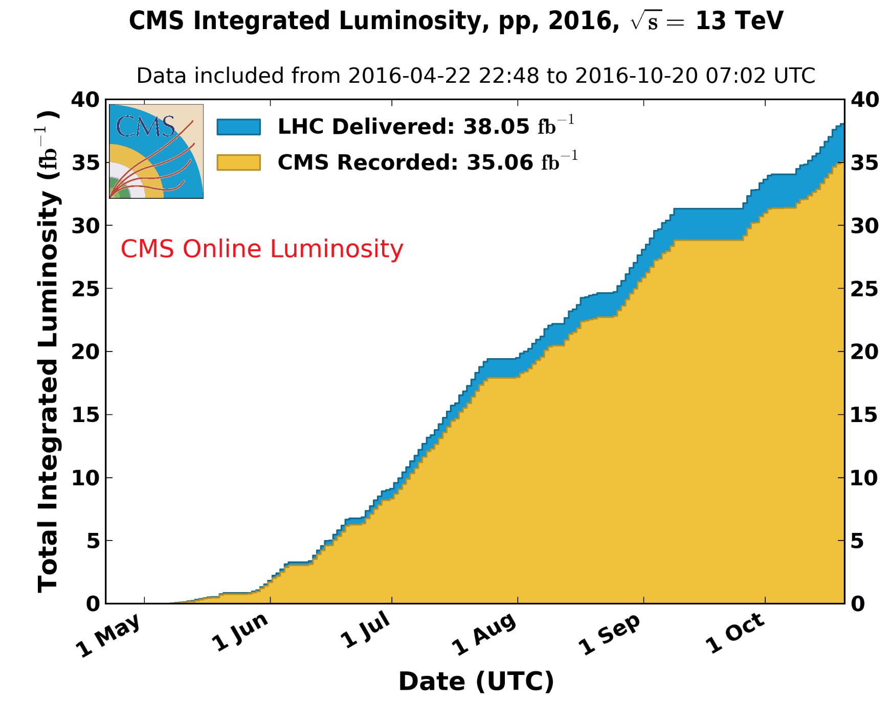
A
2015
~15% of the Run-1
luminosity!
2016 luminosity> Run-1 luminosity
2016

Slide 4
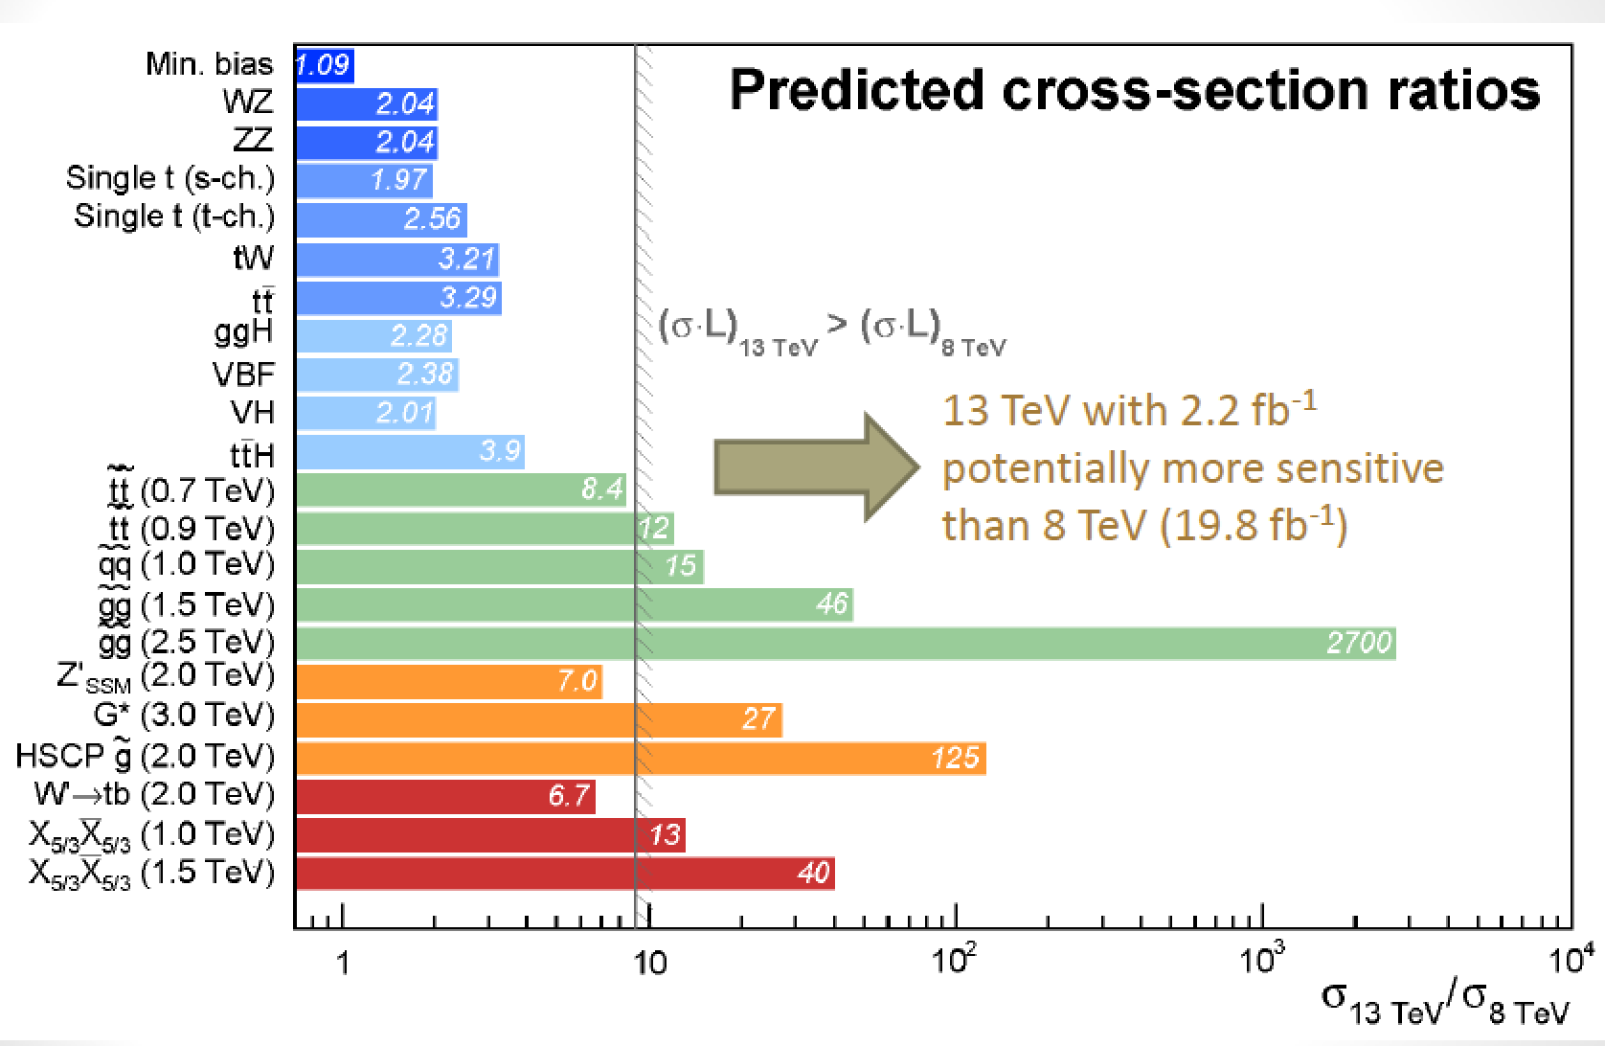
Run-II: From 8 TeV to 13 TeV
ICHEP dataset
2015 dataset

Slide 5
Naturalness: popular adopted (TH) paradigm for searches for New Physics Experimental Searches not limited to it but may be guided by Naturalness arguments Of interest for the experiments: feedback on more signatures that we should or could be exploring: The data is likely already there
Canceling quadratic
divergences to the
Higgs mass

Slide 6
Naturalness
J. Hewett, SUSY2016, Melbourne

Slide 7
Naturalness Related Searches
Classical search within supersymmetry: light stop (sbottom) or gluinos
Top partners: Vector-Like Quarks and resonances: little Higgs or composite Higgs models
Neutral Naturalness: Twin Higgs, Folded SUSY.
-> Effects on the Higgs? Higgs properties
Extra Dimensions: avoiding hierarchy problem…
Other scenarios eg Long Lived Particles, heavy vector bosons, special SUSY searches, exotic Higgs searches -> Andy

Slide 8
Searches for BSM Physics at the LHC

Slide 9
Summary of Exotica Searches
2014
8 TeV data @ 20 fb⁻¹

Slide 10
Summary of SUSY Searches
2014
No significant sign of SUSY with the data collected in Run-I
8 TeV data @ 20 fb⁻¹

Slide 11
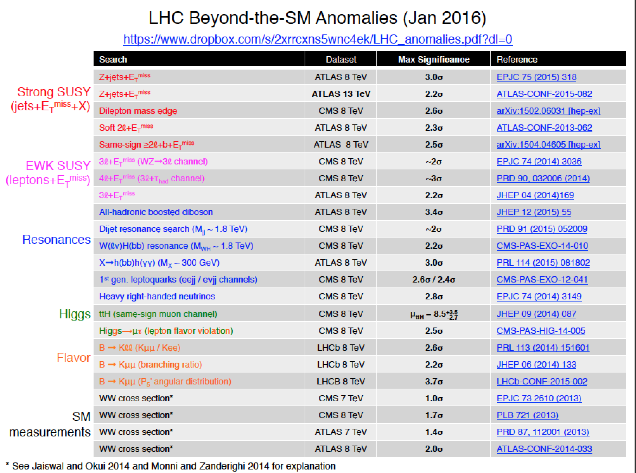
Run-1: We Observed Mild Deviations!
B. Hooberman
November 2015

Slide 12
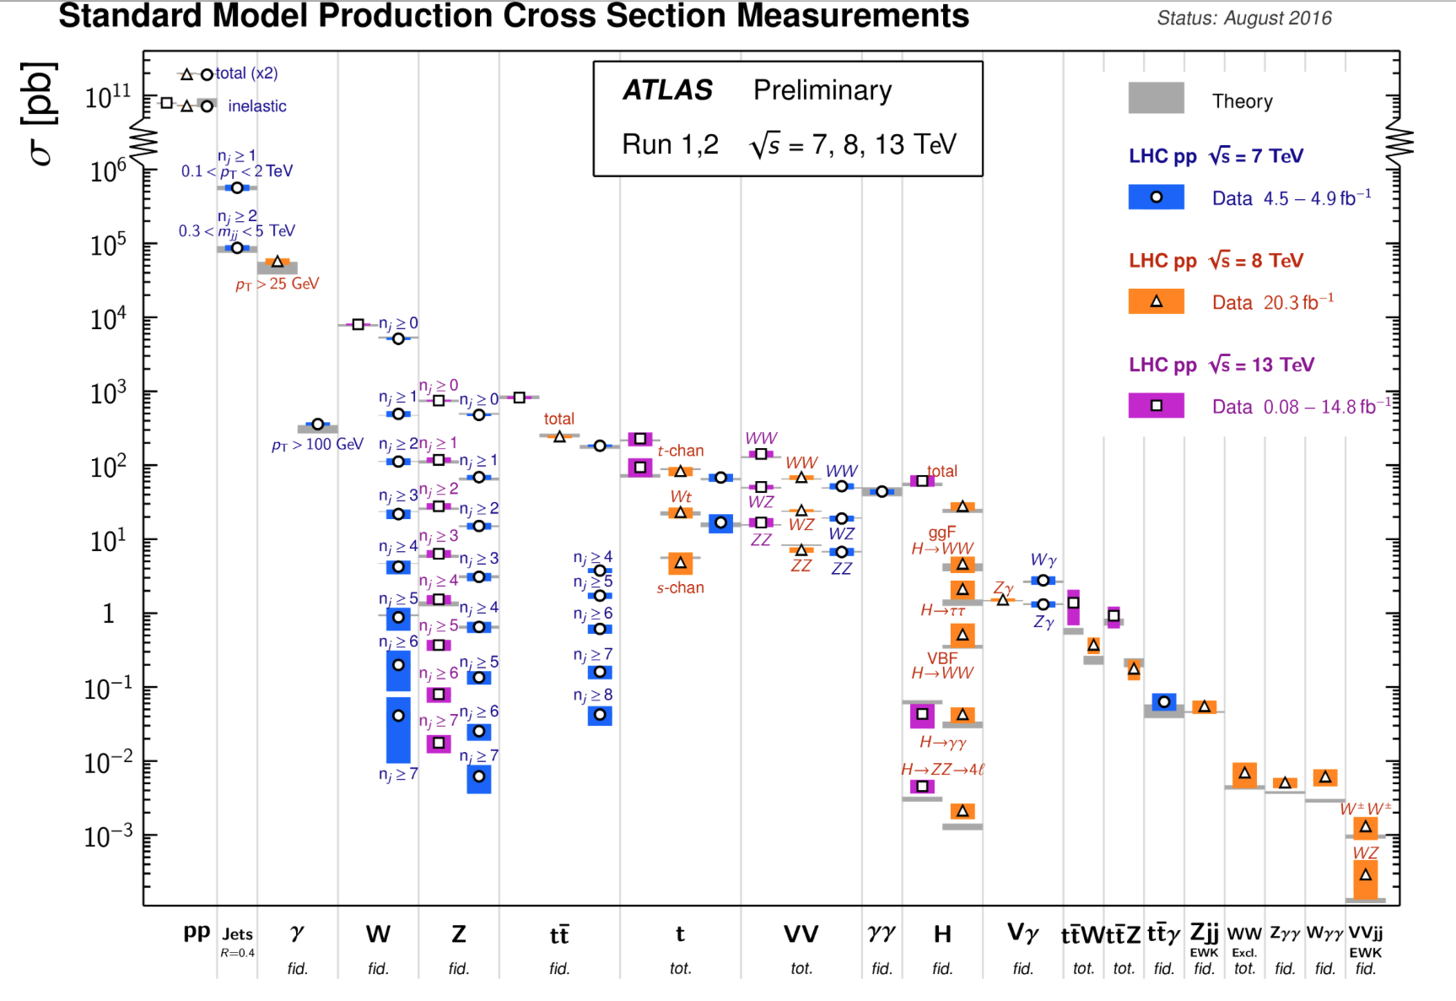
Standard Model Measurements a@ 7/813 TeV
The Standard Model continues to prevail at the highest energies !!

Slide 13
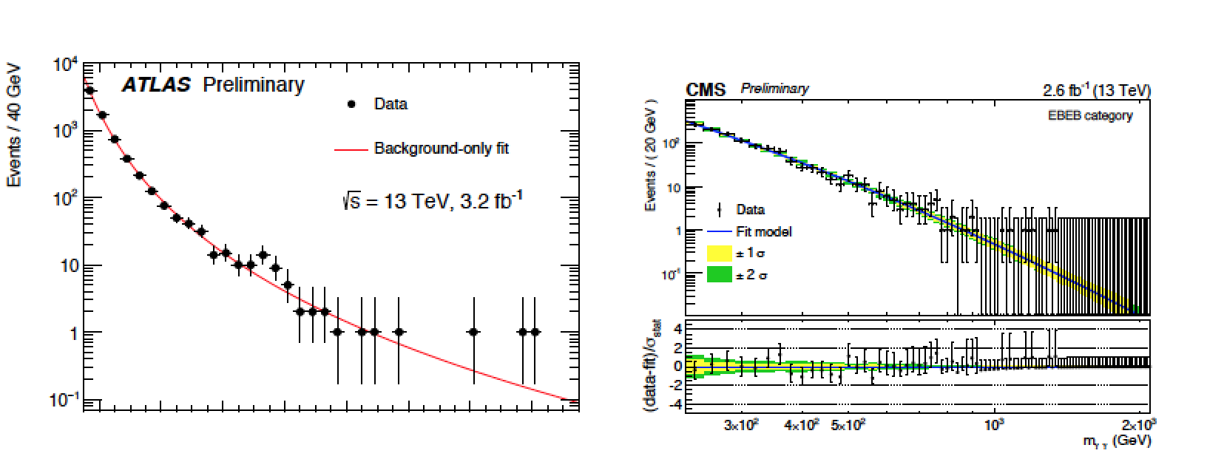
A New Particle at 750 GeV: X → γγ ?
Excitement in December 2015:… a moment of hope!
->Some excitement on an mild observed excess in both
experiments for a diphoton mass of around 750 GeV
ATLAS-CONF-2015-081
CMS EXO-15-004
A totally unexpected
new particle???
Statistical fluctuation? A new resonance? ???
Moriond: CMS: 3.4 σ ! ATLAS up to 3.9 σ !! (local significances)

Slide 14
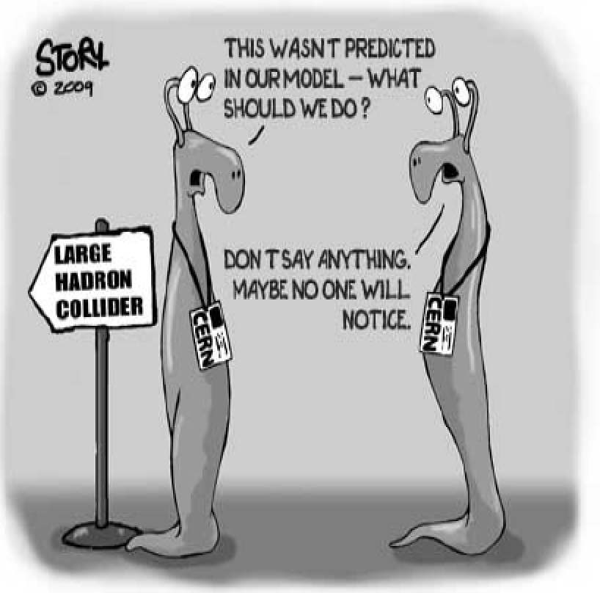
This triggered >540 papers
Andre David: http://jsfiddle.net/adavid/bk2tmc2m/show/
27/8/2016
Constant rate of 2 papers/ working day!
Note: many of these papers
did not touch on Naturalness
But often VLQs/Composite Higgses
needed to get the rates right!
… but (almost) no new entries since
Friday 5/8/2016…

Slide 15
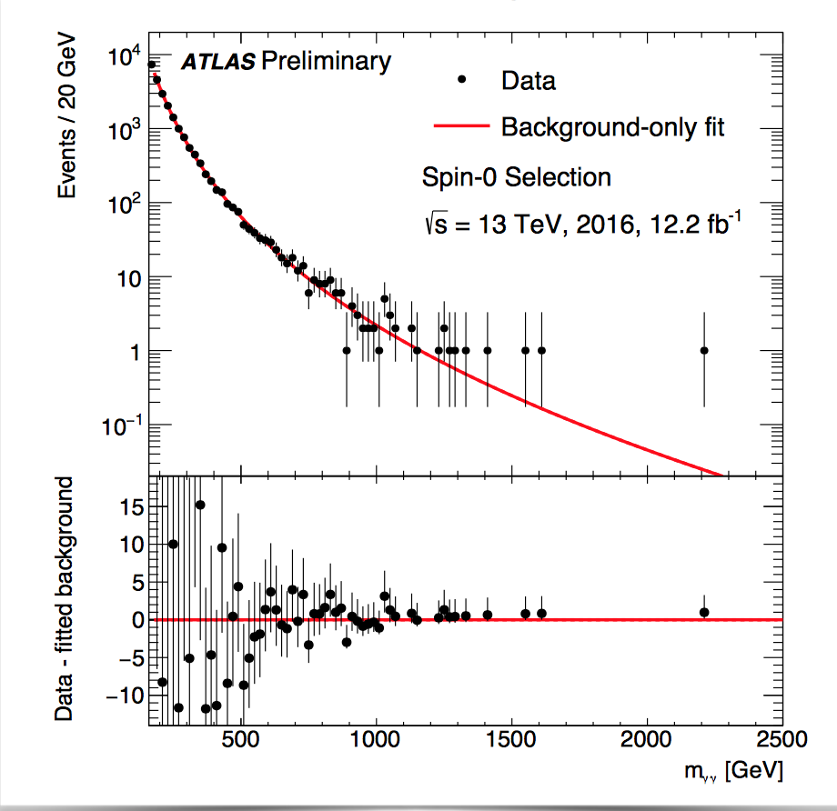
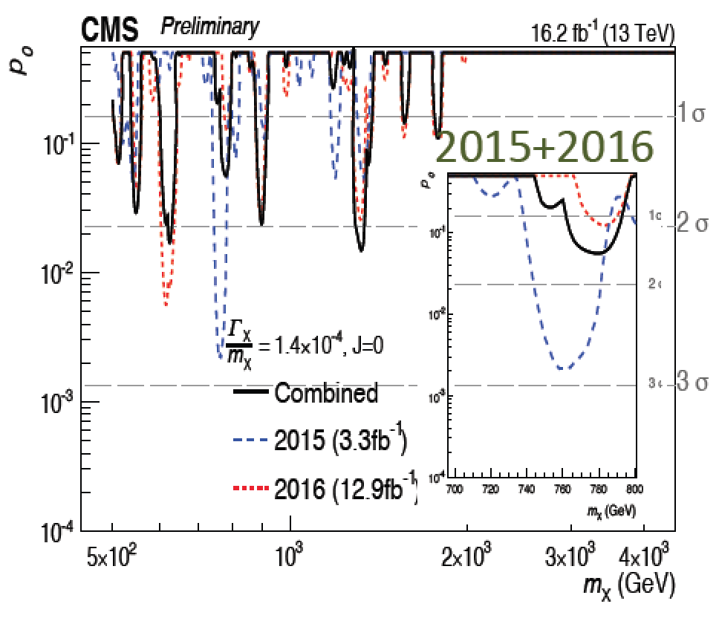
A New Particle at 750 GeV: X → γγ ?
What does the 2016 data say ? (4 x 2015 data!!)
News at
ICHEP!!
ATLAS-CONF-16-055
CMS-EXO-16-027
Spin-0
analysis
The excess is NOT seen in the new data from 2016!
So, not for this time, but a sign of new physics can be found any time now
We need only one significant deviation of the Standard Model to show the way!

Slide 16
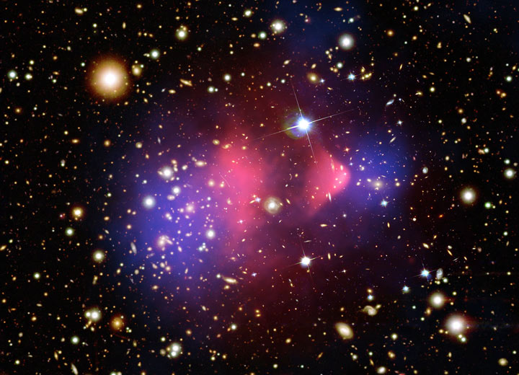
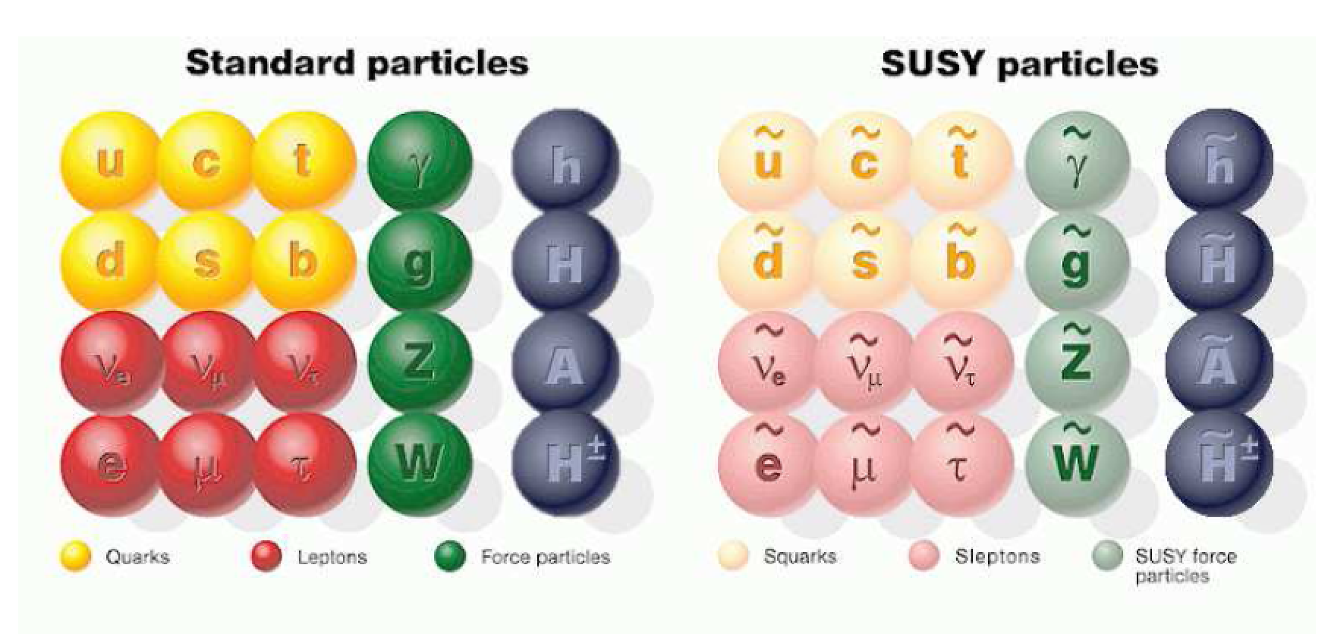
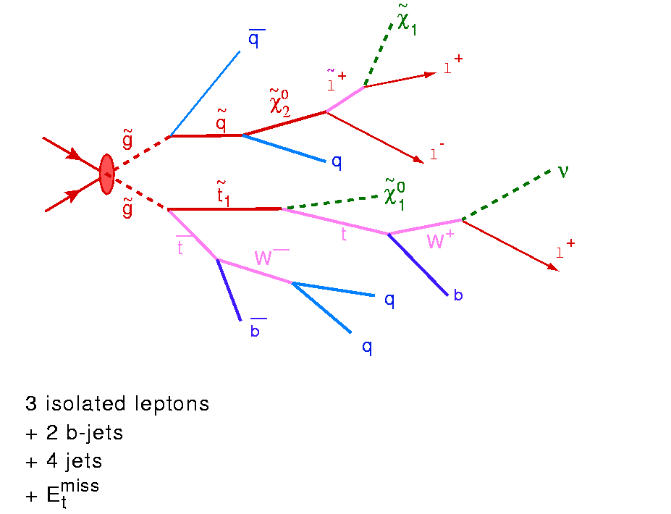
Beyond the Higgs Boson
Supersymmetry: a new symmetry in Nature?
An answer to the
hierarchy problem?
Candidate particles for Dark Matter
⇒ Produce Dark Matter in the lab
“One day all these trees will
be SUSY phenomenology papers”
SUSY particle production at the LHC
Picture from Marusa Bradac

Slide 17
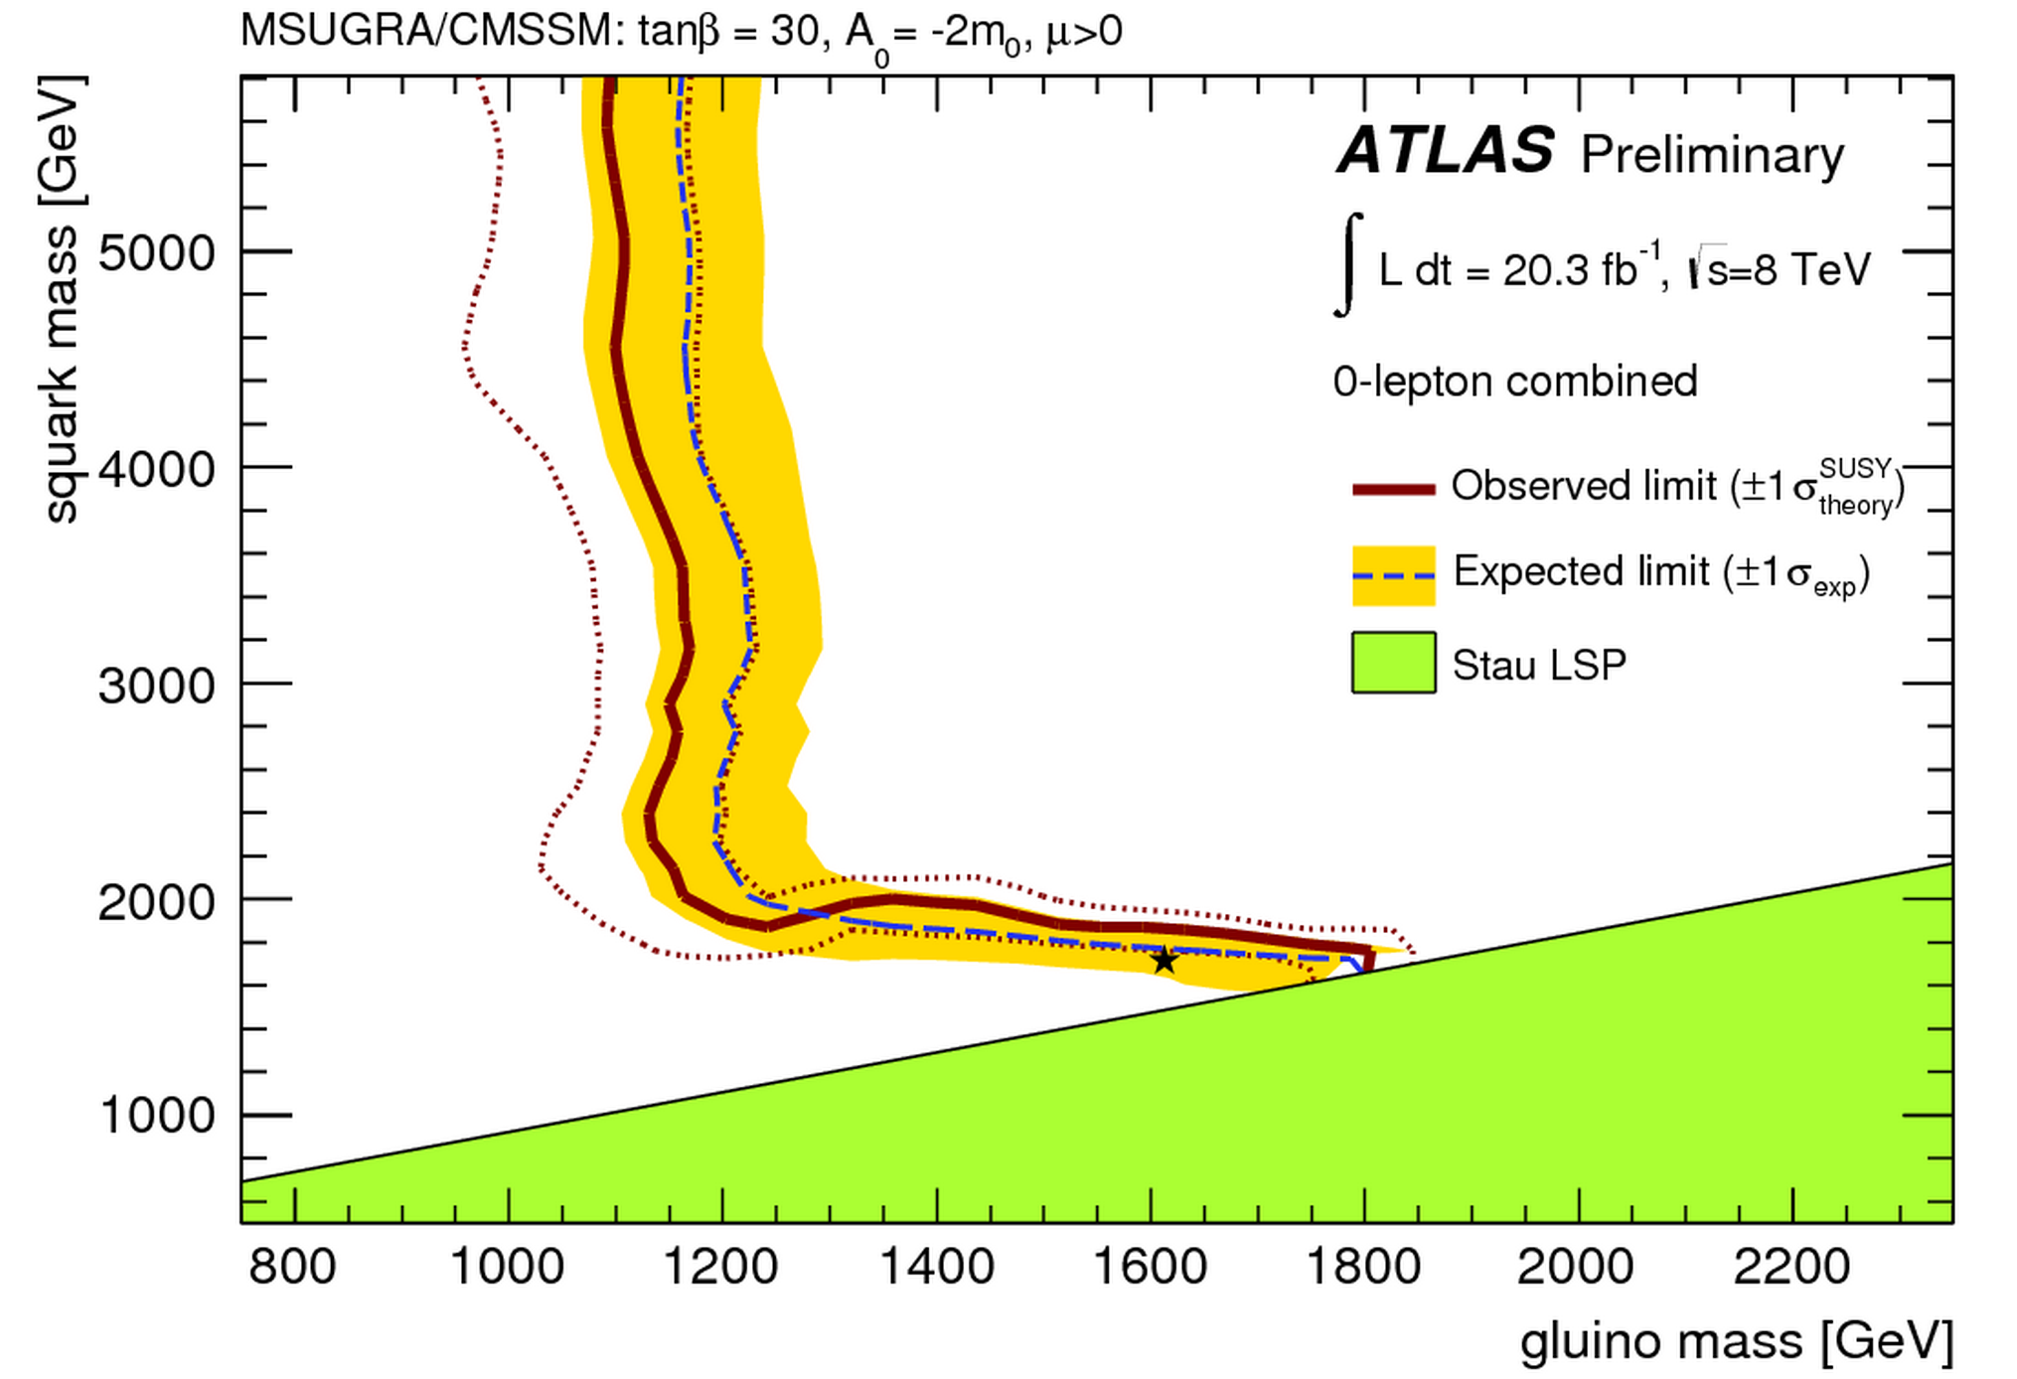
SUSY Searches: No signal yet to date…
Interpretation of the searches in MSUGRA/CMSSM
•So far NO clear signal of
supersymmetric particles
has been found
•We can exclude regions
where the new particles
could exist.
•Searches will continue for
the higher energy in run-2
allowed
excluded
Plenty of searches ongoing: with jets, leptons, photons, W/Z,
top, Higgs, with and without large missing transverse energy
Also special searches for contrived model regions
CMS-SUS-11-015

Slide 18
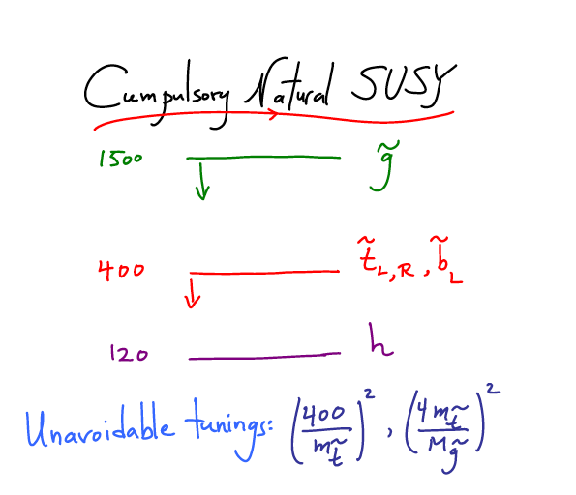
What is really needed from SUSY?
End 2011: Revision!
N. Arkani-Ahmed
CERN Nov 2011
and many many more ..
LHC data end 2011
Stops > 200-300 GeV
Gluino > 600-800 GeV
Moving away from
constrained SUSY models
to ‘natural’ models
Natural SUSY survived
LHC so far, but we
are getting close to
push it to its limits!
Also:Barbieri & Giudice (1988): Natural Models!

Slide 19
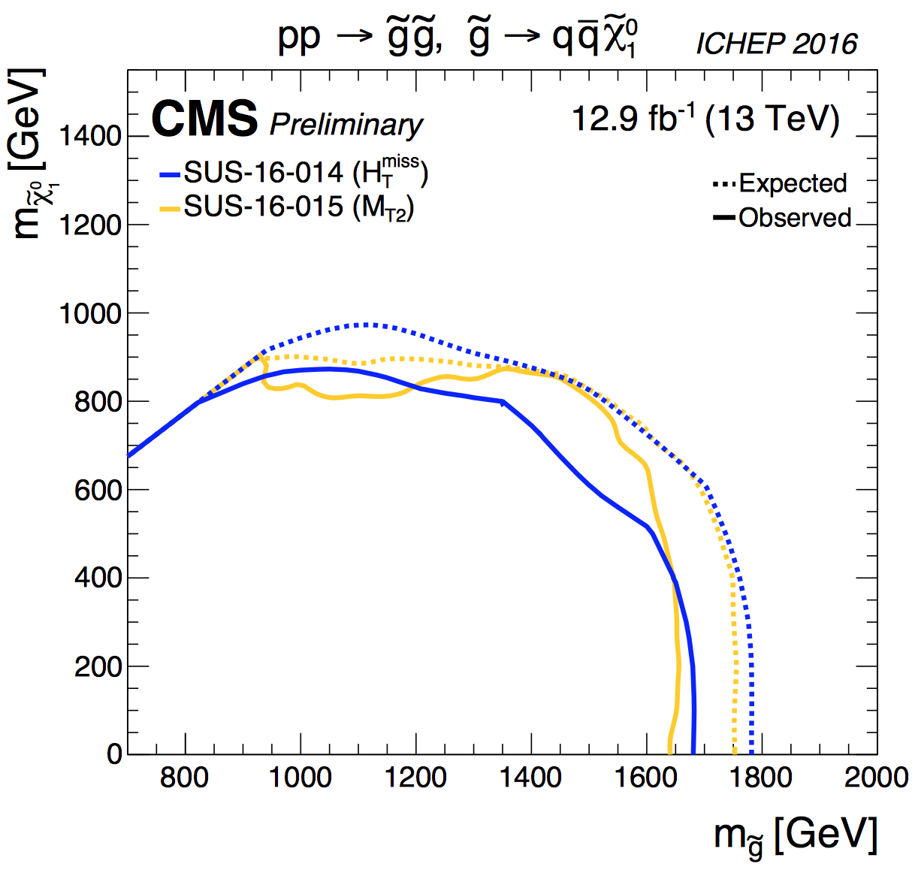
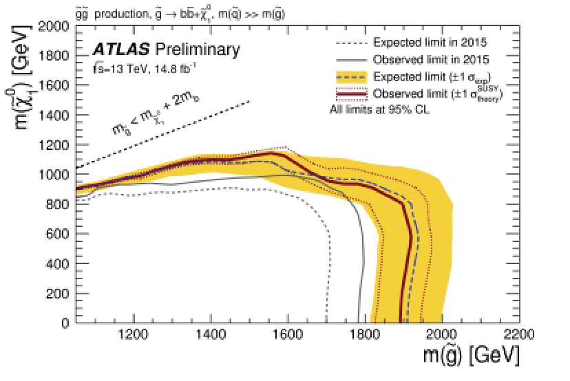
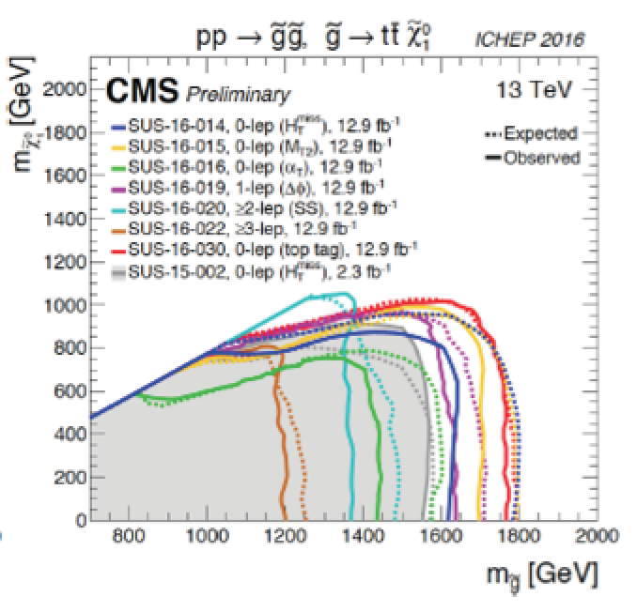
Gluino Searches
Interpretation in simplified models
Within the context of the SMS:
Exclude with masses up to 1900 GeV for neutralino masses up to 800 GeV
Sensitivity is like 400-500 GeV better than Run-1 reach

Slide 20
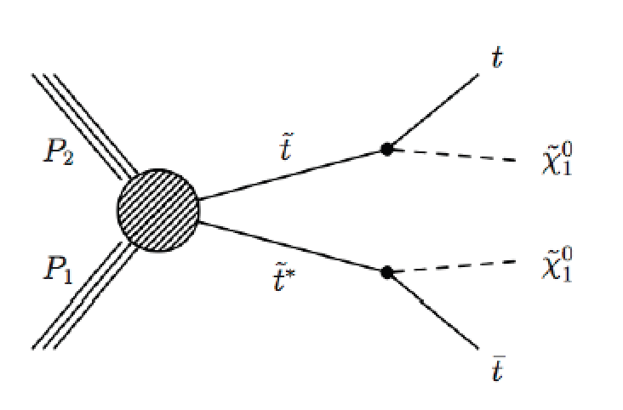
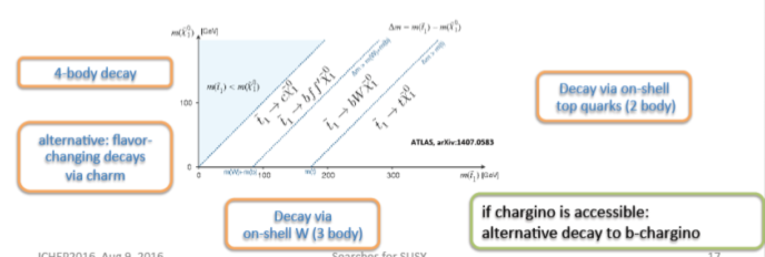
Stop Production
•Signature: flavored decay via t(*). Final states
classified according to W decay mode
•Analyses using top and b taggers, typically final states
Jets+MET, Jets+lepton(s)+MET, Jets+Z+MET, Taus+MET…
•Different approaches in different regions of the
phase space
Increasing number of methods used to search for stop quarks over the years

Slide 21
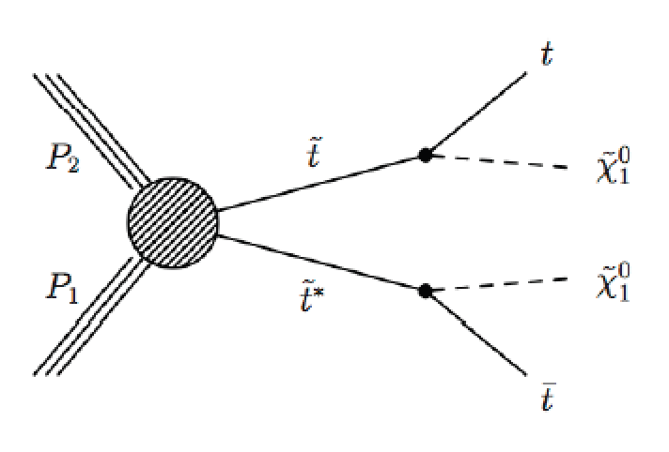
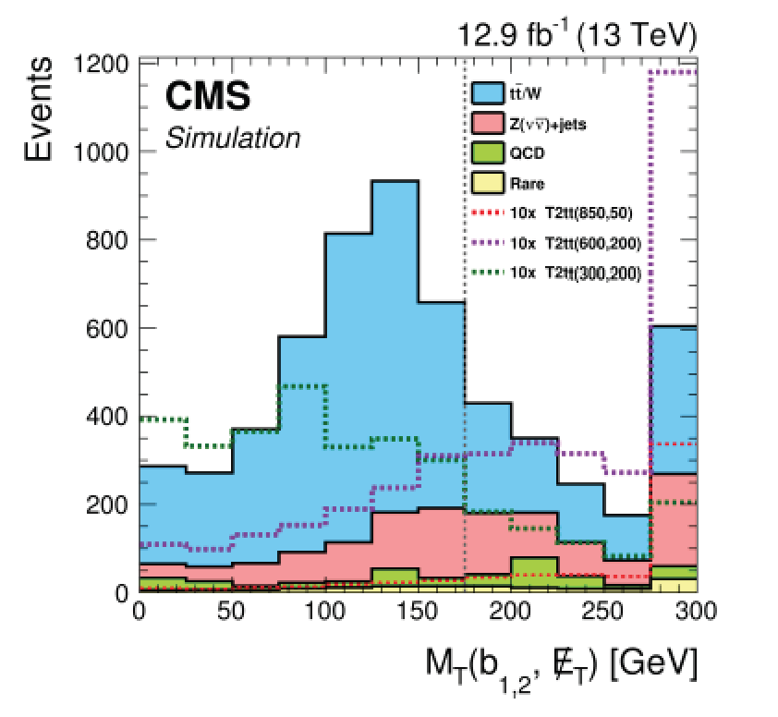
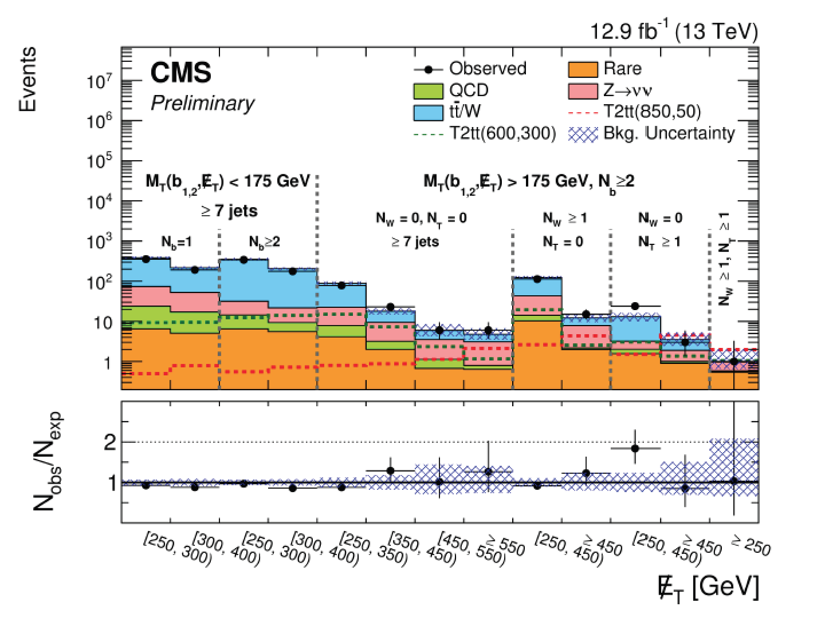
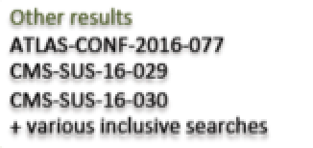
Stop Production
Example: hadronic search
Optimization for low and high Δm (stop-χ mass)
High Δm using # jets, #b-jets, M_{T}(b) and MET
#tops and #Ws from jet substructure
SUS-2016-029

Slide 22
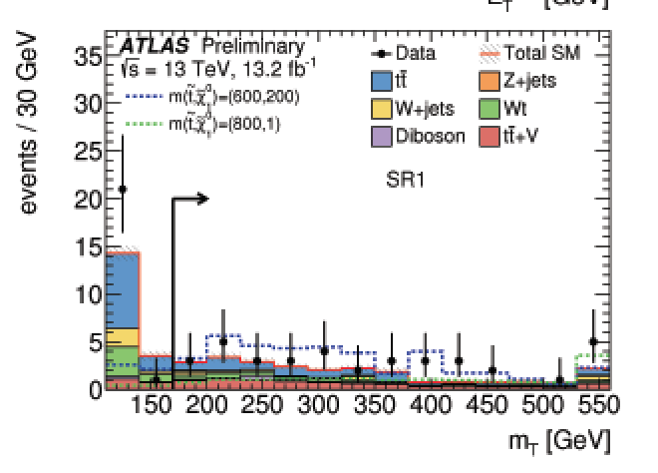
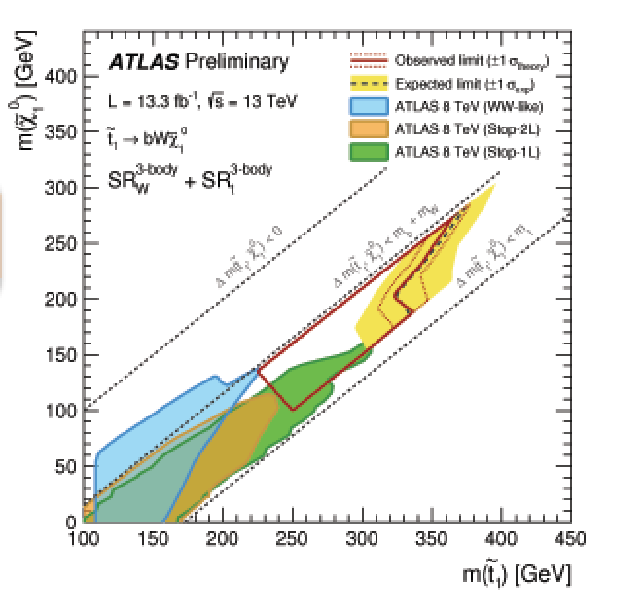
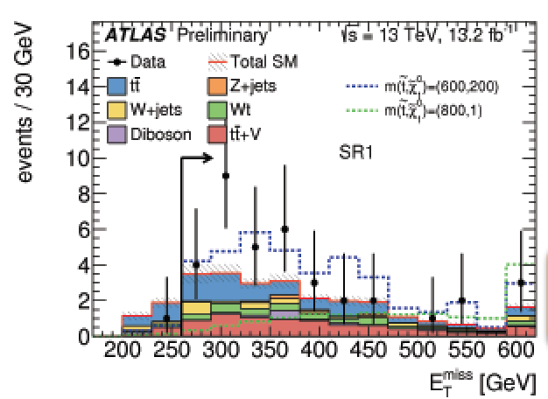
Stop Production
Leptonic searches (single and double leptons)
signal regions optimization for different Δm and
top decays with jets, b-jets MET…
ATLAS-CONF-16-050
ATLAS-CONF-16-076

Slide 23
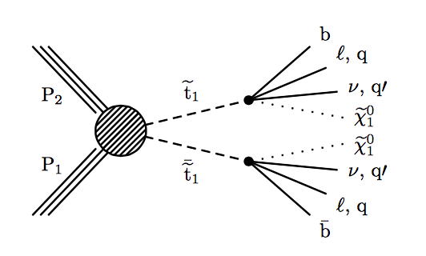
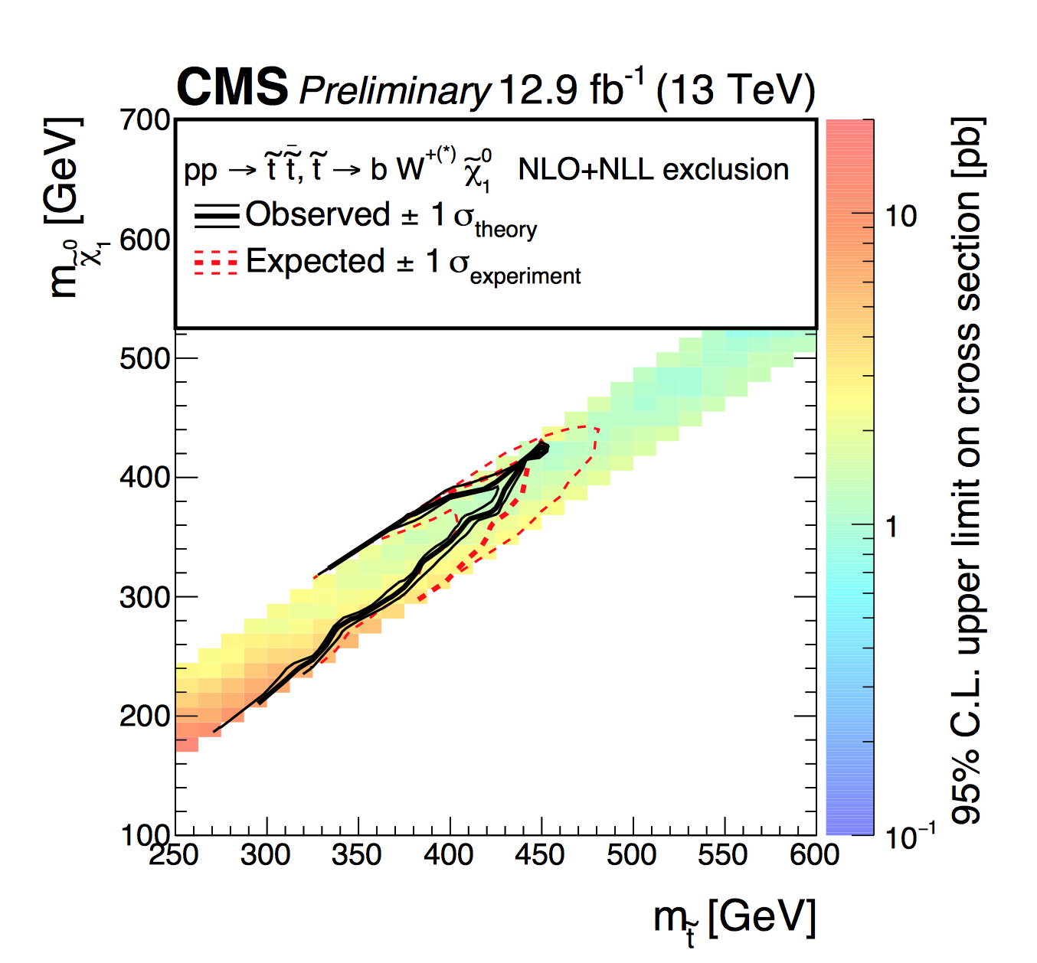
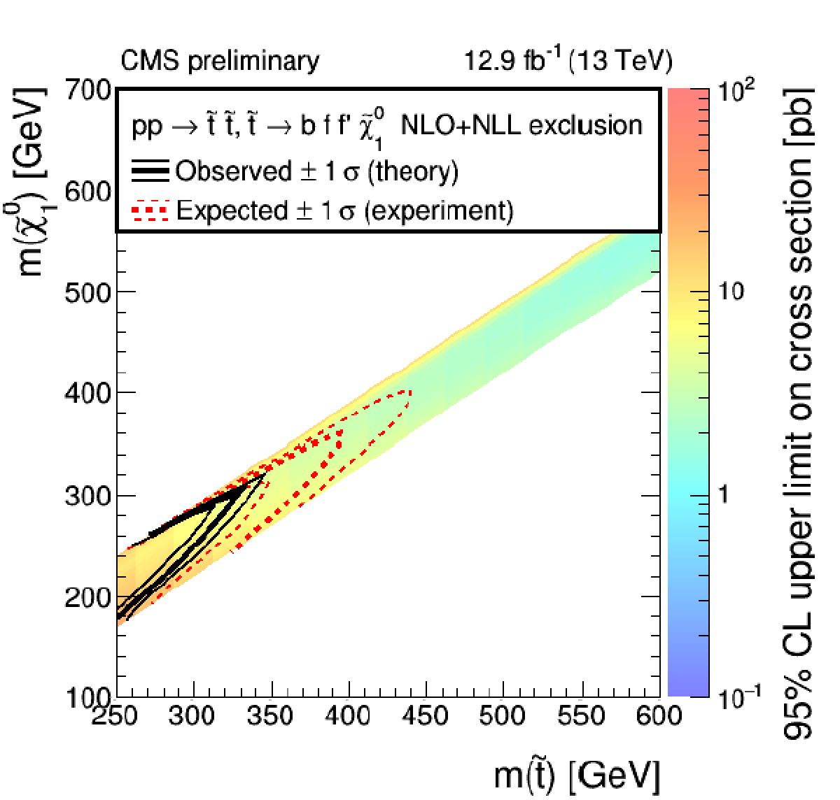
Stop Production
4-body final states with soft leptons and jets
and making use of ISR jets
Full hadronic
Lepton +jets
SUS-2016-029
SUS-2016-031

Slide 24
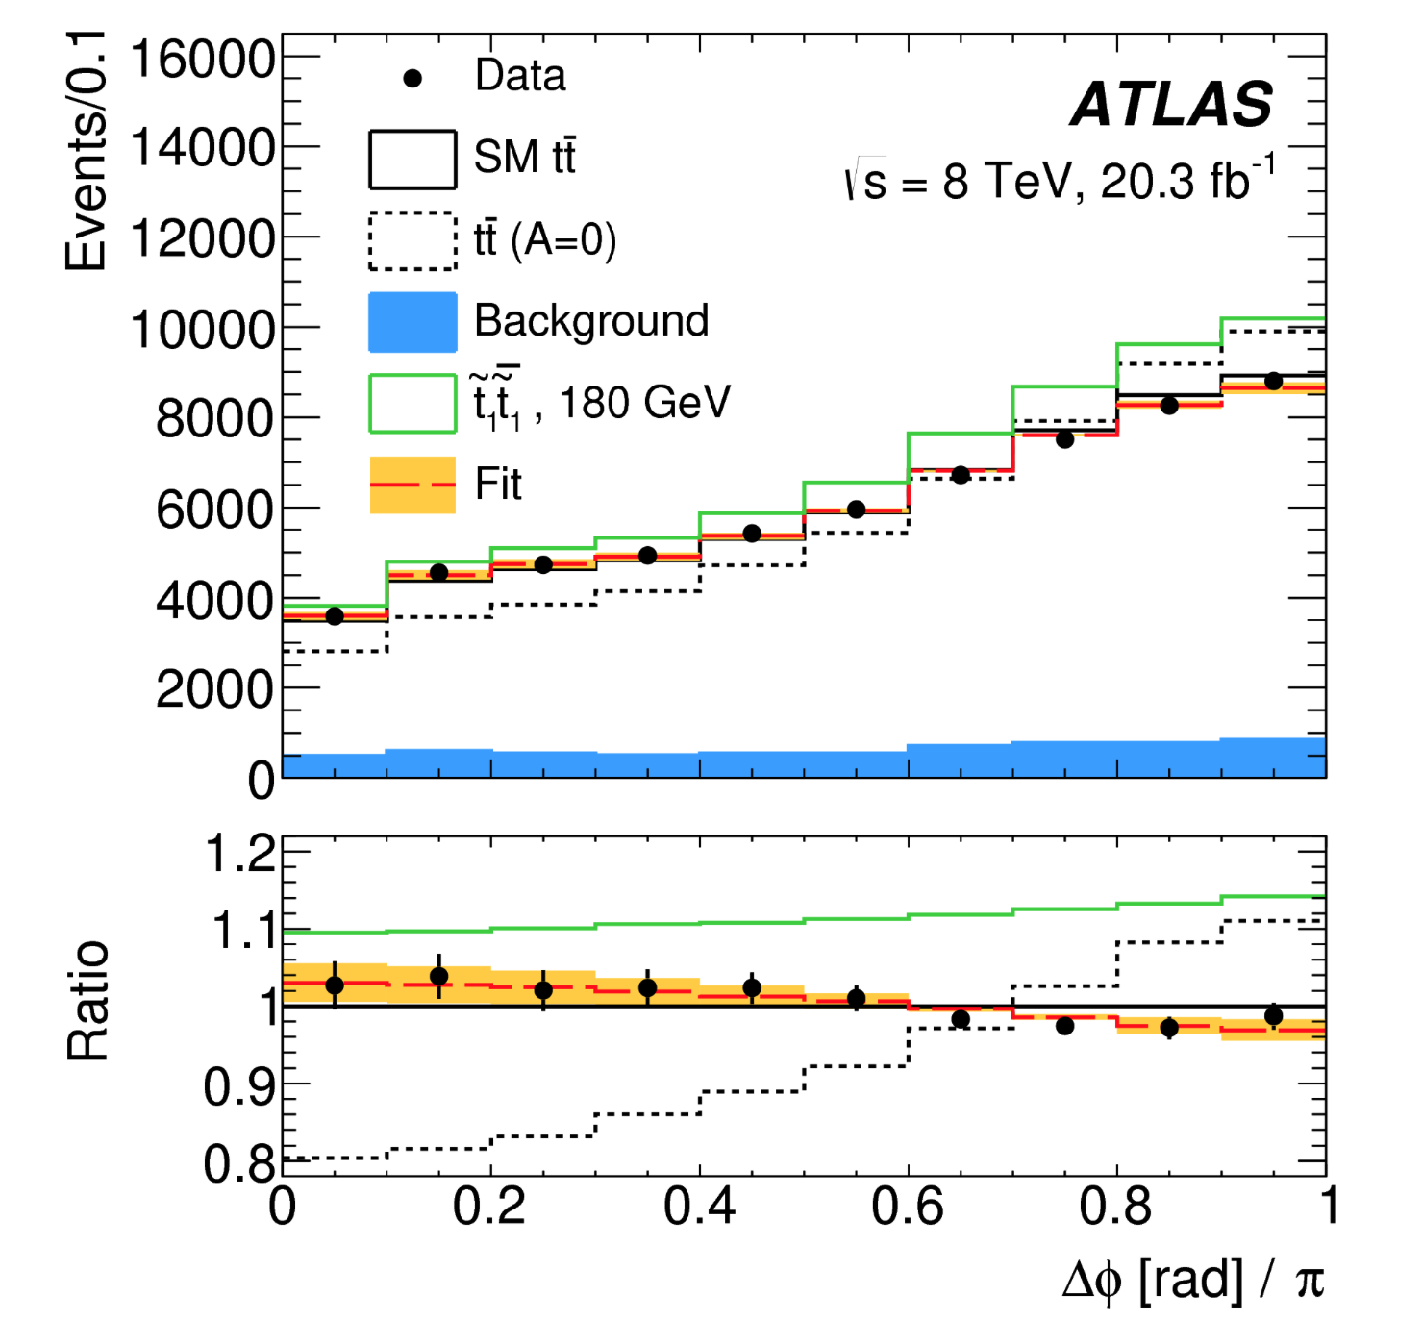
The case: Mass stop ~ Mass top
PRL114 142001 (2015)
Also the ttbar cross section has sensitivity (present precision ~ 5%)

Slide 25
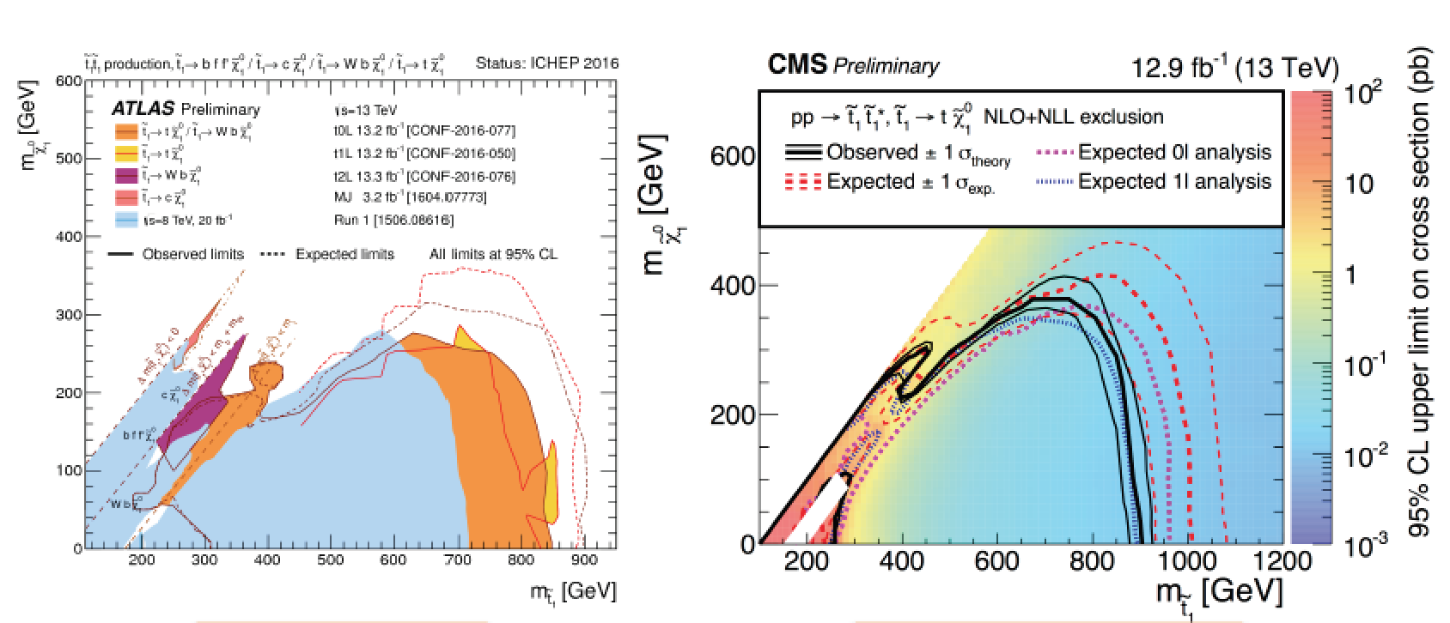
Top Squark Search Summaries
Within the context of the SMS:
Exclude with masses up to 900 GeV for neutralino masses up to 400 GeV
Sensitivity is like 100-200 GeV better than Run-1 reach & gaps being covered
Is this getting critical for Natural Models??

Slide 26
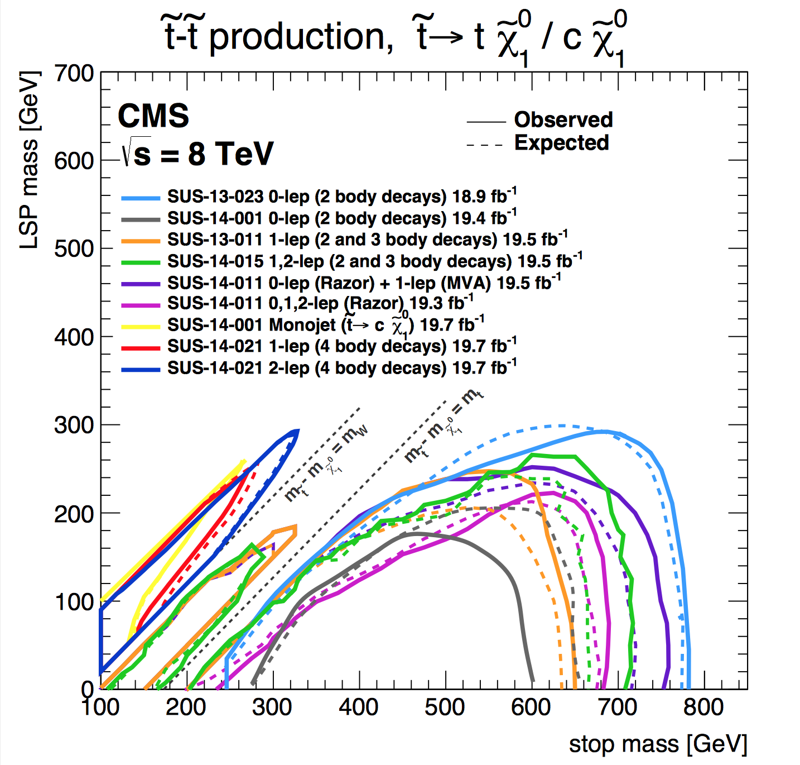
Top Squark Search Summaries
Run-1
Run-2
Within the context of the SMS:
Exclude with masses up to 900 GeV for neutralino masses up to 400 GeV
Sensitivity is like 100-200 GeV better than Run-1 reach & gaps being covered
Is this getting critical for Natural Models??

Slide 27
Note on Simplified Models
Simplified models are a language for experimental results to theorists…
W. Adam

Slide 28
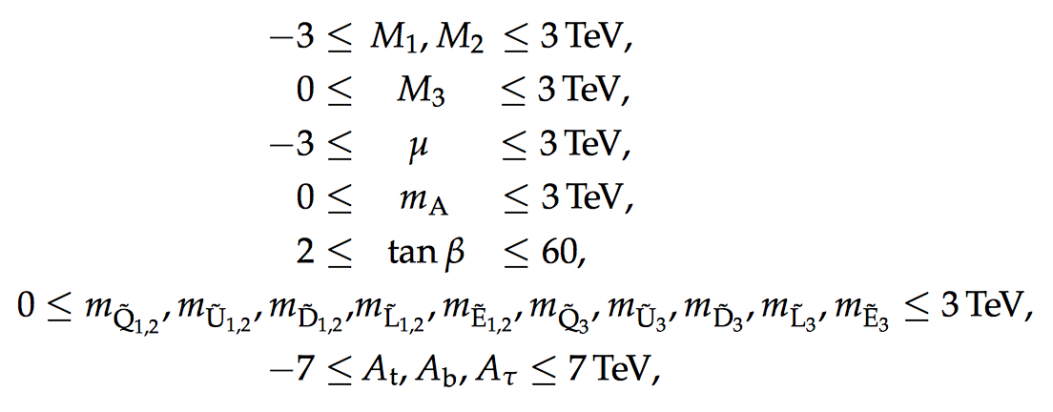
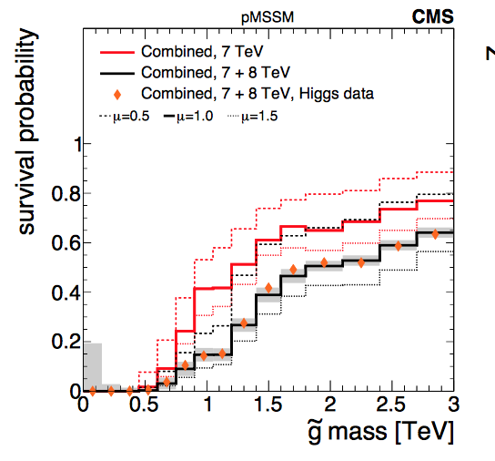
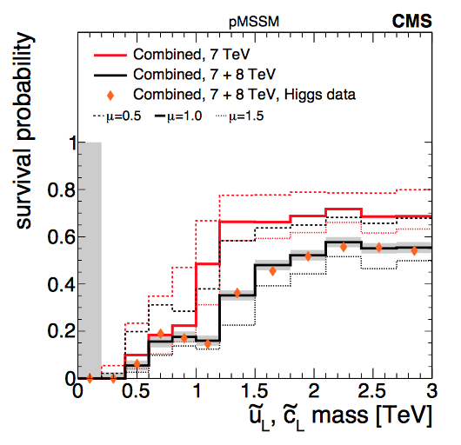
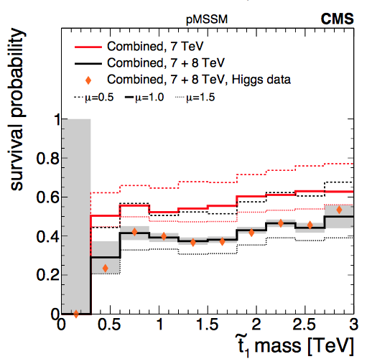
Phenomenological MSSM analysis
SMS don’t always fully cover signatures…
-> the 19 parameter phenomenological MSSM (pMSSM) analyses
arXiv:1606.03577
ATLAS: arXiv: 1508.06608
gluinos
squarks
stop
2.10⁷ points sampled: Leads to softer limits on the sparticles masses
Gluinos > 500 GeV, stops > 250 GeV => there is still low mass phase space left!

Slide 29
Search in the Z+Jets+MET Channel
ATLAS-CONF-2015-082
Search for gluino or squark production with Z in decay chain
•In Run-1 ATLAS observed an excess in this
channel: 3 (1.7) σ excess in ee (μμ) channel
•No excess observed in CMS in Run-1
Reproduce the Run-1 analysis in Run-2:

Slide 30
Search in the Z+Jets+MET Channel
Run-2 (2015)
Local excess of 2.2σ
14
•ATLAS continues to observe
an excess in the 2015 data
•CMS remains consistent with
the background expectation.
No new ATLAS result@ICHEP…

Slide 31
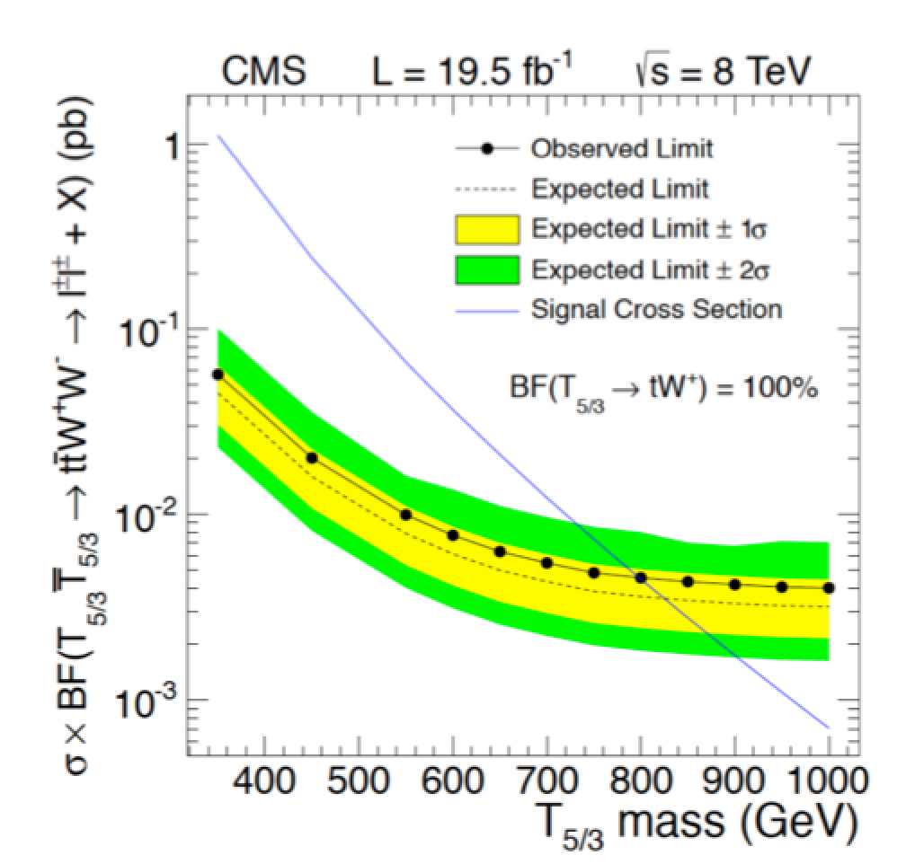
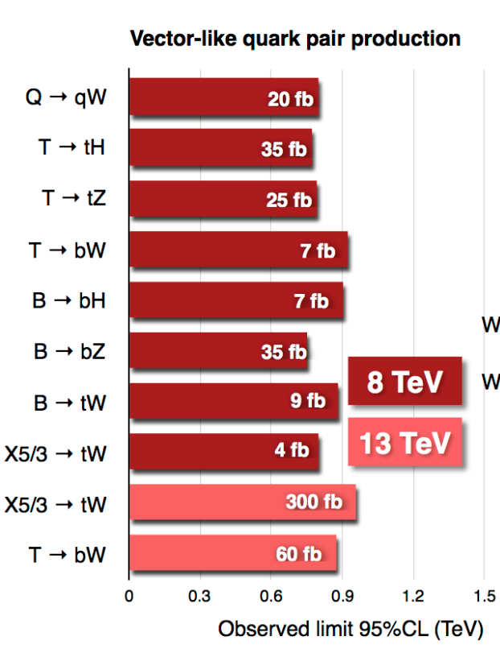
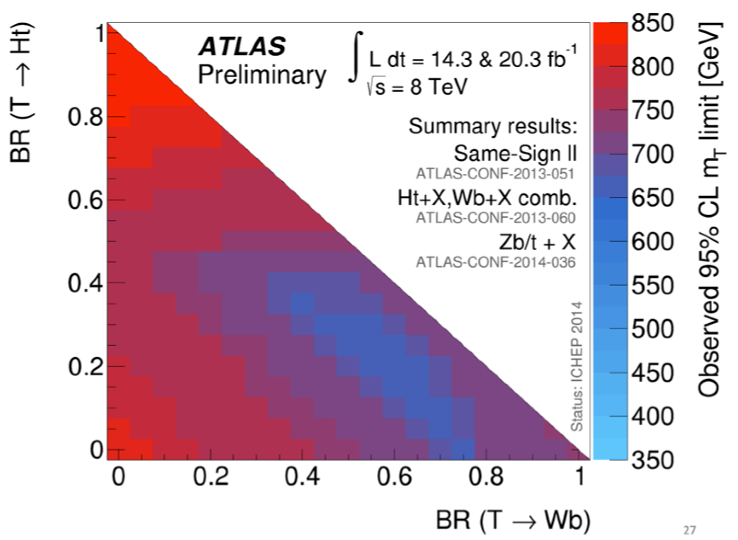
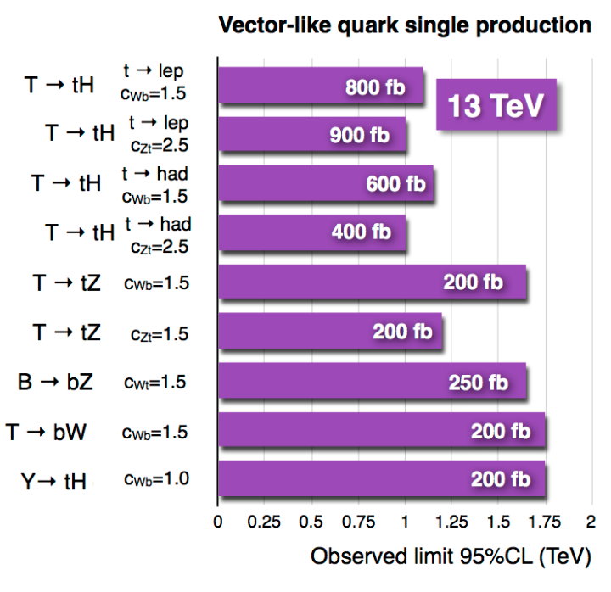
Vector-like Top/Bottom Partner Searches
Vector-like quarks
Relevant eg in
composite Higgs
models
Exclusions up
to masses of
800-900 GeV
and up to 1.75 TeV
for singly produced
VLQs (model dep.)

Slide 32
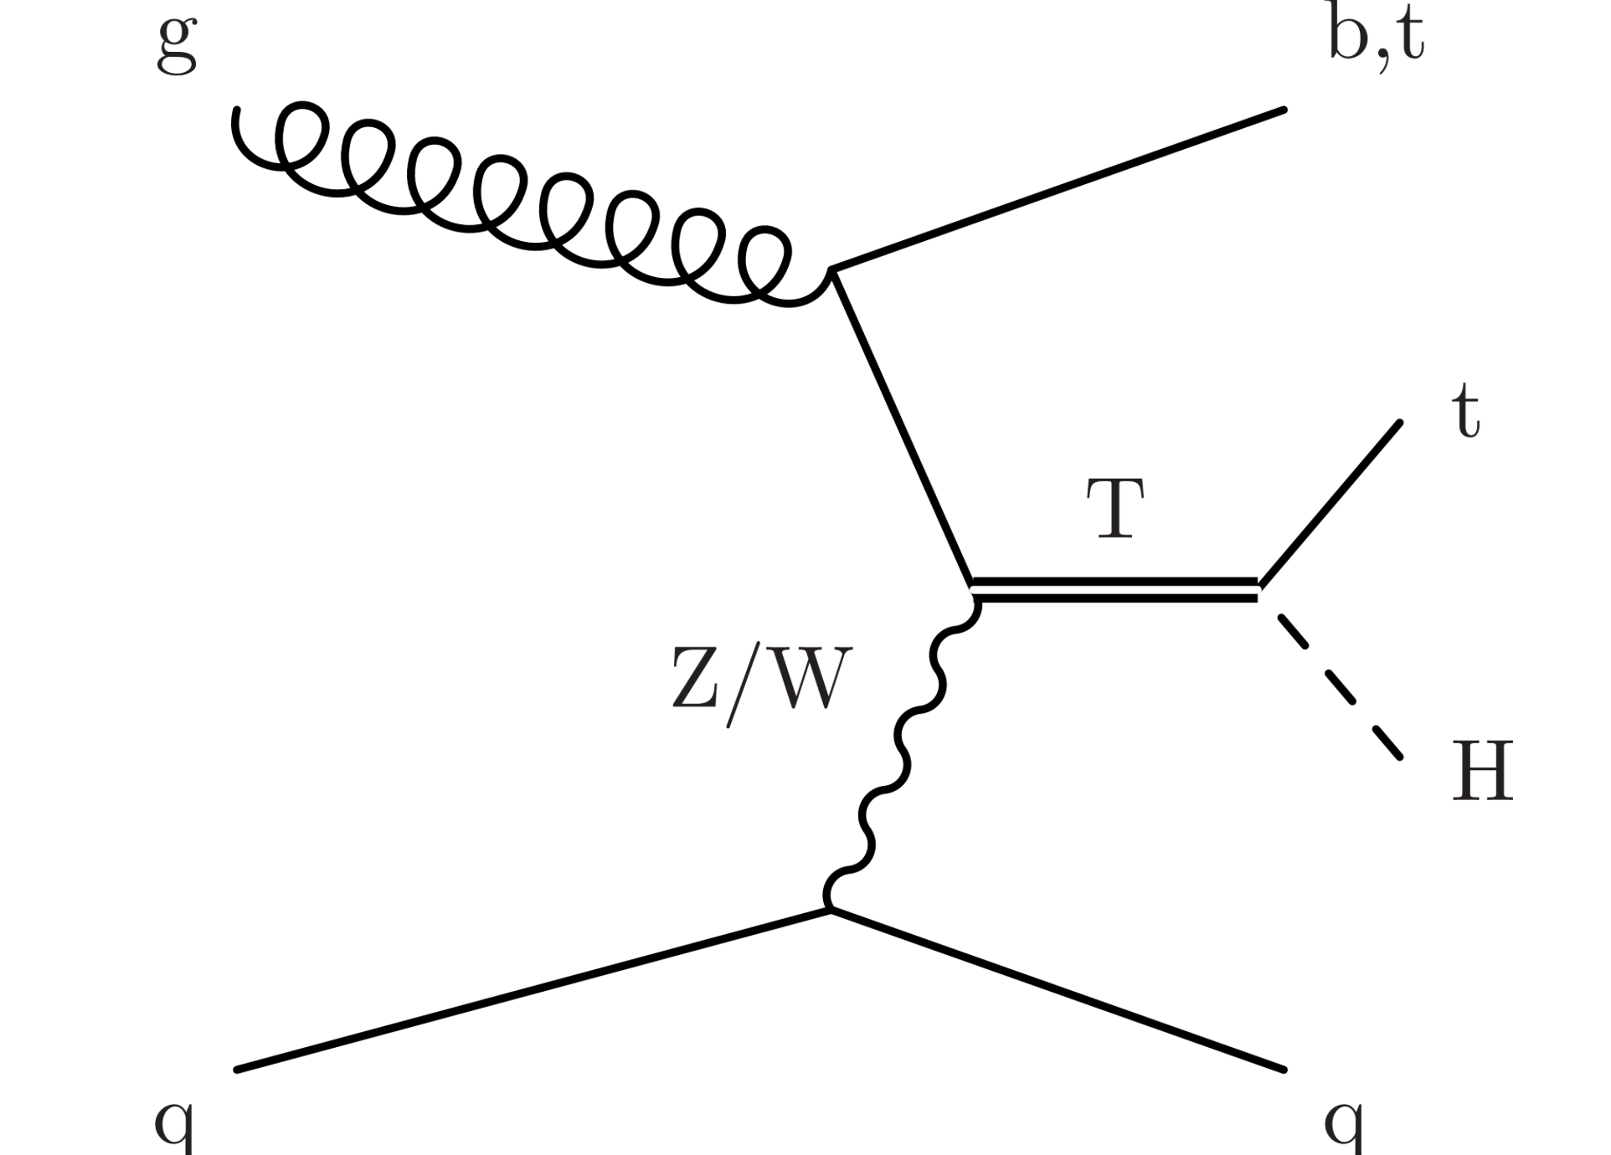
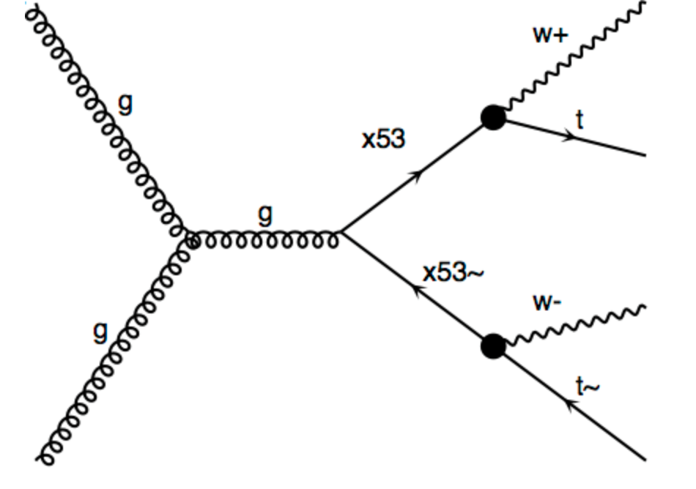
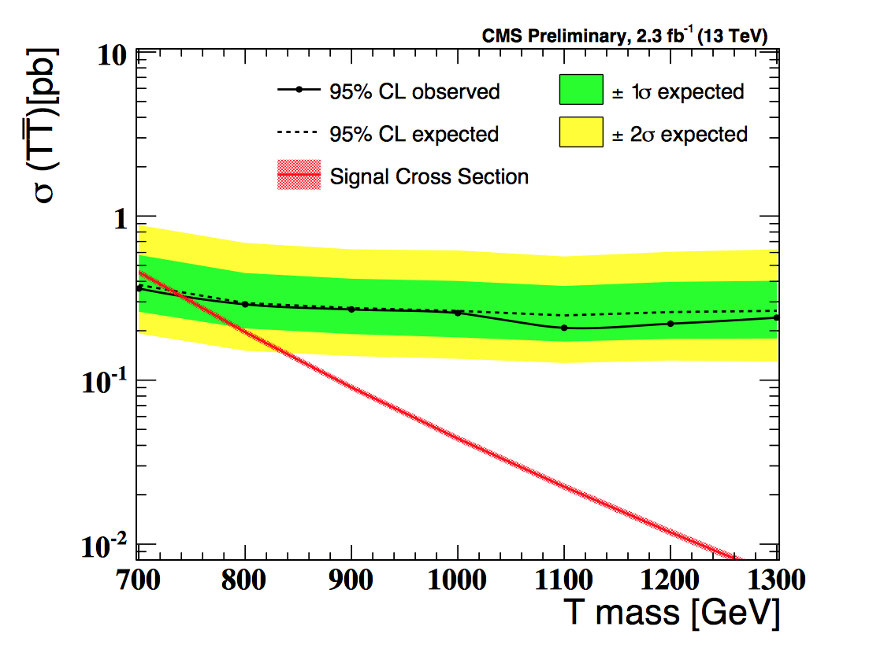
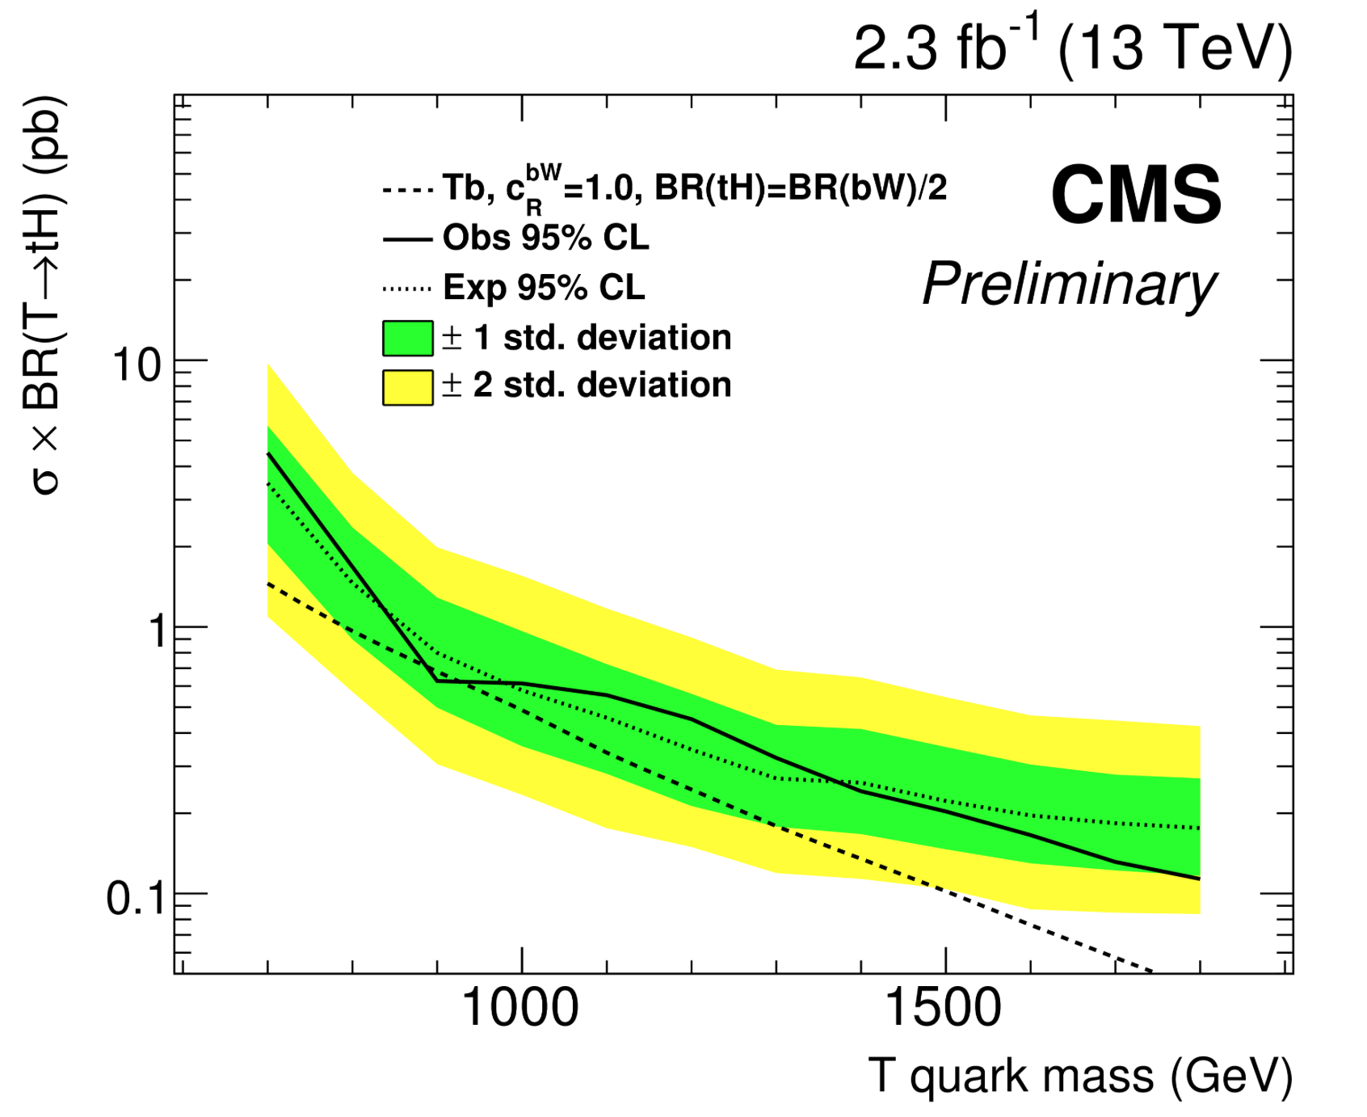
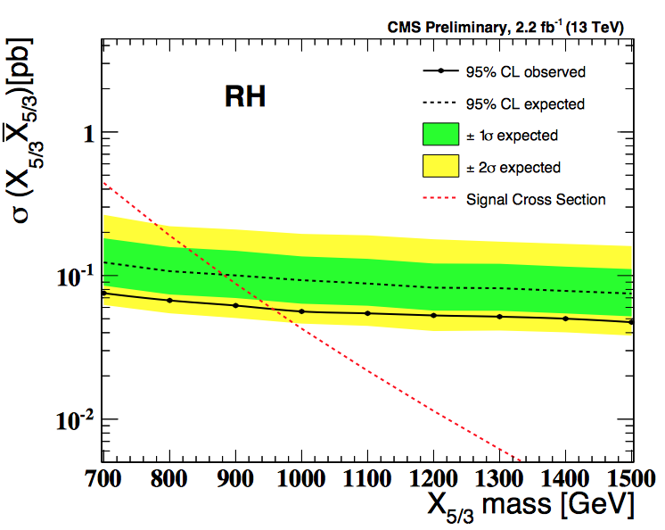
Top Partner Searches @ 13 TeV
Pair productionT->bW, tH, TZ
Single production
T->tH, H->bb
Search for
Q=5/3 states
B2G-16-002
95% CL: 750/743 GeV obs/ exp
Limit at 8 TeV was 696 GeV
95% CL cross section x BR
0.6 pb@1TeV (right handed)
95% CL for right handed
960/900 GeV obs/ exp

Slide 33
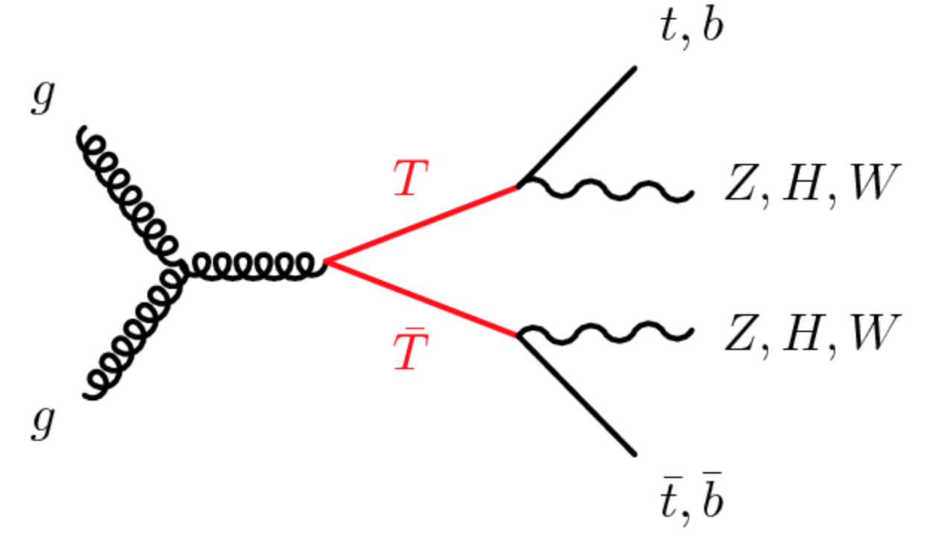
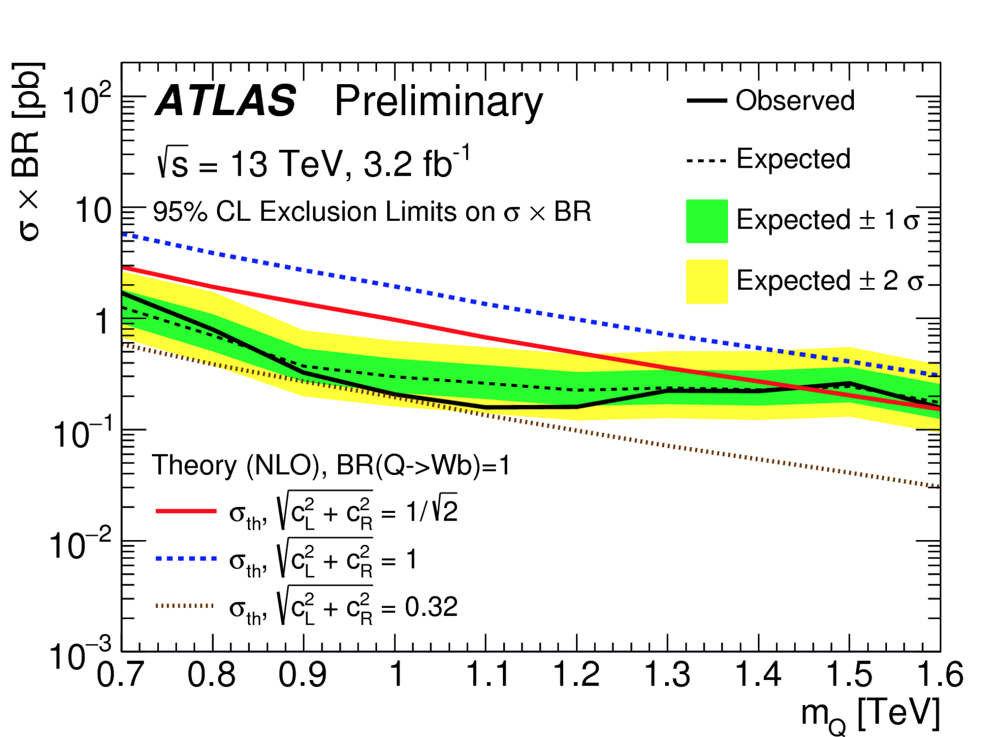
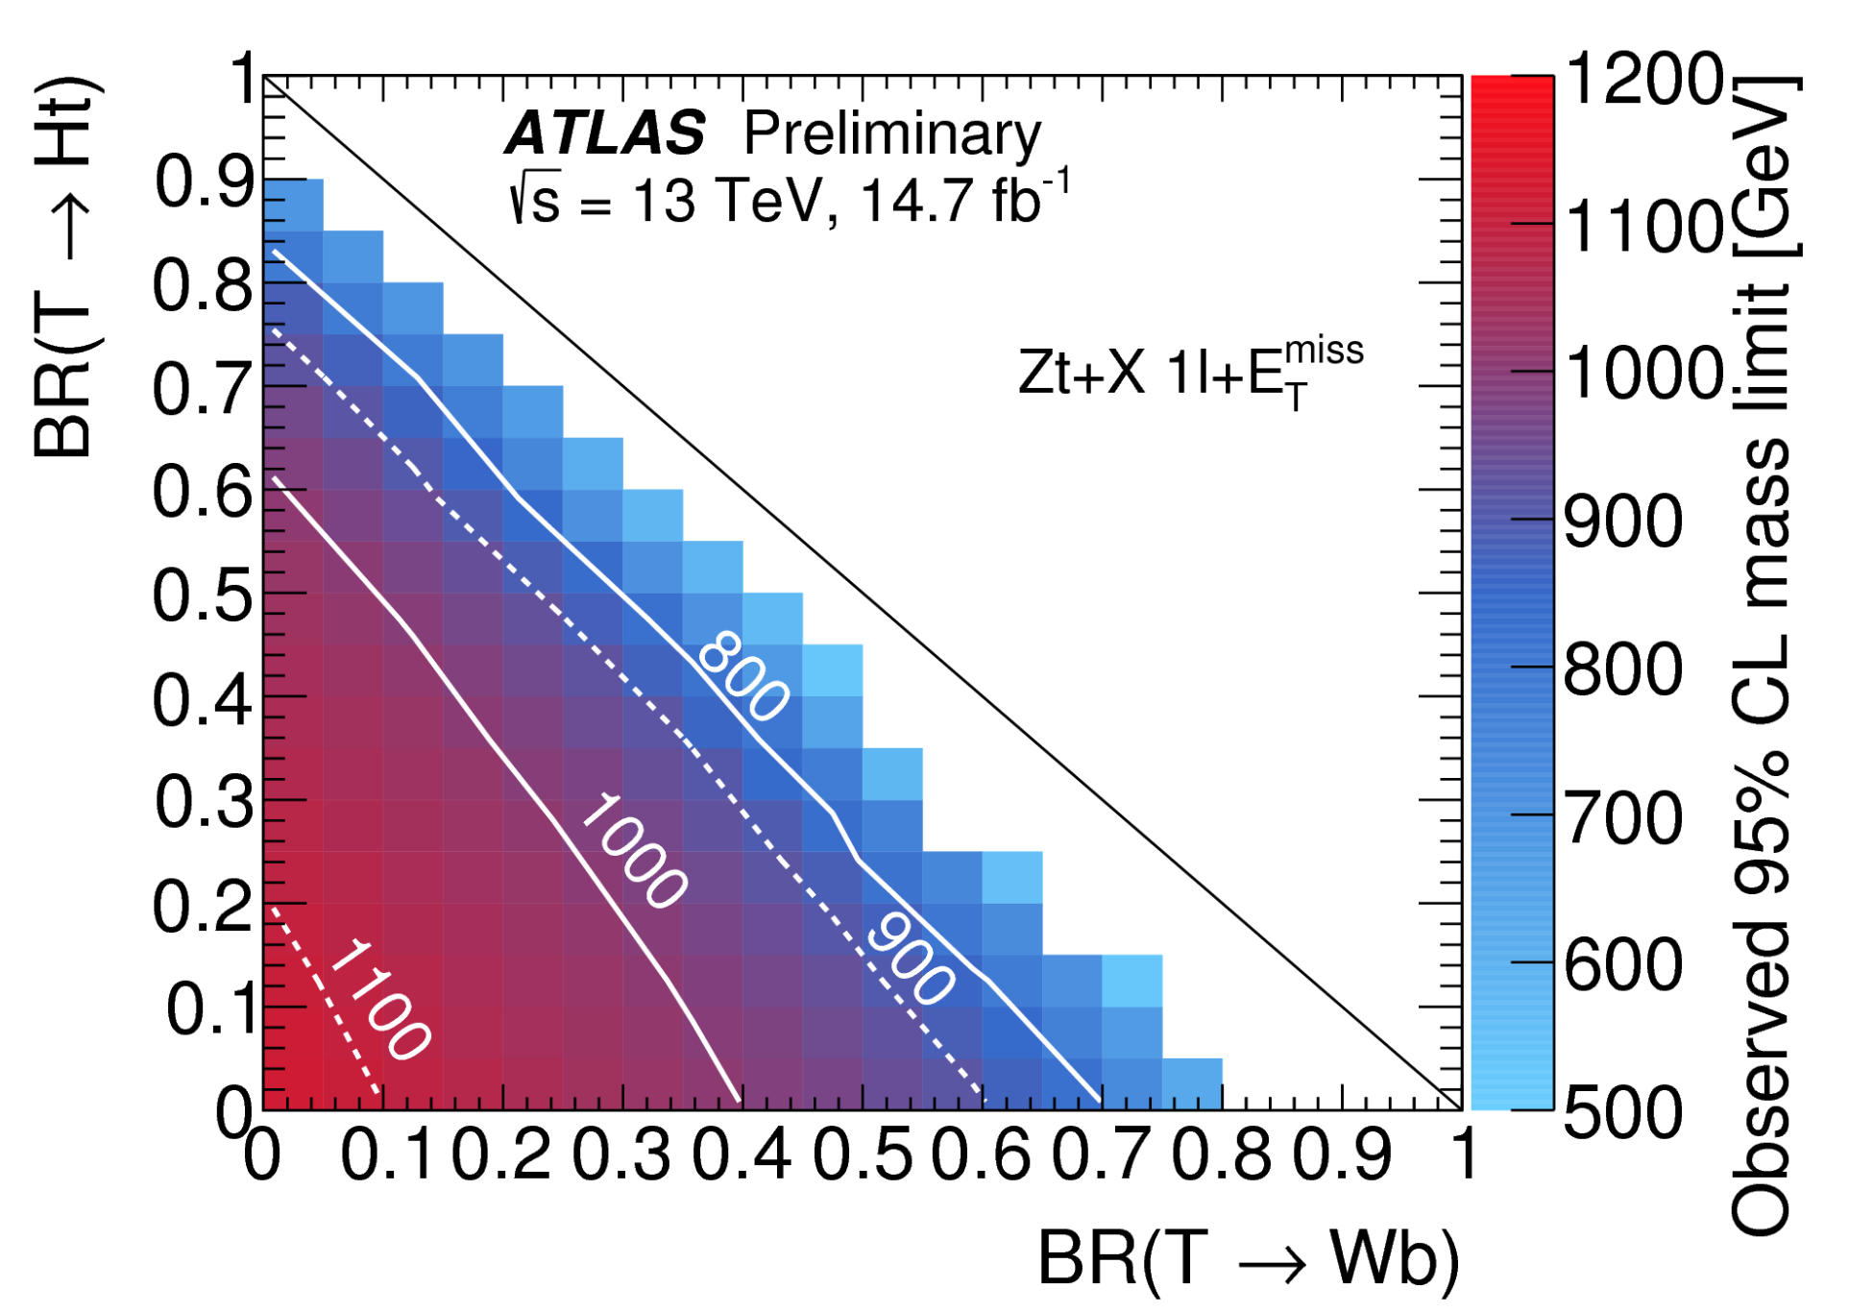
Top Partner Searches @ 13 TeV
Single production VLQ Q->Wb
Pair production T->bW, tH, TZ
ATLAS-CONF-16-072
ATLAS-CONF-16-101
95% CL limit up to 1.4 TeV
95% CL limit up to 1.1 TeV

Slide 34
Resonances Decaying into VV?
Search for heavy resonances decaying into VV jets
using boosted jets and jet substructure analysis
arXiv:1506.00962
arXiv:1606.04833
Jets start to merge for
X = 700-900 GeV
arXiv:1405.1994
EXO-15-002
Run-1: Excess in ATLAS in WZ channel of 3.4σ (2.5σ with LEE) around 2 TeV.
Bump around 1.9 TeV in CMS in different channels (~2σ)
2015 data: Not confirmed
more data needed to
completely settle the issue

Slide 35
Diboson Search with the 2016 Data
WZ -> 4quarks
(2jets ) channel
2.0 TeV excess seen at 8 TeV strikes (a little) back? Let’s see what happens
with more data..
More channels analysed: X-> VV, VH, HH, γγ, Zγ,… No striking signals seen

Slide 36
Extra Space Dimensions
Problem:
The Gravity force becomes strong!

Slide 37
Search for Large Extra Dimensions
Example: Mono-jet final state +Missing E_{T} (ADD)
arXiv:1604.07773
Limits on M_{D}
between
~ 7 and 4 TeV
Lower limit on the Planck Scale
versus number of extra dimensions
p_{T} jet > 250 GeV
MET > 250-700 GeV

Slide 38
Search for Micro Black Holes
Extra Dimensions!
2015: 12 jet event with S_{T}=5.4 TeV
Planck scale
a few TeV?
CMS-EXO-15-007
Look for the decay producs
of an evaporating black hole
•Define S_{T} to be the scalar
sum of all high p_{T} objects
found in the event
•Look for deviations
at high S_{T}
Black hole mass excluded in range below ~8-9 TeV depending on assumptions

Slide 39
Exotic Search Summary

Slide 40
Summary of Exotica (Continued)

Slide 41
Summary of SUSY Searches
In short: no clear sign of SUSY with the data collected so far (similar for CMS)

Slide 42
The Higgs Particle
The party in 2012!
A. Pomarol ICHEP2012

Slide 43
2012: A Milestone in Particle Physics
Observation of a Higgs Particle at the LHC, after
about 40 years of experimental searches to find it
2013
2015: Higgs Boson
well established.
All accessible
channels studied

Slide 44
Mass of the Higgs
•The first combined result from
CMS and ATLAS
•Combine the H->ZZ and H->γγ
channels (most precise channels)
•Mass precision ~ 0.2%
arXiv:1503.07589

Slide 45
Coupling Measurements
•Overall combinations from
ATLAS and from CMS individually
CMS arXiv:1412.8662
ATLAS arXiv:1507.04548
Combination of ATLAS & CMS
arXiv:1606.02266

Slide 46
Combined Fit of ATLAS & CMS Data
Overview of the decay channels included in the analysis
Values for a common mass M_{H} of 125.09 GeV

Slide 47
Production/Decay Signal Strength
Signal strength

Slide 48
Global Signal Strenght μ
Results for ATLAS & CMS and for the combined data set

Slide 49
Results as Function of Particle Mass

Slide 50
Testing u/d fermion/ lepton couplings
Up- and down-type fermion coupling ratios
Lepton and quark coupling ratios

Slide 51
Higgs: ATLAS+CMS Combination
The Run-1 Higgs Legacy!
Vector Boson Fusion production
mechanism and H-> tau tau decays
established with 5σ significance in
combination
arXiv:1606.02266
Signal strength/SM:

Slide 52
BSM Searches
Search for effects in loops
in 2-photon decays and ggF
Allow for B_{BSM}>0
Assuming B_{BSM}=0
Data shows no deviation of SM!

Slide 53
Fermion and Vector Boson Coupling Modifiers
Results for the individual channels and the overall combination
Zooming in on the interesting region…

Slide 54
Brief Higgs Summary from Run-1
We know already a lot on this Brand New Higgs Particle!!
Mass = CMS+ATLAS
125.09 ±0.21(stat)
±0.11(syst) GeV
Width
< 24 MeV
(95%CL)
Couplings are
within ~20% of
the SM values
Spin =
0⁺⁽⁺⁾ preferred
over 0⁻,1,2
SM-like behaviour for most properties, but continue to look for anomalies,
i.e. unexpected decay modes or couplings, multi-Higgs production…

Slide 55
Invisible Channels Combination
Combination of all channels including also the
mono-jet channel gives for a 125 GeV Higgs a limit
of 24% (23% expected) at 95% CL
Profile
likelihood
scan
CMS-HIG-16-016
Dark Matter interpretation

Slide 56
High Mass Searches
CMS-PAS-HIG-16-025
CMS-PAS-HIG-16-033
CMS-PAS-HIG-16-023
H->ZZ (4 lepton)
H->bb
H->WW (full leptonic)
Not al channels analysed yet, but no signal so far

Slide 57
13 TeV Higgs Results: Higgs ->γγ
CMS 2016 data
Observed 5.6σ
Expected 6.2σ
μ= 0.91
CMS-HIG-16-020
ATLAS-CONF-2016-067

Slide 58
13 TeV Higgs Results: H-> ZZ
CMS 2016 data
Observed 6.2σ
Expected 6.5σ
μ= 0.99
CMS-HIG-16-033
ATLAS-CONF-06-079

Slide 59
The Hunt for ttH @ 13 TeV
We saw a small an unexpected excess in run-1 in the multi-lepton channel
Is this real? Is it in fact ttH or something else (we do not constrain the Higgs)
The ttH cross section
increases with a
factor ~4 @ 13 TeV
2015 data
No significant
excess in the
new data.
But more data
will referee

Slide 60
The Hunt for the ttH Channel
Update with 2016 data!
12.9 fb⁻¹ of data
CMS-PAS-HIG-16-022
BDT classifier
outputs
Search for associated production of Higgs
bosons and top quarks in multilepton final states

Slide 61
Outlook towards the HL-LHC

Slide 62
LHC Outlook
F. Gianotti, April 2016
7-8 TeV
13-14 TeV
HL-LHC
Run 1
Run 2
Run 3
~3000 fb⁻¹
Splices
fixed
Injectors
upgrade
New
low-β*
quads
~300 fb⁻¹
~100 fb⁻¹
Approved program at CERN to collect 3000 fb⁻¹ with the LHC (HL-LHC)
Maximize the reach for searches and for precision measurements (eg Higgs)

Slide 63
High-Energy LHC??
F. Gianotti
FCC meeting
Rome April 2016
16 TeV vs 14 TeV
28 TeV vs 14 TeV
WG set up to explore technical feasibility of pushing LHC energy to:
design value: 14 TeV
ultimate value: 15 TeV (corresponding to max dipole field of 9 T)
beyond (e.g. by replacing 1/3 of dipoles with 11 T Nb₃Sn magnets)
Identify open risks, needed tests and technical developments, trade-off
between energy and machine efficiency/availability
Report on 1) end 2016, 2) end 2017, 3) end 2018 (in time for ES)
Various options,
with increasing
amount of HW
changes, technical
challenges, cost,
and physics reach
HE-LHC (part of FCC study): ~16 T magnets in LHC tunnel (→ √s~ 30 TeV)
uses existing tunnel and infrastructure; can be built at fixed budget
strong physics case if new physics from LHC/HL-LHC
powerful demonstration of the FCC-hh magnet technology

Slide 64
High Luminosity LHC Precision
Determine the Higgs couplings to a few % precision…

Slide 65
Example: Searches for New Particles
Searches for pair produced SUSY particles
Energy is key for searches for massive particles!!

Slide 66
Summary
Standard Naturalness is a guiding principle for many New Physics Models. Experimental signatures from such predictions get special attention by the experiments
But the experiments cover much more of course.
Since 2011 a lot of attention to the search of SUSY partners of the top quark with tailored analyses. No signal yet, but despite some common thinking low mass stop still not fully excluded
No sign of new physics in the first 13 TeV data… This starts to cut into the ‘preferred regions’ for a large number of models, like SUSY. 750 GeV excess not observed in 2016 13 data ☹ No sign as yet of top partners eg Vector-Like Particles.
More exotic channels are now being covered… Still many unexplored channels left to explore
It would be enough to observe one significant deviation…

