Slide 1
Current Status and Future Plans of the Axion Dark Matter Experiment (ADMX)
Gianpaolo Carosi
Oct 23rd, 2016
CoSMS Naturalness Workshop
UNC – Chapel Hill

Slide 2
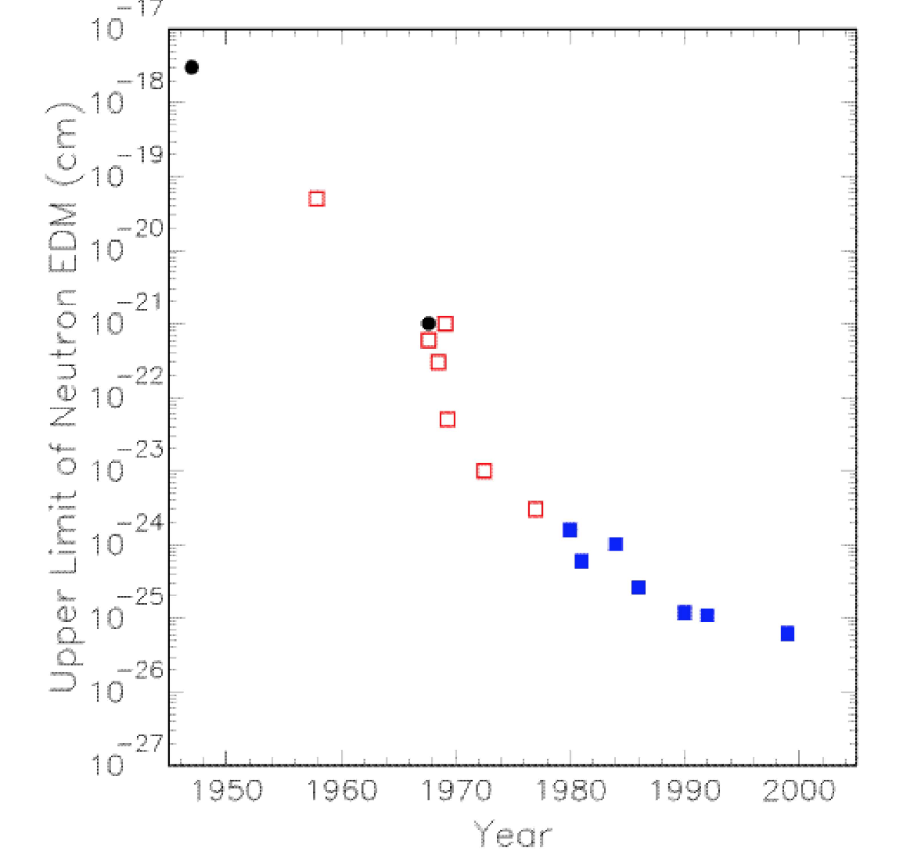
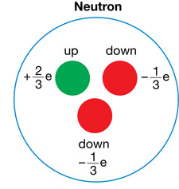
Why is the neutron electric dipole moment so small?
Naive estimate gives
d_{n} ≈ 10⁻¹⁶ e-cm
NMR expts.
10⁻¹⁵ m
*Slide from Aaron Chou (FNAL)

Slide 3
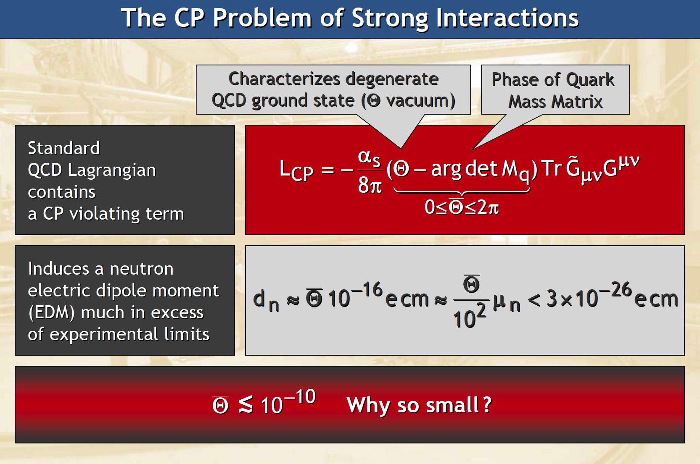
*Slide from George Raffelt (DESY)

Slide 4
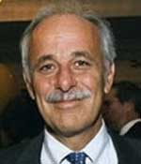
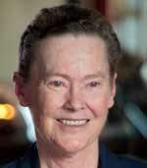
Peccei-Quinn solution to the strong-CP problem
(1977)
Awarded Dirac Medal
(2000)
Postulate a new U(1) symmetry that would be spontaneously broken.
A new Goldstone boson (the axion)
Remnant axion VEV nulls QCD CP violation.
Only free parameter: symmetry breaking scale (f_{a}).

Slide 5
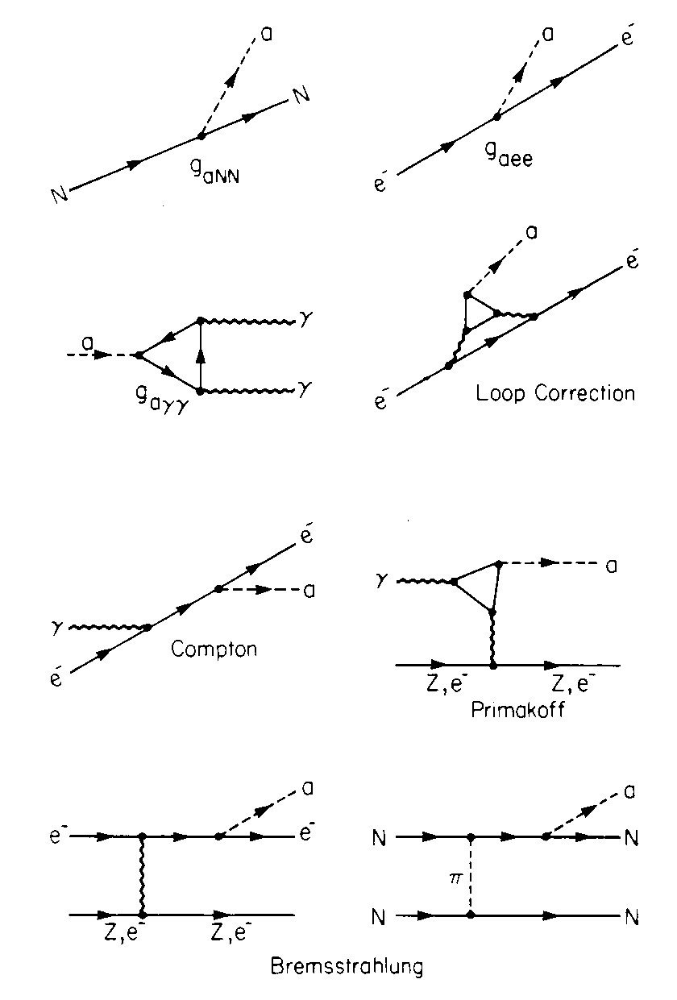
What’s an axion?
Selected axion couplings & the important two-photon coupling
A process with small model uncertainty
Exploited in certain terrestrial searches
Easily calculable
Rate depends on “unification group”
(that is, the particles in the loops),
ratio of u/d quark masses,
and mostly f_{PQ}
A process with large model uncertainty
Can occur, e.g., in the Sun
Contains unknown U(1)_{PQ} charge of electron
Kolb & Turner

Slide 6
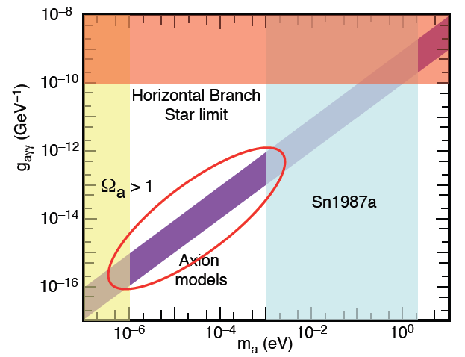
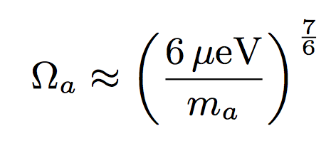
The “classic” axion window
or even more due to cosmic string decay.
PQ model + local energy conservation guarantees the existence of dark matter axions.
NN → NNa
*Slide from Aaron Chou (FNAL)
Excluded by “naturalness.” Axion potential energy decays at time 1/H = 1/m_{a}. If this is too late in cosmological time, dark matter can be overproduced relative to the photons which have redshifted away.

Slide 7
The “classic” axion window
Excluded by SN1987A
If 1/f_{a} couplings are too strong, then axion emission becomes the dominant loss mechanism in supernovae. Not compatible with duration of observed neutrino burst.
NN → NNa
*Slide from Aaron Chou (FNAL)

Slide 8
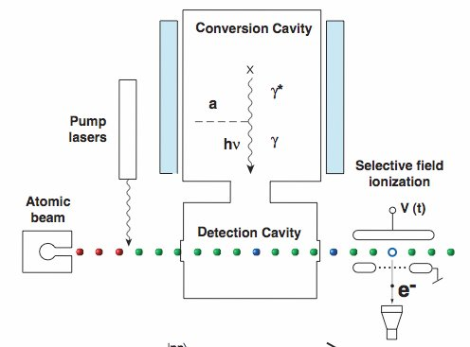
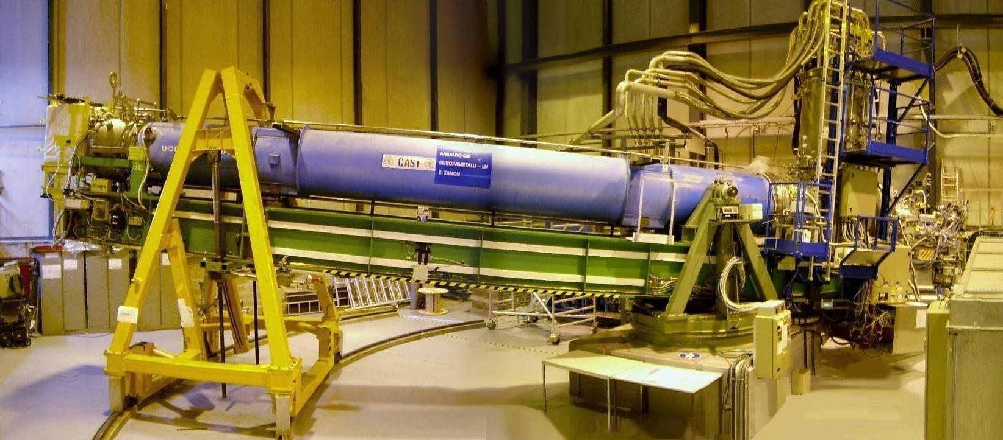
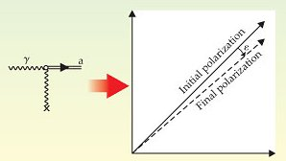
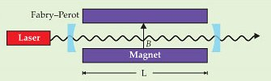
Variety of experiments*…
Dark Matter
  Microwave cavities: Linear amps (ADMX) and Rubidium Atoms (CARRACK)
    Look for dark matter axions (low mass) converting to photons in B-Field
    New techniques: Ultralight axions (nano-eV)
    NMR, LC-circuit, Toroid magnet (Ben Safdi talk)
Solar Observatories
  X-Ray (CAST, IAXO) and Germanium detectors
    Look for axions generated from the sun
    Higher coupling required than for DM axions.
Lab experiments
  Photon regeneration and polarization changes (PVLAS, ALPS)
    Look for production of axions from light passing through B-field
    Higher coupling required.
CARRACK
axion
X-ray
CAST

Slide 9
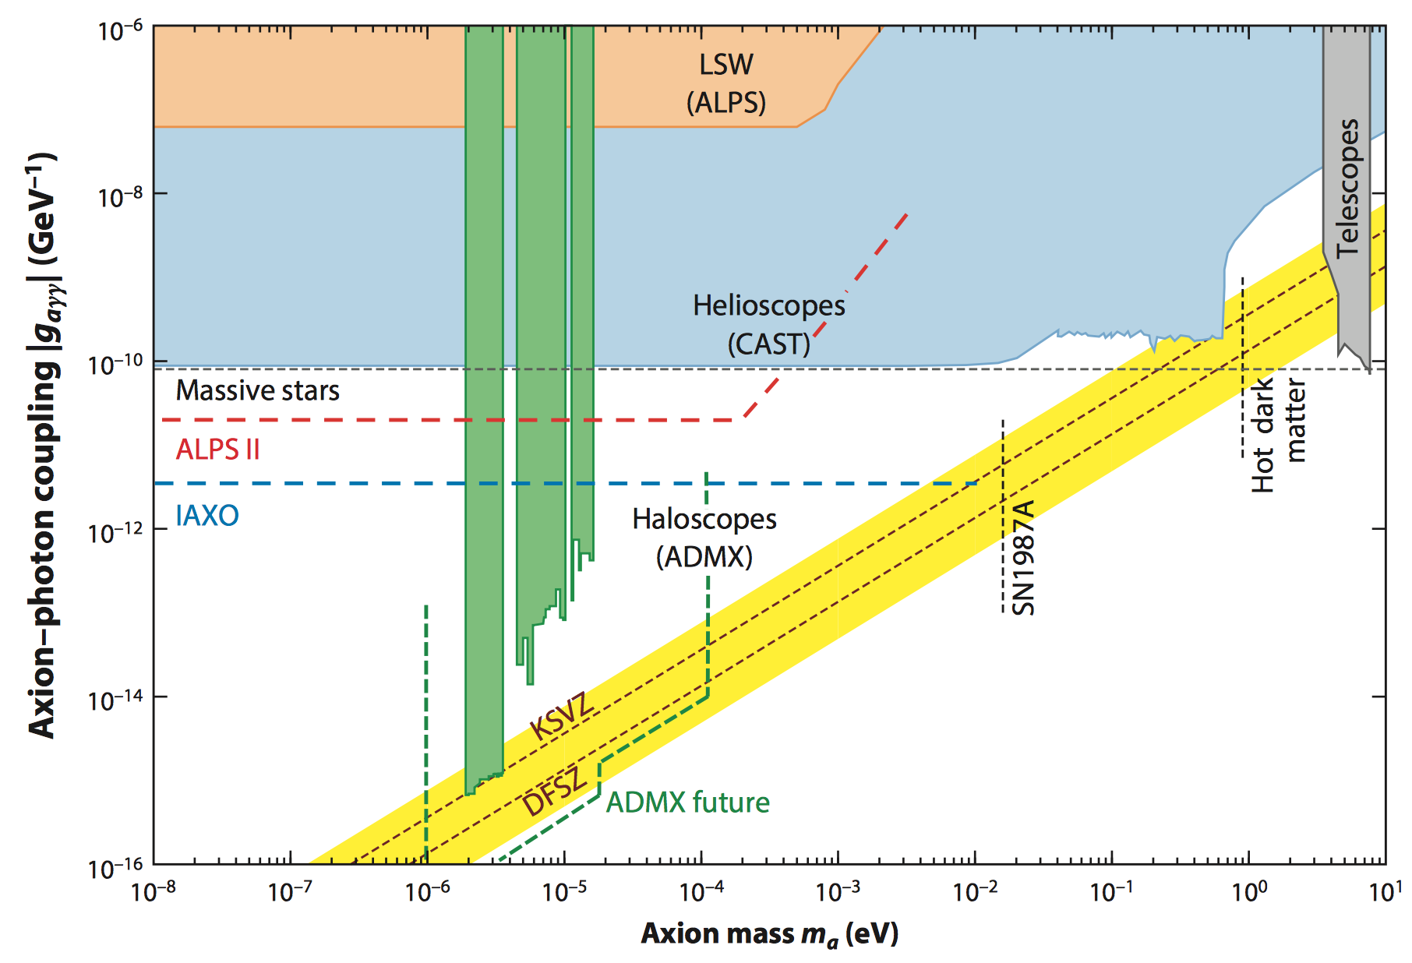
Experimentally constrained parameter space
With current technology, only ADMX has reached the dark matter QCD axion band.
Graham, et.al (2016)

Slide 10












ADMX: Collaboration (begin in mid-1990s)
Recently Joined
Sponsors
ADMX now DOE Gen 2 project
ADMX-High Frequency
Separate collaboration based at Yale
Primary sponsor
Notes:
Add color to for people who are directly involved in the bead pull measurements and cavity modeling

Slide 11
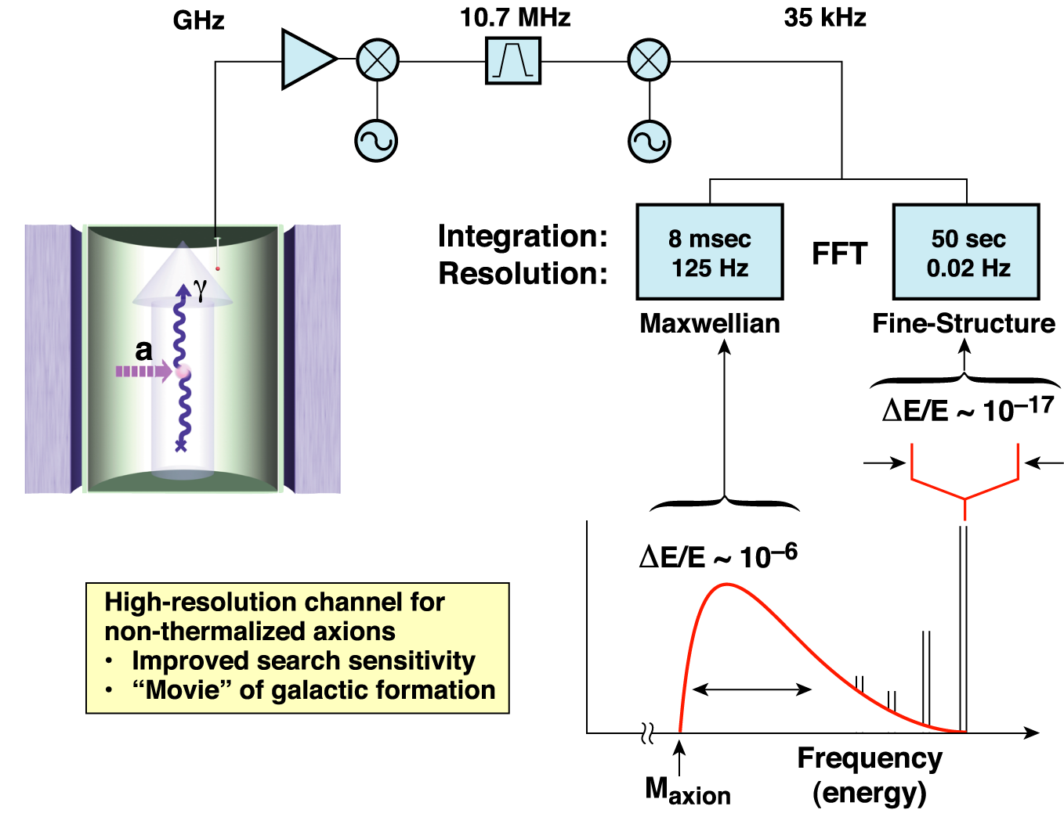
The ADMX experimental layout
(original concept from P. Sikivie)
Local Milky Way density:
ρ_{halo} ~ 450 MeV/cm³
Thus for m_{a} ~ 10 μeV:
ρ_{halo} ~ 10¹⁴ cm^{–3}
ΔE/E ~ 10^{–22}
“High Resolution” channel
“Medium Resolution” channel
β _{virial} ~ 10^{–3} :
λ _{De Broglie} ~ 100 m
Δ β _{flow} ~ 10^{–11} :
λ _{Coherence} ~ 1000 km

Slide 12
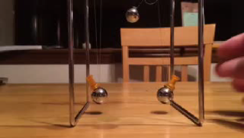
Power transfer increased by time coherence between cavity E field and axion field
Weak coupling -- takes many swings to fully transfer the wave amplitude.
Number of swings = cavity Quality factor.
Narrowband cavity response → iterative scan through frequency space.
*Slide from Aaron Chou (FNAL)

Slide 13
Microwave Cavity needs tunable resonance
Antennas
Tuning Rod
Transmittance between Antennas
Cavity
1.5 GHz
Frequency
* LLNL sponsored HMC Clinic Final Presentation – 2010

Slide 14
Microwave Cavity needs tunable resonance
Antennas
Tuning Rod
Tuning Rod
Transmittance between Antennas
Cavity
1.5 GHz
1.6 GHz
Frequency
* LLNL sponsored HMC Clinic Final Presentation – 2010

Slide 15
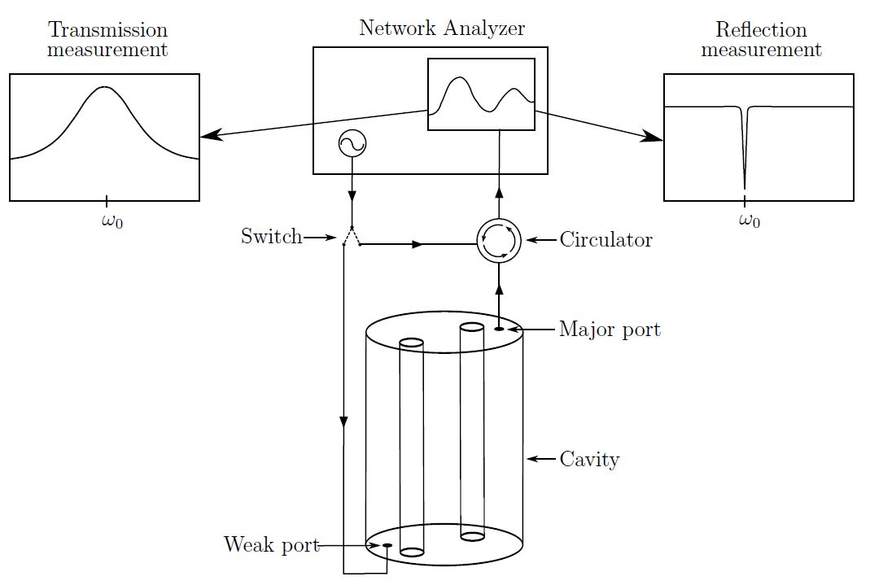
Typical ADMX Run Cadence
Start by injecting a broad, swept RF signal to record cavity response. Record state data (temperatures, hall sensors, pressures, etc)
Integrate for ~ 100 sec to 10s of minutes (final integration time dependent experimental parameters).
Every few days adjust the critical coupling of the antennas
Scan rate is trade off in sensitivity vs frequency (mass) coverage
The scan rate uses a threshold sensitivity.
Any candidate above threshold is flagged for further study.

Slide 16
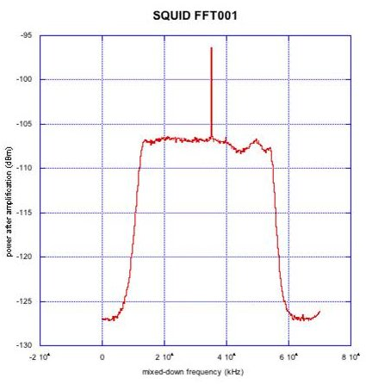
Example of single injected signal (with SQUID amp)
Injected Power
Noise floor
Bandpass filter

Slide 17
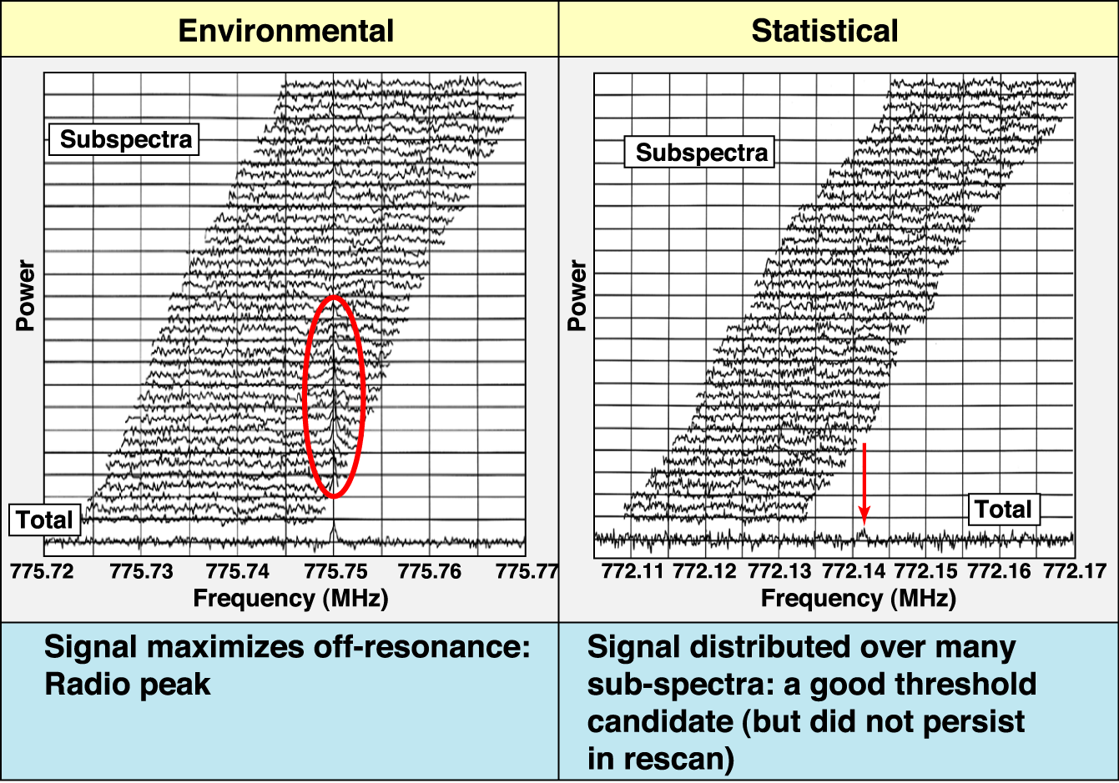
Sample data and candidates
Notes:
17

Slide 18
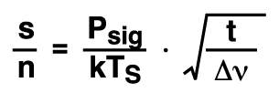
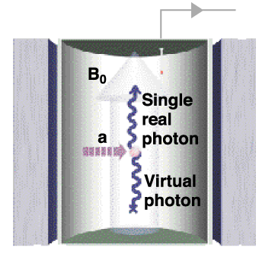
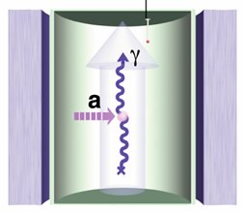
The Radiometer equation dictates strategy
But integration time limited to ~ 100 sec
* Dicke, 1946
System noise temp. now
T_{S} = T + T_{N} ~ 1.5 + 1.5 K
But T_{Quant} ~ 30 mK
This is where we invested to get to Gen 2
P_{sig} ~ ( B²V Q_{cav} )( g² m_{a} ρ_{a} )
But magnet size, strength B²V ~ $
~ 10^{–23} Watts for ADMX

Slide 19
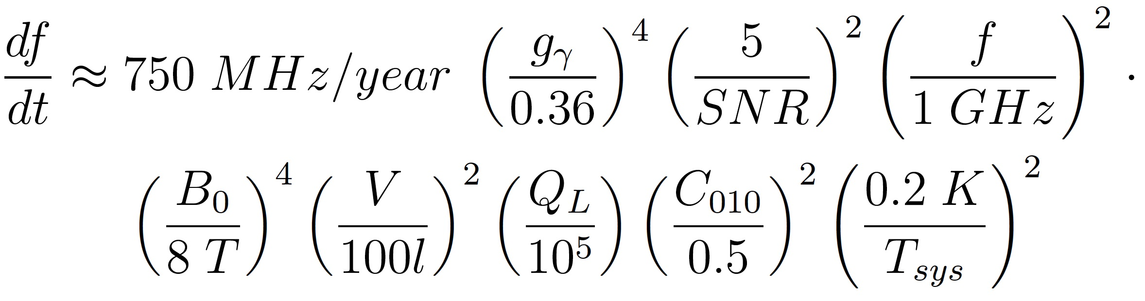
Scan Rate from Dicke Radiometer equation
Rate determined from SNR
SNR is the Signal-to-Noise for detection (usually set to 5),
f is the frequency being searched (where 1 GHz ~ m_{a} = 4.1 ueV)
T_{sys} is the total system temperature (T_{sys} = T_{cavity} + T_{amps})
To scan at this sensitivity would take > 100 years with original ADMX

Slide 20
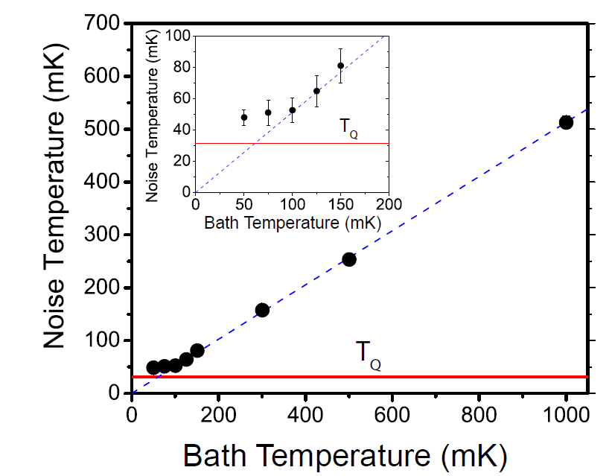
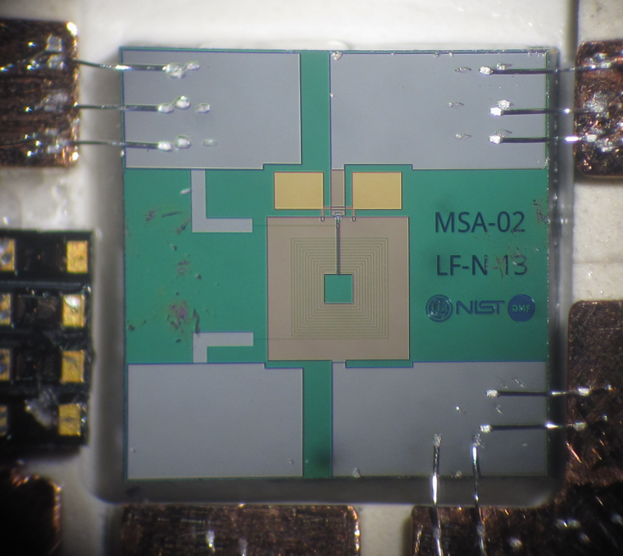
Enabling technology: Quantum-limited amplifiers
500-1000 MHz Microstrip SQUID Amp (MSA) Devices
Gain = 20 dB
Frequency 612 MHz
T_{Q}
At T_{bath} = 50 mK
Noise temperature:
T_{N}^{opt} = 48 ± 5 mK
Quantum limit T_{Q} = 30 mK
Darin Kinion, JC
Noise temperatures of 48 ± 5 mK have been demonstrated at 612 MHz, within 1.7 times the quantum limit

Slide 21
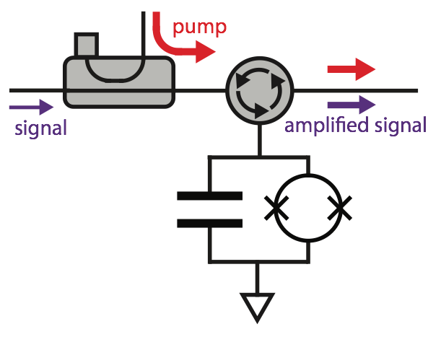
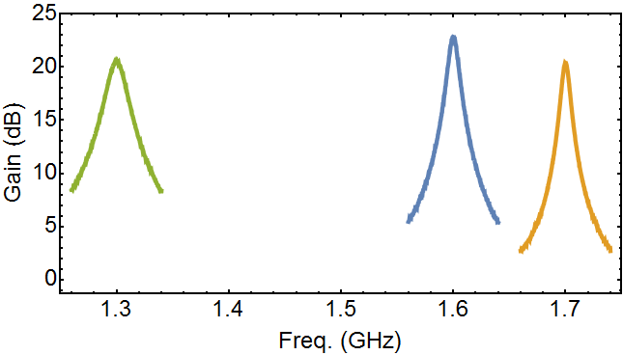
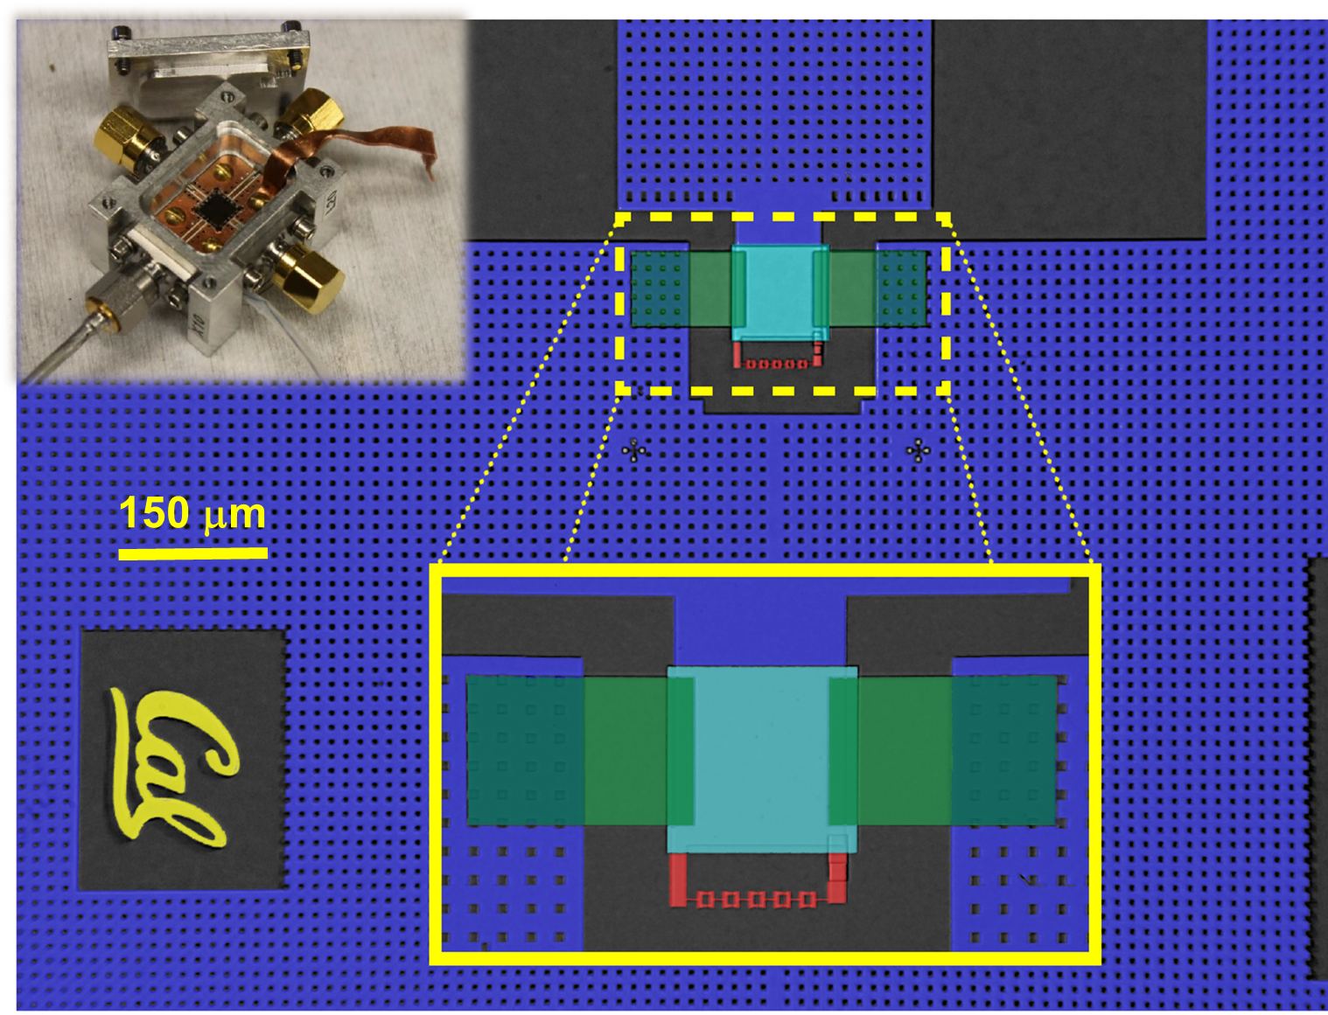
Josephson Parametric Amplifier: 1-10 GHz
(UCB Design – I. Siddiqi)
G ~ 20 dB
BW ~ 1-50 MHz
Tunable BW ~ 1 octave
Recently device installed in ADMX (Ch 2)
5-SQUID design
1 – 2 GHz
BW ~ 4 - 6 MHz

Slide 22
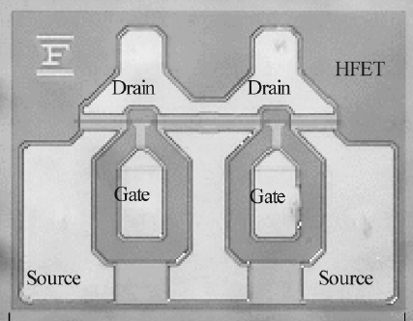
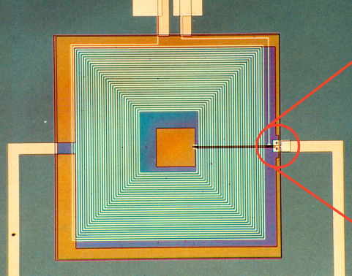
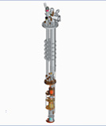
The Axion Dark Matter eXperiment
Multiple phases from 1995 onward
Stage | Phase 0 | Phase I | Phase II
Technology | HEMT; Pumped LHe | Replace w. SQUID | Add Dilution Fridge
T_{phys} | 2 K | 2 K | 100 mK
T_{amp} | 2 K | 1 K | 100 mK
T_{sys} = T_{phys} + T_{amp} | 4 K | 3 K | 200 mK
Scan Rate ∝ (T_{sys} ) ^{–2} | 1 @ KSVZ | 1.75 @ KSVZ | 5 @ DFSZ
Sensitivity Reach g ² ∝ T_{sys} | KSVZ | 0.75 x KSVZ | DFSZ
OR
AND !
LLNL: 1996 - 2006
LLNL: 2008 - 2010
UW: 2016…

Slide 23
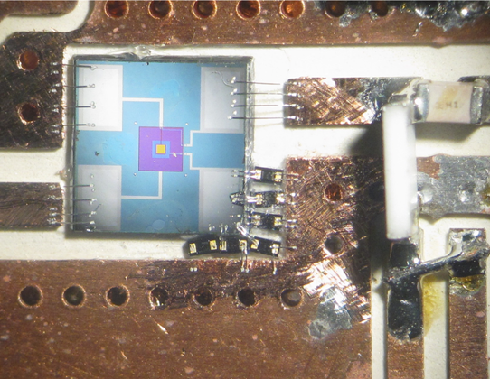
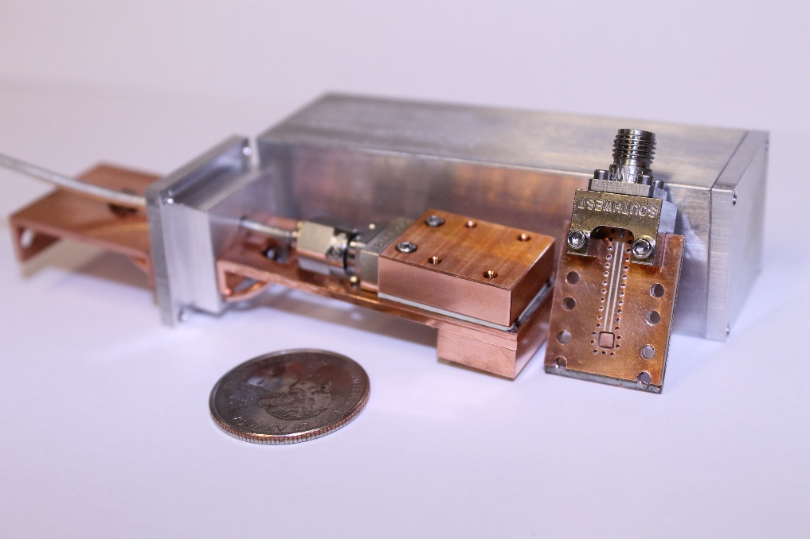
Quantum Limited Amplifiers
SQUIDs
(at lower frequencies)
“JPAs”
(at higher frequencies)

Slide 24
Amplifier “Squidadel” and Bucking Magnet

Slide 25
Cavity and thermal shielding (4 K, 1 K, 100 mK)

Slide 26
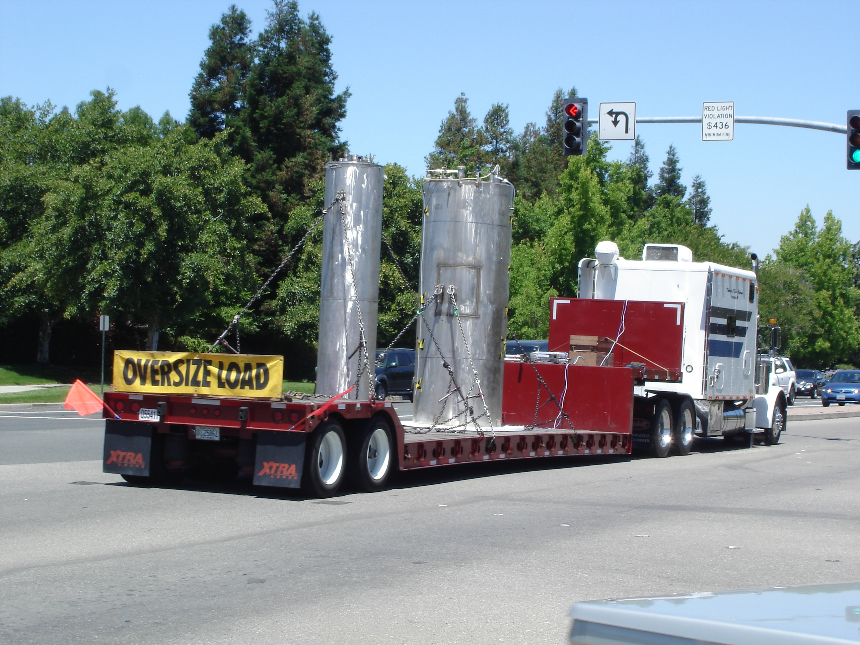
ADMX: Ran at LLNL from 1996 - 2010
Moved main magnet to the U. of Washington

Slide 27
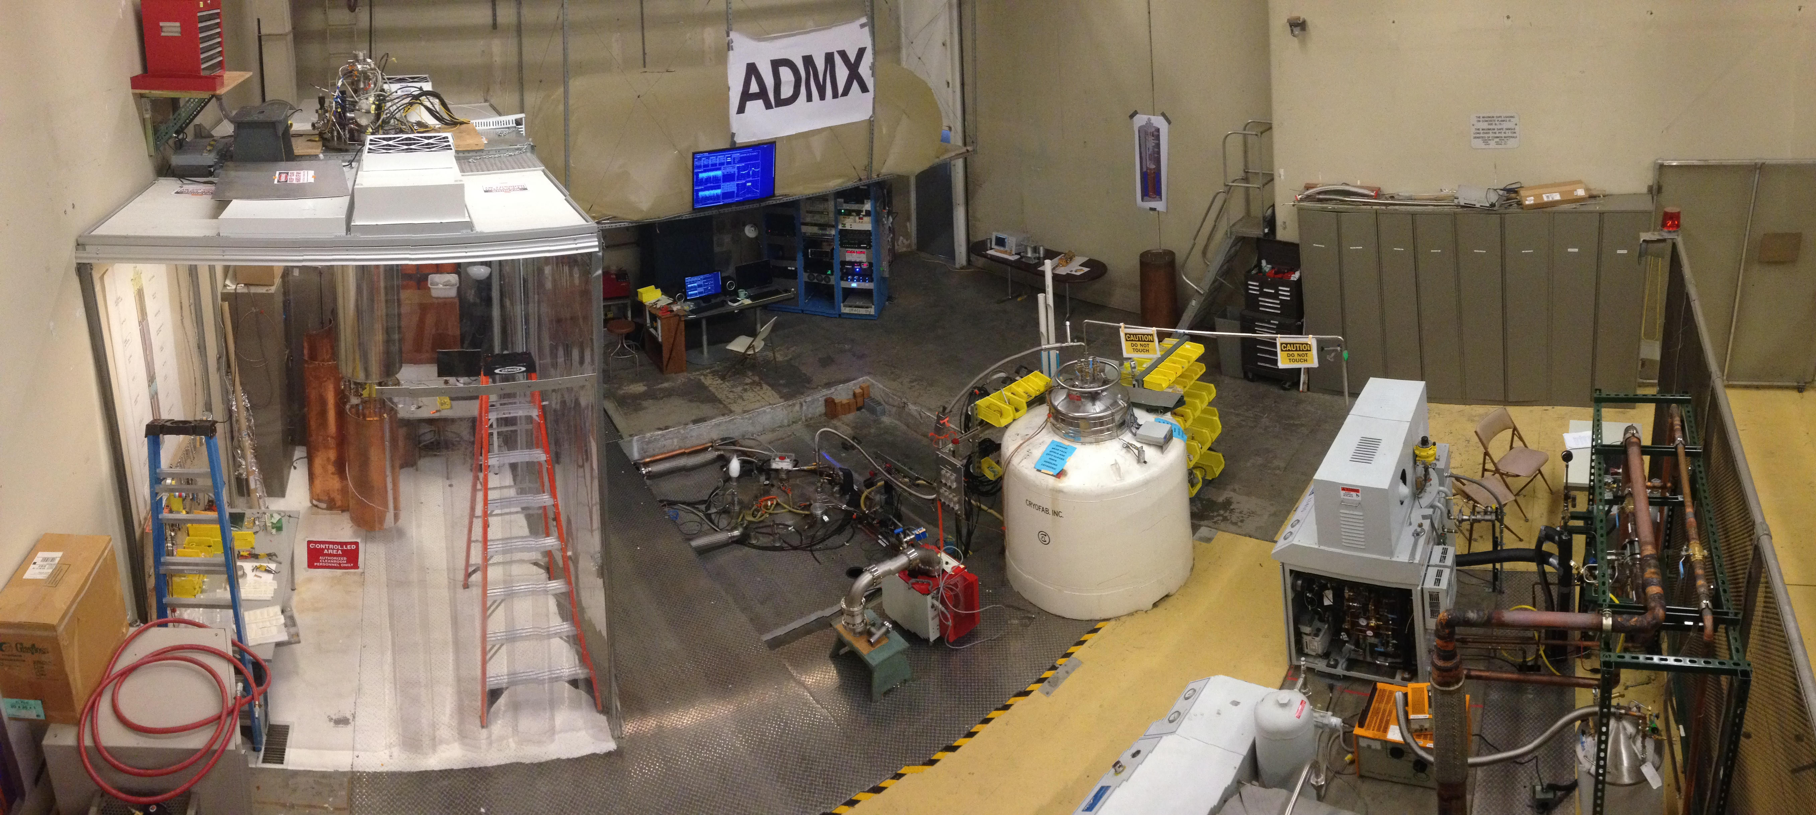
ADMX site: University of Washington
Center for Experimental Nuclear Physics and Astrophysics (CENPA)
ADMX DAQ & Controls
Cleanroom
(with insert hanging)
ADMX Magnet
Helium liquefier

Slide 28
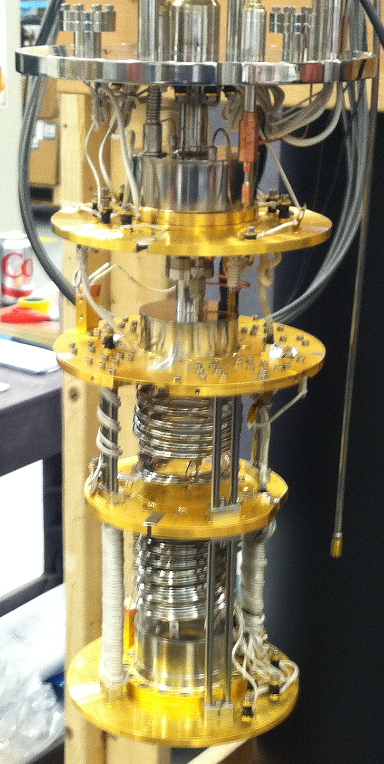
The Dilution Refrigerator
Custom high power fridge
  - 800 µW at 100 mK
Janis Research Company, Woburn, MA
Demonstrated at Janis and at UW.

Slide 29
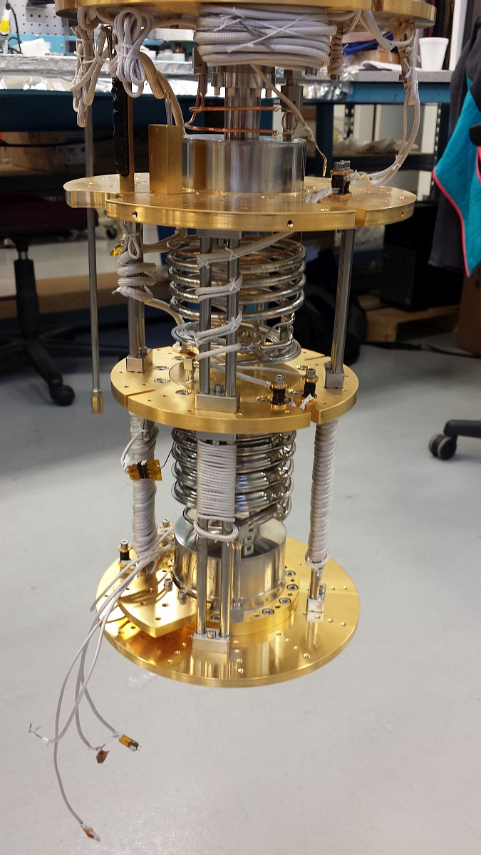
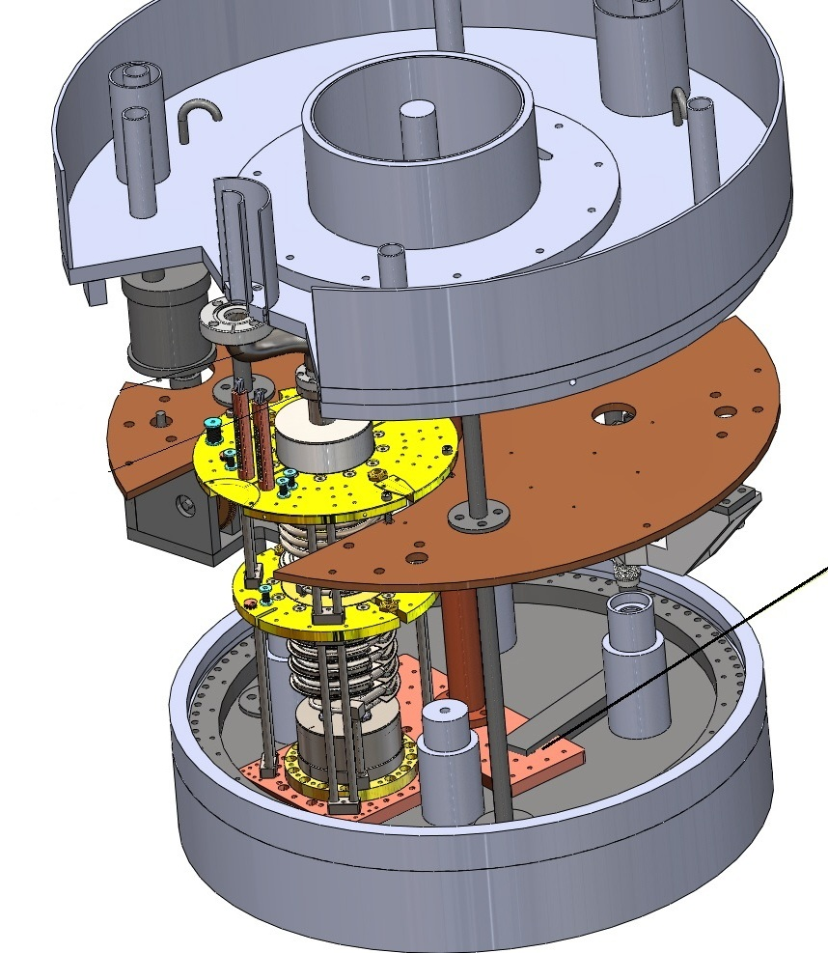
Dilution Refrigerator:
Cold stage directly on cavity
LHe reservoir
1K pot
1K plate
Still
Cavity
top plate
Mixing chamber
ADMX
Dilution Fridge
at Janis
Notes:
Add another slide that shows the

Slide 30
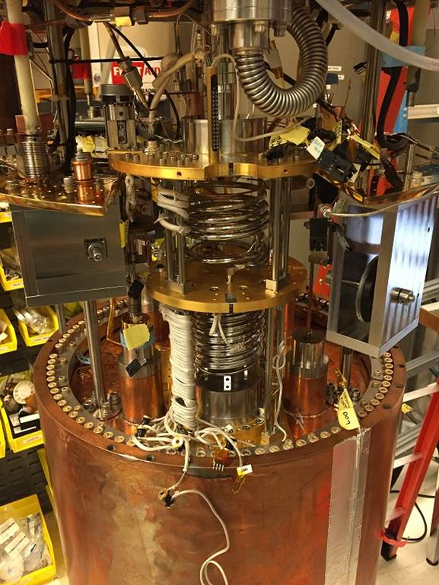
Dilution Refrigerator: After installation
Dilution refrigerator
Rotary Gearboxes
Main Cavity
Notes:
Add another slide that shows the

Slide 31
Additional upgrades: multiple frequency channels
ADMX 31

Slide 32
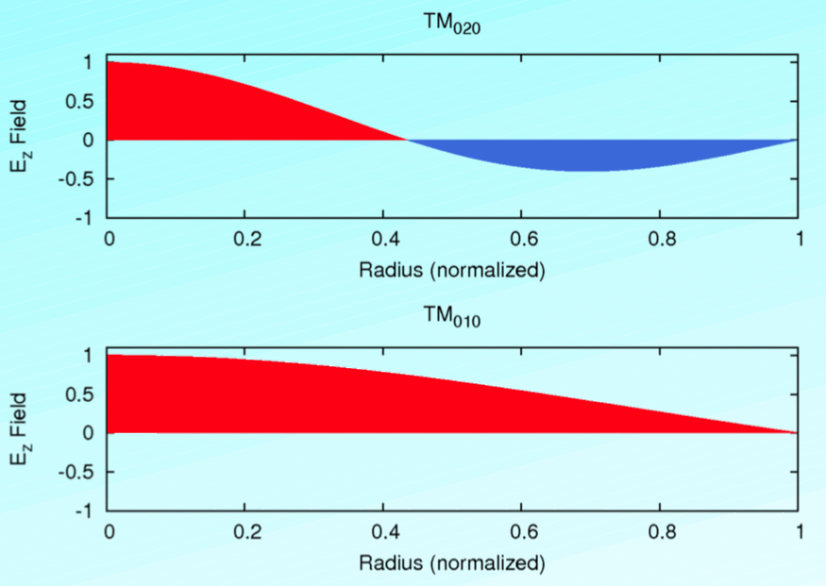
Higher order mode instrumented
Ch 1: TM₀₁₀ mode Ch 2: TM₀₂₀ mode
Take data concurrently at 2 different mass ranges
TM₀₂₀ Mode
Relative Frequency
2.3
Tuning Range
920-2,100 MHz
JPA
Relative Power
0.41
TM₀₁₀ Mode
Relative Frequency
1.0
Tuning Range
400-900 MHz
Microstrip SQUID

Slide 33
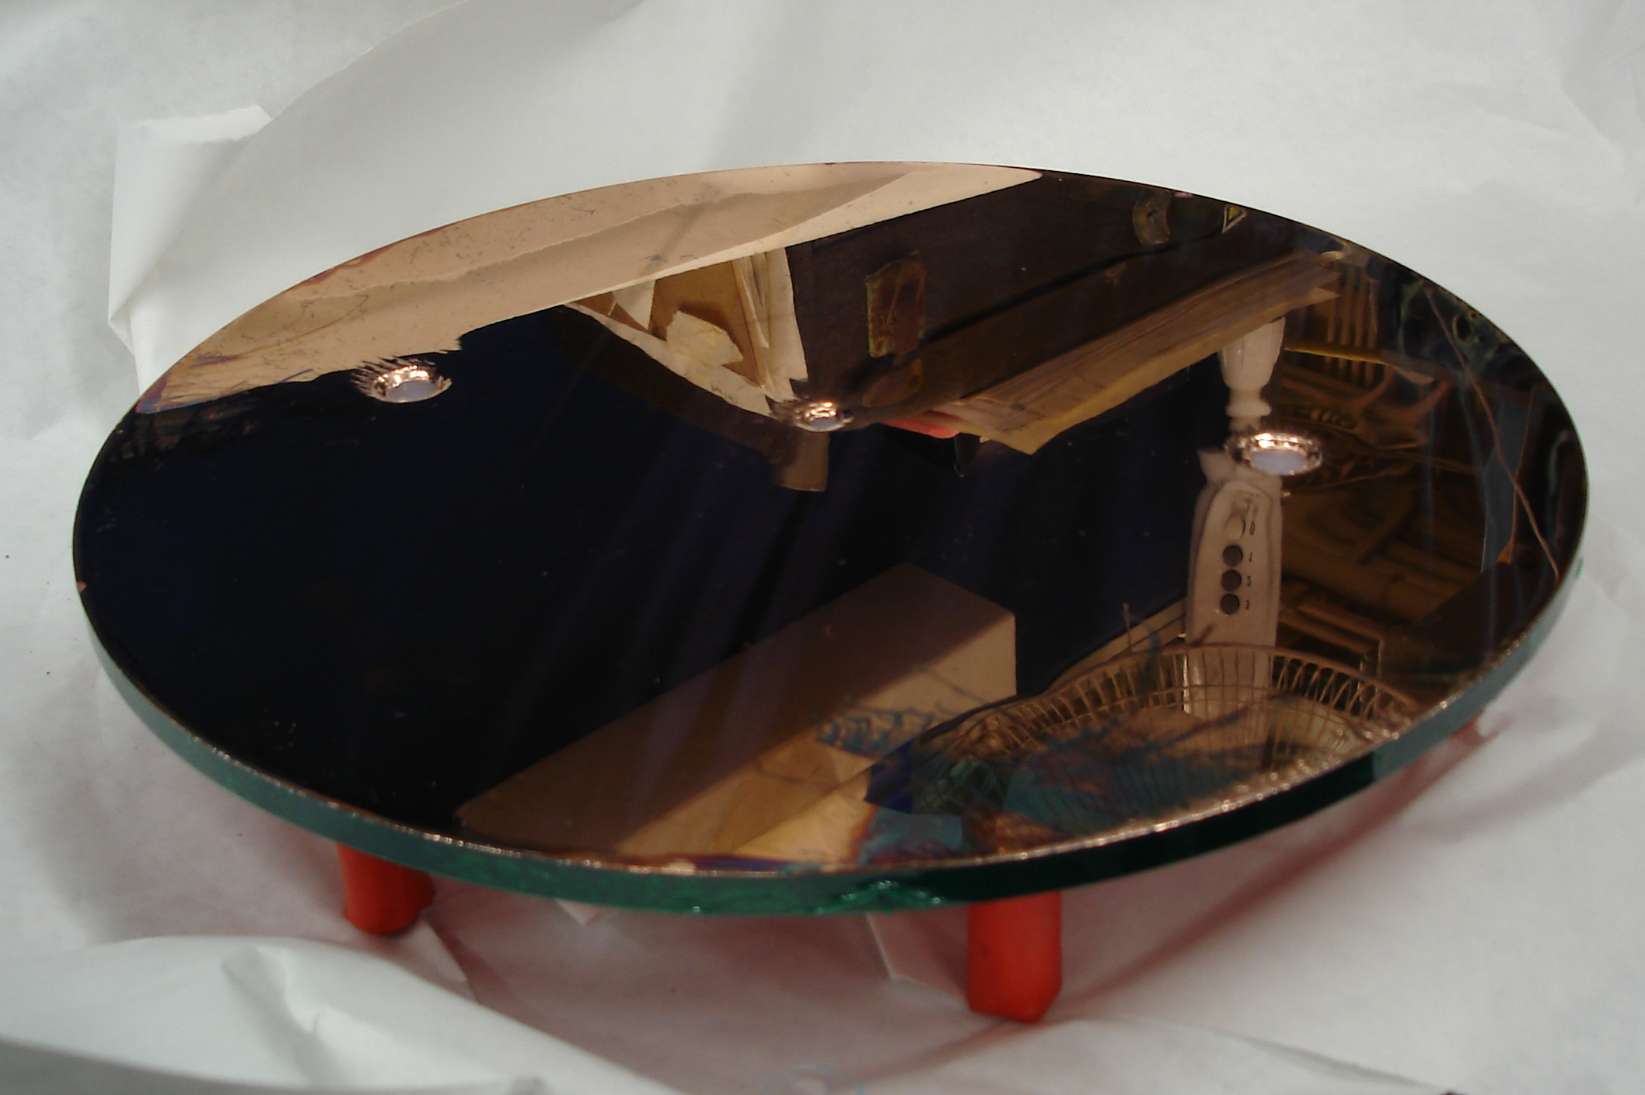
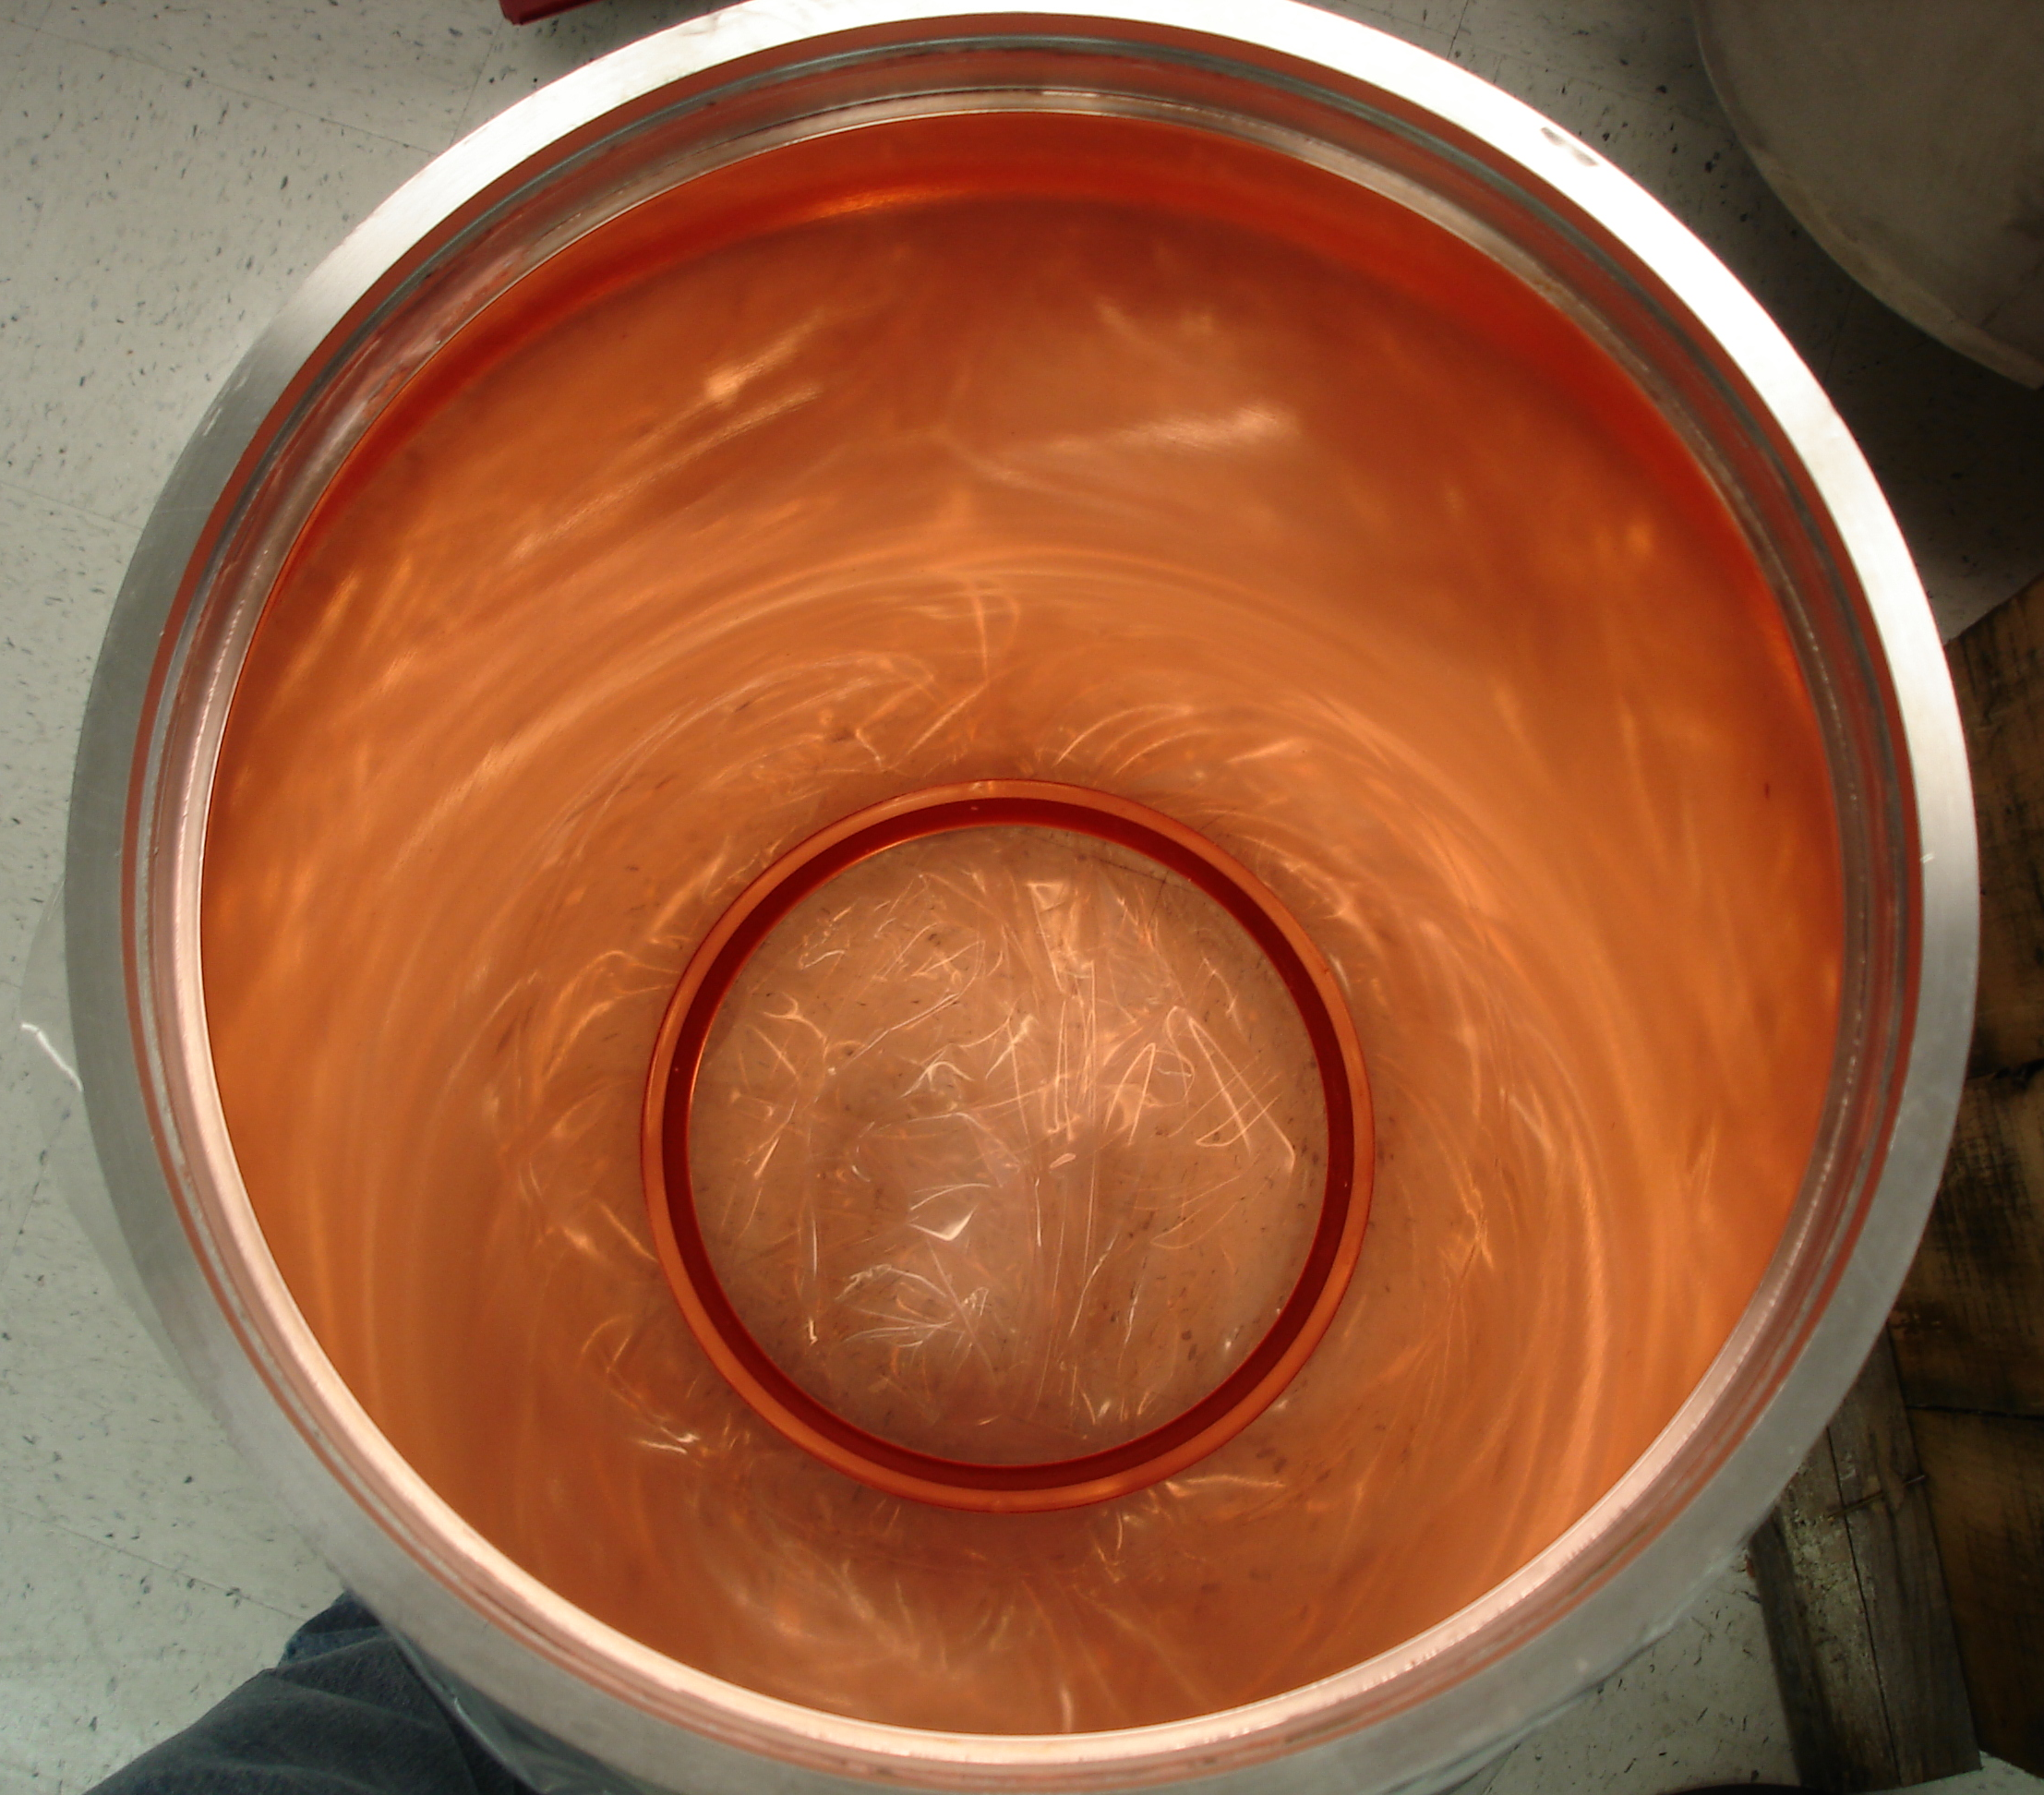
ADMX: Multi-mode readout
(low pass / high pass filters to prevent interference)
TM₀₁₀
filter
receiver
TM₀₂₀
DAQ
filter
receiver
cold
warm

Slide 34
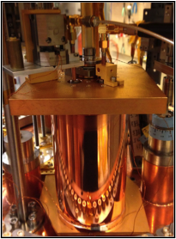
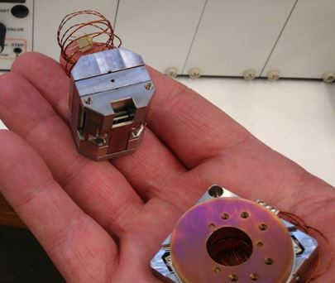
3rd instrumented channel: Sidecar cavity
Test new technologies in-situ and search in new frequency ranges (4-6 GHz) (piezoelectric motors, JPAs, etc)
Mounted directly above main cavity
Piezos to replace large bulky gearboxes
Linear drive controls antenna depth
Rotary drive
controls tuning rod
Piezos compatible with high B-field (>30 T), vacuum and cryogenic temperatures (10 mK)

Slide 35
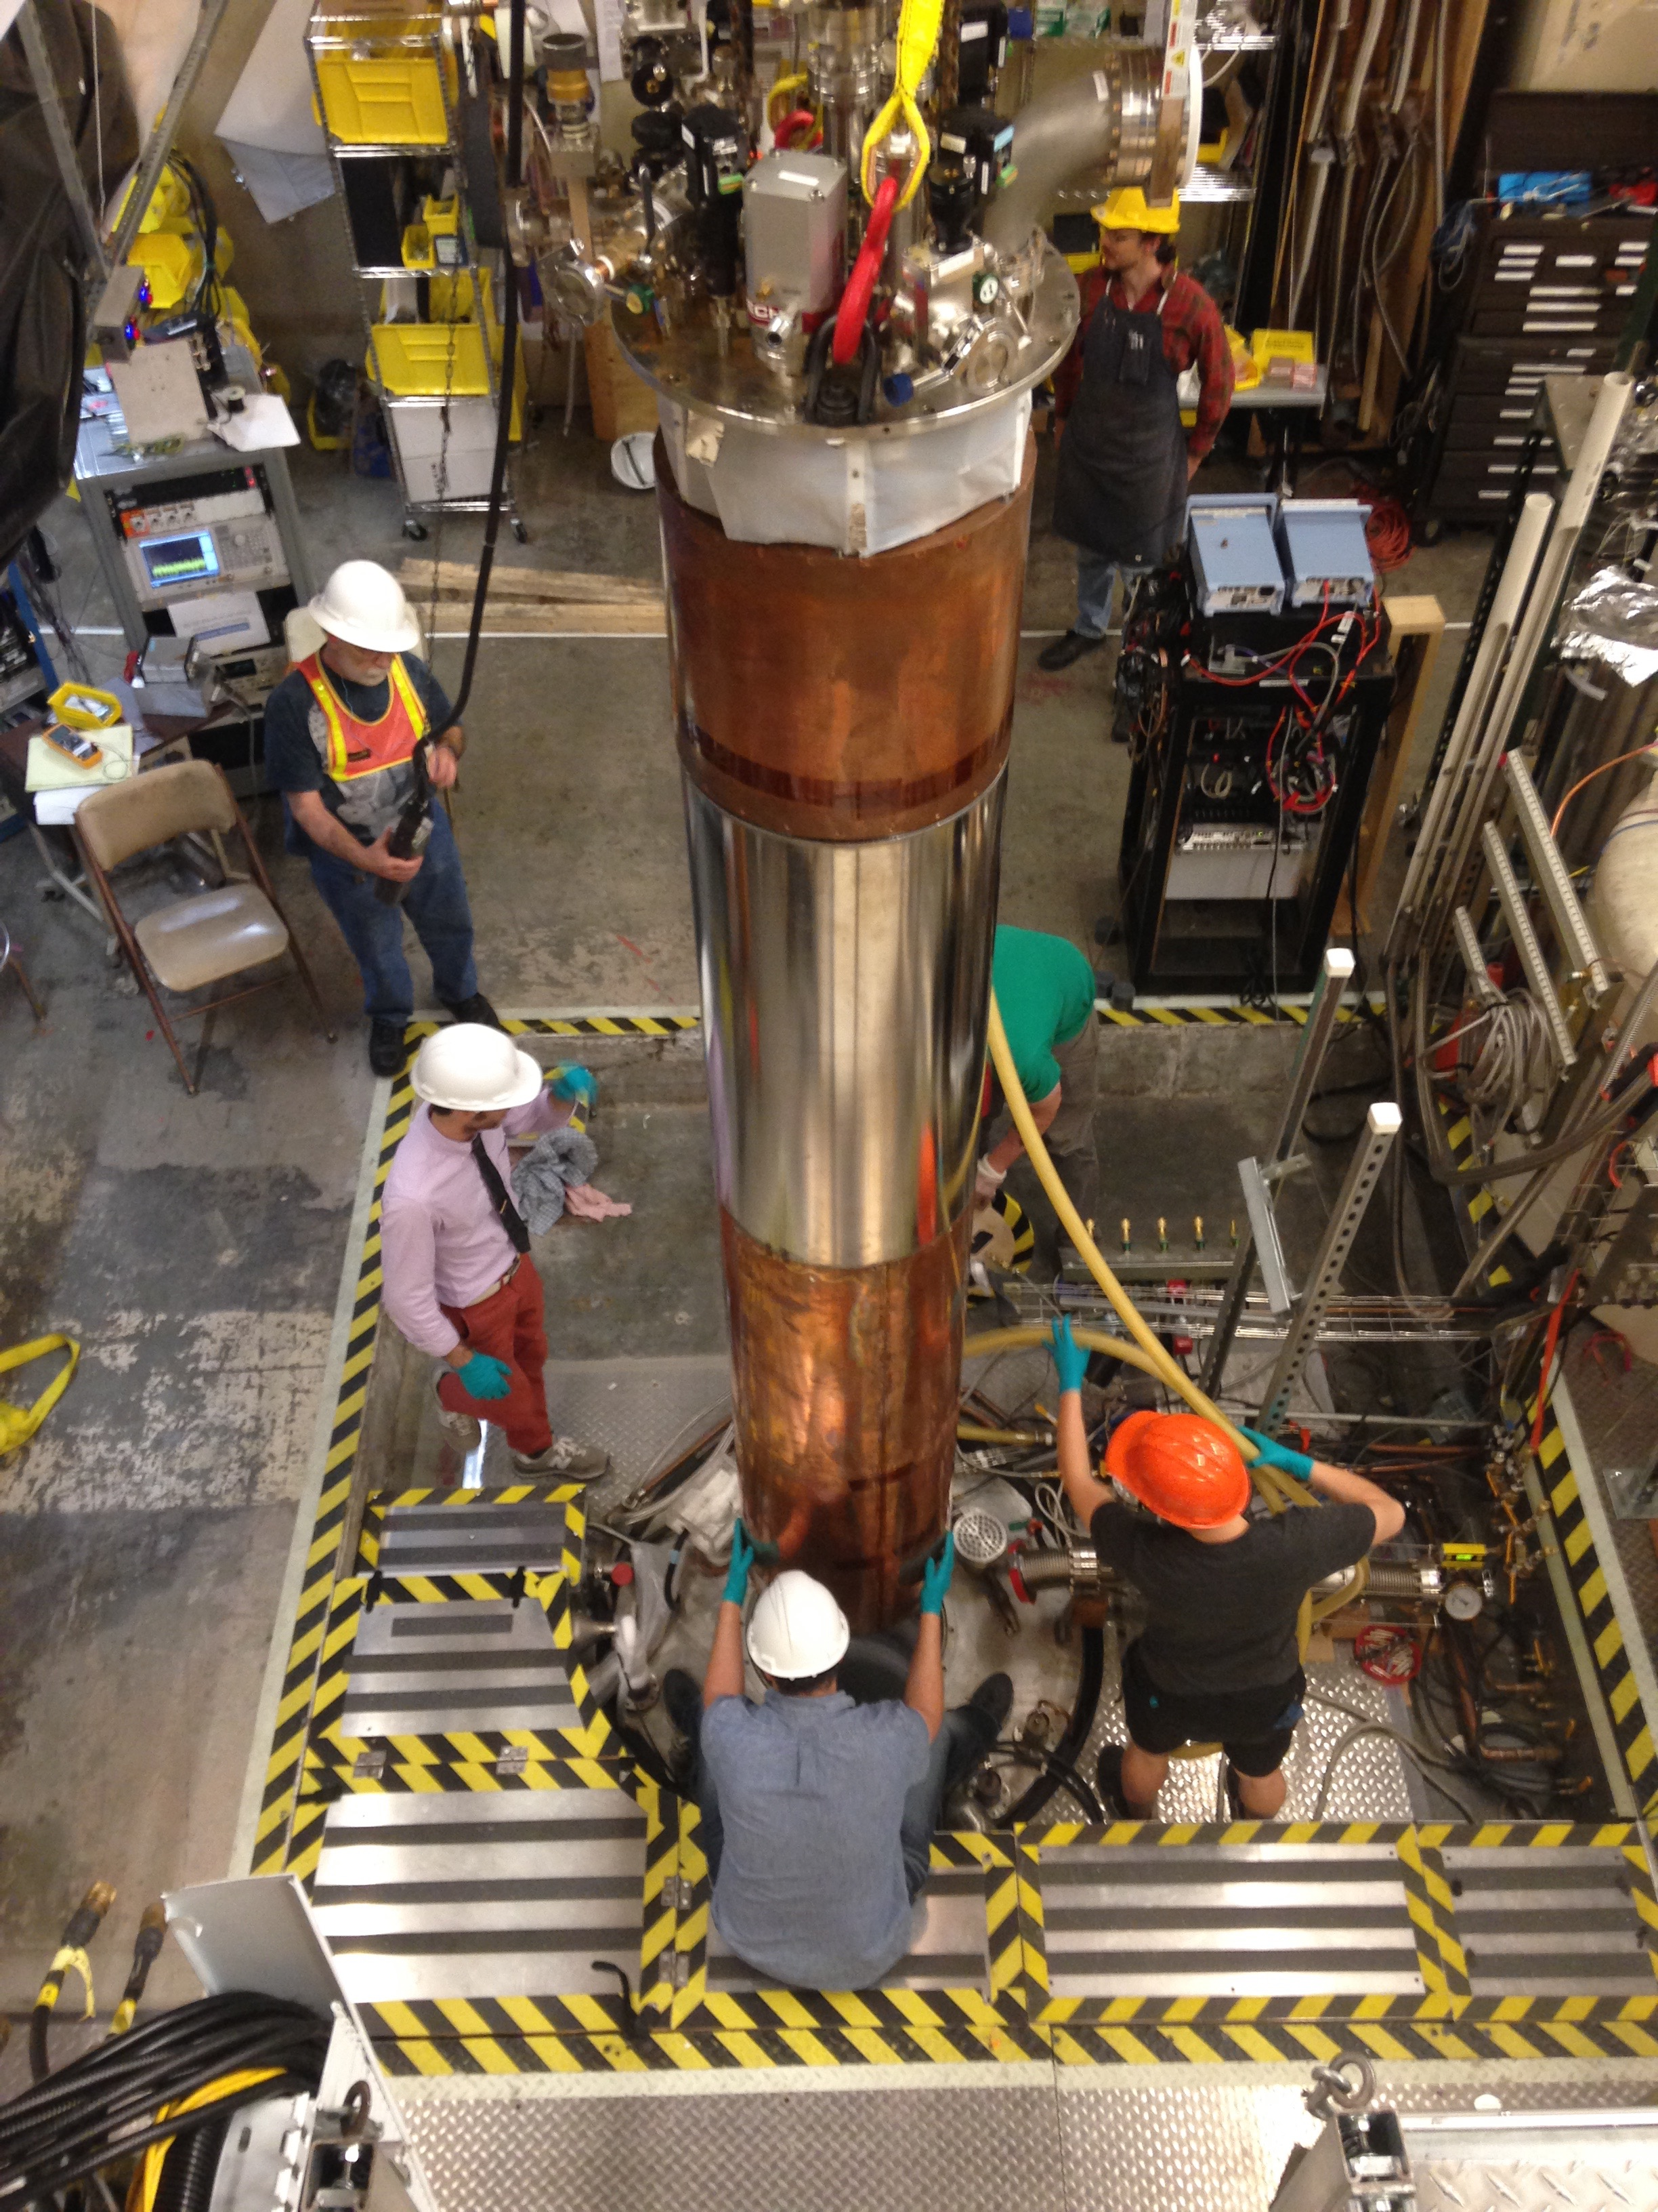
Installed ADMX insert for cold commissioning
June install followed by systems tests
Long, slow initial cool down to monitor for any 3He/4He leaks in the dilution refrigerator (2 months).
Subsequent cool downs ~ 3 weeks.
Magnet ramp, 9 Aug to 2 Tesla
Later brought to 5.5 Tesla
  No evidence of vibration
  heating from motion in field
  No evidence of cavity heating from motion control
Dilution refrigerator stable (~200 mK)
Notes:
Add another slide that shows the

Slide 36
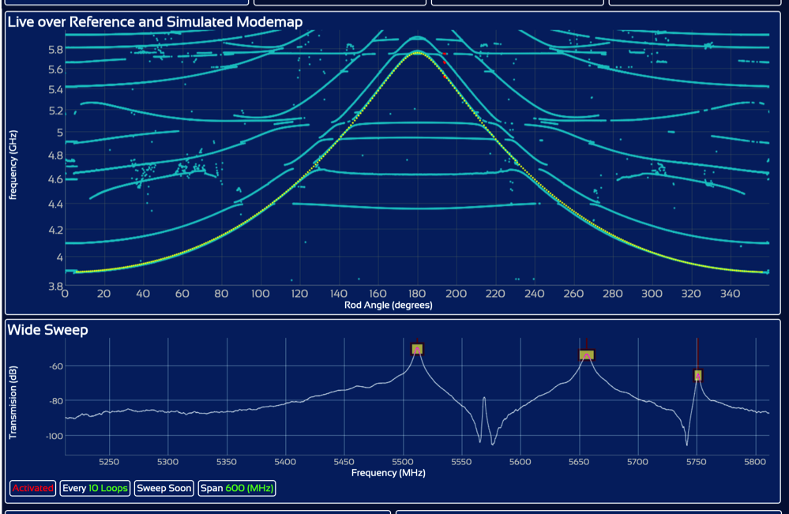
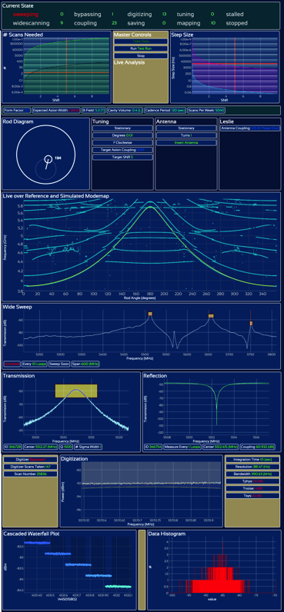
Example DAQ: Sidecar Mode Map
Red Dots are live data taken from wide scan
Reference mode map in blue
Simulated mode map in yellow

Slide 37
Raw data and hardware synthetic axion (✕100)
Able to inject custom lineshape through weak port (blinded)

Slide 38
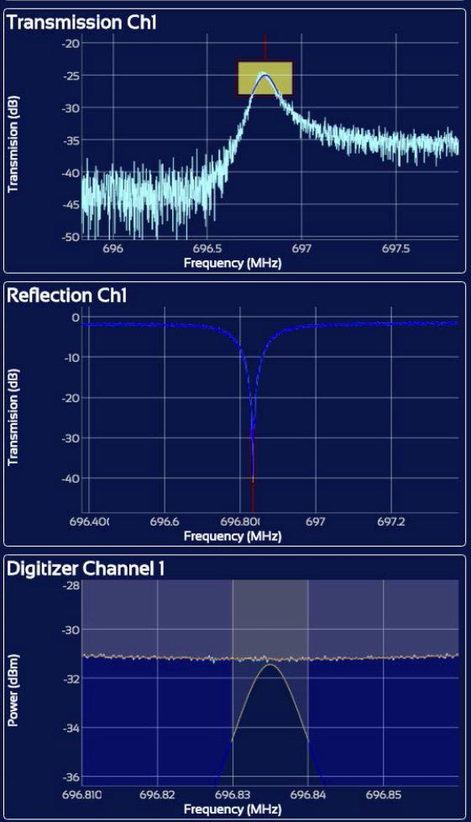
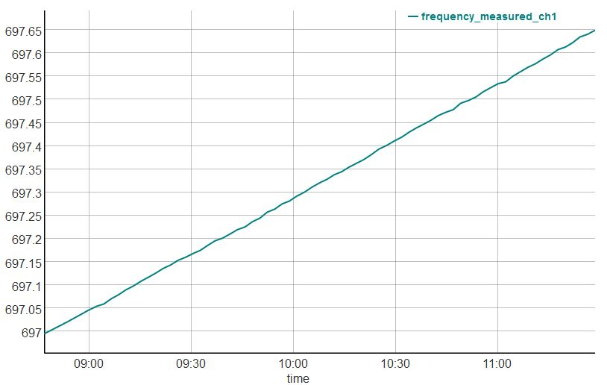
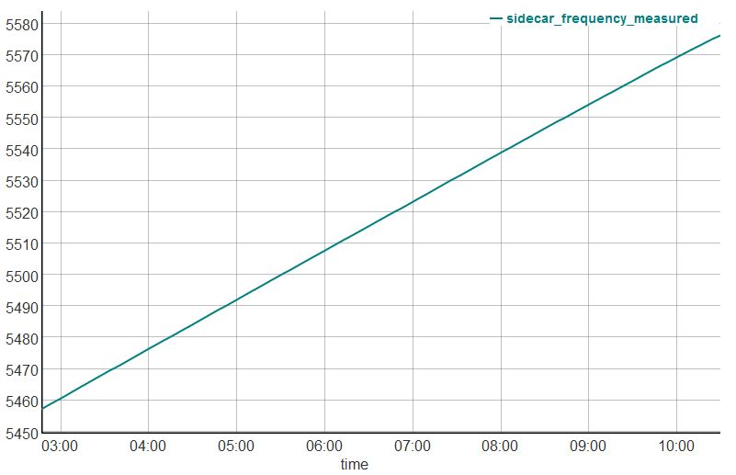
ADMX recent commissioning run (B ~ 2 T & 5.5 T)
Took data from Aug 9th – Oct 3rd
Dilution refrigerator maintained stable operations @ < 200 mK
  Not at design temp yet (150 mK).
  Confident it can be recified with additional heat sinking
Took data with SQUID amp ~ 700 MHz (2.85 μeV)
Sidecar cavity took data ~ 5.5 GHz (22 μeV)
Ch1 frequency vs time
Sidecar frequency vs time
Ch1 DAQ

Slide 39
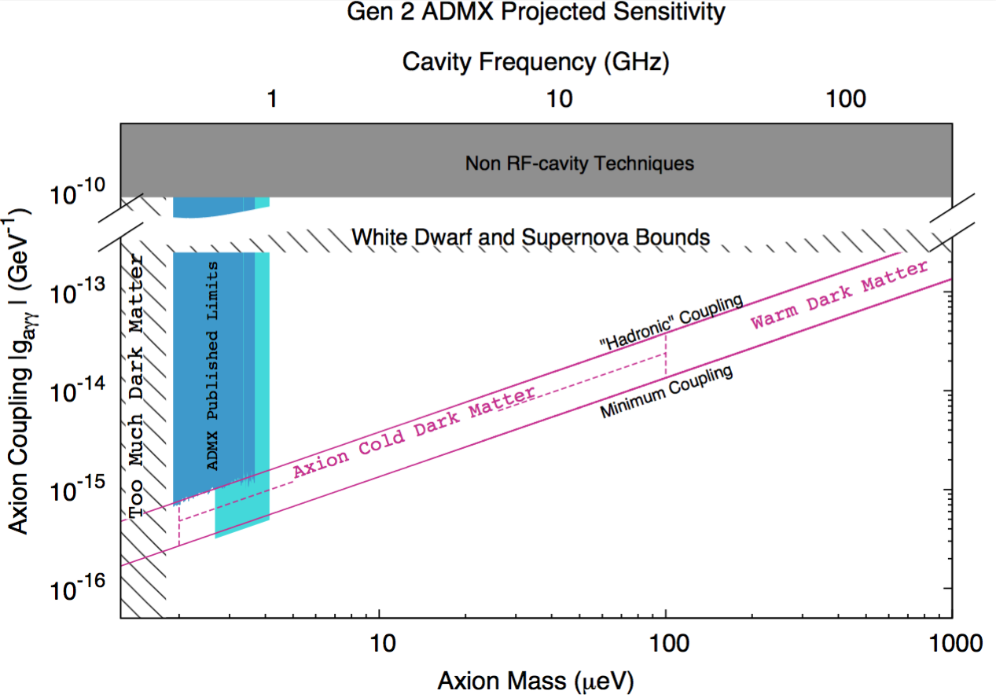

ADMX Science Prospects: Year 1 (0.5 – 1 GHz) Anticipate production data taking: Jan 2017
Current cavity system

Slide 40


ADMX Science Prospects: Year 2 (1 – 2 GHz)
4-cavity array
Notes:
Replace

Slide 41



ADMX Science Prospects: Year 3 (2 – 4 GHz)
Multi-cavity array
Notes:
Put

Slide 42


ADMX Science Prospects: Year 4 (4 – 6 GHz)
Multi-cavity array

Slide 43


ADMX Science Prospects: Year 5 (6 – 8 GHz)
Photonic bandgap cavities

Slide 44

ADMX Science Prospects: Year 6 (8 – 10 GHz)
Photonic bandgap cavities

Slide 45




ADMX Science Prospects: Out-Years (<0.5 GHz)
Slow-wave cavity with alumina tuning rods
Notes:
Scientifically higher frequency more attractive.
We do have an option to go lower. Straightforward for us. In unlikely event that we haven’t found the axion.

Slide 46

Other groups: ADMX-High Frequency
Separate collaboration at Yale U.
Notes:
Scientifically higher frequency more attractive.
We do have an option to go lower. Straightforward for us. In unlikely event that we haven’t found the axion.

Slide 47

ADMX-High Frequency: Recent data run
Recently submitted to PRL (arXiv:1610.02580)
Notes:
Scientifically higher frequency more attractive.
We do have an option to go lower. Straightforward for us. In unlikely event that we haven’t found the axion.

Slide 48
Going beyond 10 GHz (40 μeV)…
ADMX 48

Slide 49


New Magnet Systems: Maximize B²V
Magnet technology continues to improve
Large solenoid fields (> 22 T) now possible
Scan Rate ~ B⁴V²
Prudent to invest here to broaden search
Multiple frequencies scanned at same time
Bruker NMR magnet
23.5 T with 5.4 cm bore
ADMX magnet
8 T with 0.5 m bore

Slide 50

New Geometries: beyond cylinder in solenoid

Slide 51



New Geometries: Open Resonator R&D
Open resonators may access frequencies too high to reach with closed cavities
could expand ADMX reach to highest possible dark matter axion masses
Prototype Model
UW Undergraduate project
PhysRevD.91.011701
System potentially good to much higher frequencies (40 GHz or more)

Slide 52

Open Resonator R&D
Open resonators may access frequencies too high to reach with closed cavities
could expand ADMX reach to highest possible dark matter axion masses
Prototype Model
UW Undergraduate project
PhysRevD.91.011701
System potentially good to much higher frequencies (40 GHz or more)

Slide 53
Open Resonator R&D
Open resonators may access frequencies too high to reach with closed cavities
could expand ADMX reach to highest possible dark matter axion masses
Prototype Model
Current R&D work
(cryogenic test)
UW Undergraduate project
PhysRevD.91.011701
System potentially good to much higher frequencies (40 GHz or more)

Slide 54
Linear amps subject to the Standard Quantum Limit
where
ν [ GHz ] | m_{a} [ μeV ] | T_{SQL} [ mK ]
0.5 | 2.1 | 24
5 | 20.7 | 240
20 | 82.8 | 960
The SQL can be evaded by:
Squeezed-vacuum state receiver (e.g. GEO, LIGO)
Single-photon detectors (e.g. qubits, bolometers)
Currently focus of R&D (LLNL, FNAL, UC Berkeley)
S.K. Lamoreaux et al.
(PhysRevD.88.035020)

Slide 55
ADMX Generation 3
Long term goal is to detect or rule out axion as primary dark matter candidate.
ADMX Gen 3

Slide 56

Can obtain axion phase space distribution immediately after discovery + reconfirmation
For example:
Test N-body simulations from T. Quinn predicting long-suspected co-rotating galactic DM → Softer spectrum?
Narrower line = better Signal/Noise?
frequency = ½ m_{a}v² / h
For 2x frequency resolution, need 2x sample time. Half-power in each bin requires 4x samples.
Total 8x integration time is easy!
*Slide from Aaron Chou (FNAL)

Slide 57


Test models of debris flow, narrowband caustic structure from recent infalls, etc.
Via Lactea 2 simulation,
Caustics (Sikivie)
Kuhlen, Lisanti, Spergel (2012)
If dark matter is multicomponent, these measurements could also provide valuable input to WIMP detection experiments.
*Slide from Aaron Chou (FNAL)

Slide 58

Annual modulation is also easy
Annual modulation δv/Δv = (60 km/s) / (300 km/s) = 20% of linewidth.
Resolve frequency shift with 5x integration time = few 10’s minutes.
Power spectral density (arb. Units)
Δf (kHz)
*Slide from Aaron Chou (FNAL)

Slide 59
Summary & Conclusions
Axions: solve the Strong-CP problem and are a compelling DM candidate
The ADMX Gen 2 project A narrow band experiment with concurrent R&D
Takes data in one mass range while developing systems for higher masses.
Finished commission run.
Anticipate 6 year data taking run starting Jan 2017.
Technologies that are under active development (haloscopes):
Microwave Cavities:
  High-Frequency, Large-Volume Tunable Systems with high Q
RF Detectors: Quantum Limited (0.25 – 10 GHz): SQUIDs & JPAs
Beyond several GHz the standard quantum limit begins to dominate
  Employ Squeezed States and Eventually Single-Photon-Counters
Large Magnets can increase axion conversion signal.

Slide 60
Summary & Conclusions
Axions: solve the Strong-CP problem and are a compelling DM candidate
The ADMX Gen 2 project A narrow band experiment with concurrent R&D
Takes data in one mass range while developing systems for higher masses.
Finished commission run.
Anticipate 6 year data taking run starting Jan 2017.
Technologies that are under active development (haloscopes):
Microwave Cavities:
  High-Frequency, Large-Volume Tunable Systems with high Q
RF Detectors: Quantum Limited (0.25 – 10 GHz): SQUIDs & JPAs
Beyond several GHz the standard quantum limit begins to dominate
  Employ Squeezed States and Eventually Single-Photon-Counters
Large Magnets can increase axion conversion signal.
See Ben Safdi’s talk next for exciting new ideas to probe nano-eV axions

Slide 61

Plug for upcoming workshop…
January 9-12th, 2017 at the Lawrence Livermore National Laboratory Open Campus
Funded by Heising-Simons Foundation (funds for travel & lodging)
http://indico.fnal.gov (search under “axions” and you’ll see this one and last years)

