Slide 1
Cryogenic Ge detector R&D:
Toward single electron resolution large mass Ge
Nader Mirabolfathi
PIRE/GEMADARC Ge workshop, Knoxville, Dec 2018
Main interest in developing very low threshold detectors for DM, CEvNNS searches.
Use the information in the single electron excitations for directional searches.
Use phonon mediated detectors using successful CDMS TES technology.
Novel techniques toward development of single electron resolution large mass detectors.

Slide 2
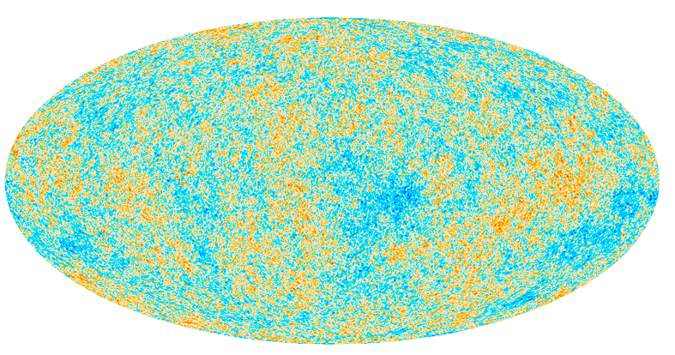
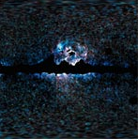
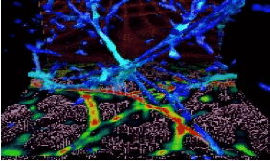
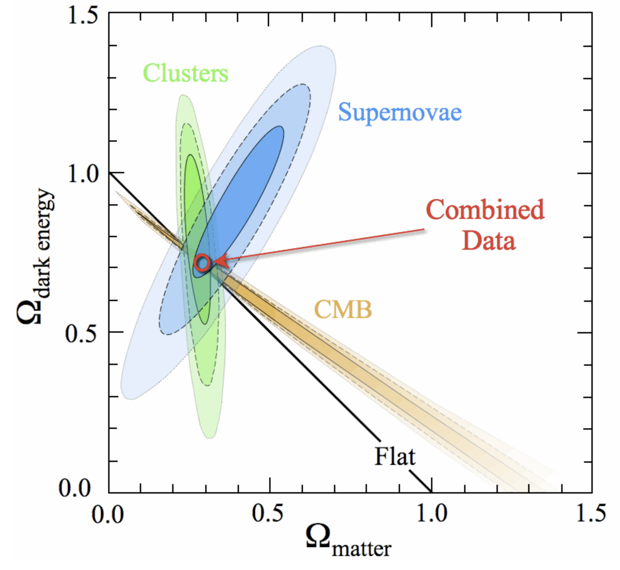
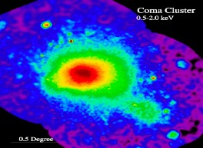
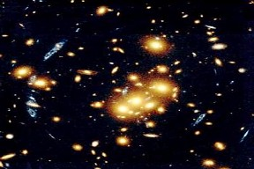
Dark Matter: Evidences

Slide 3
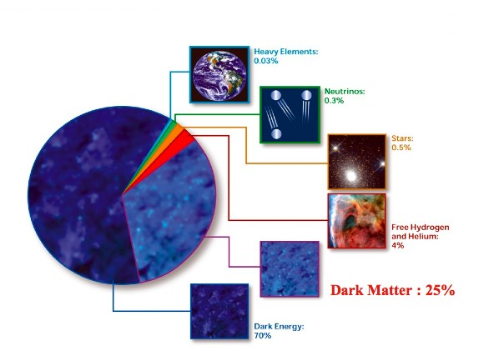
Confession:
95% of the content of the Universe is unknown

Slide 4
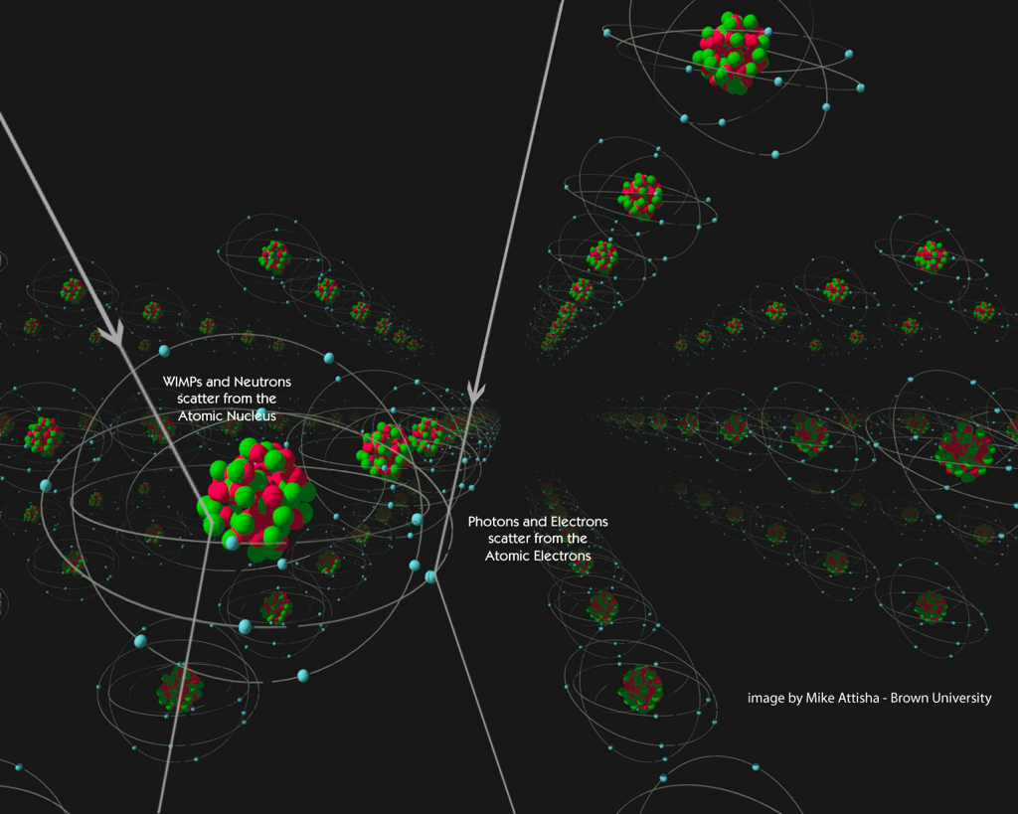
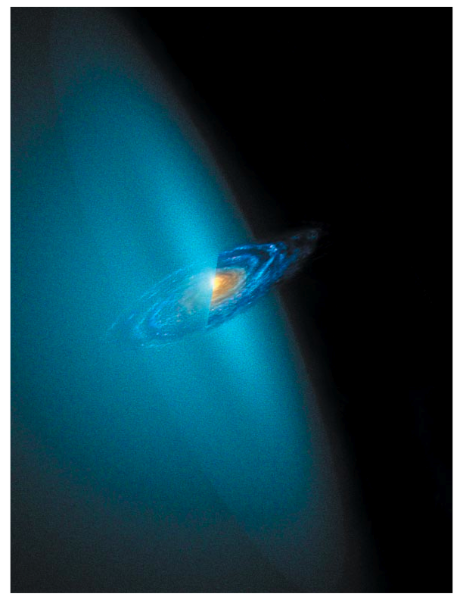
WIMPs in the Halo
χ
χ
χ
χ
~
q
isothermal Maxwell-Boltzmann distribution:
q
q
q
Escape velocity=680 Km/s
q
V₀ = 230 Km/s
ρ= 0.3 GeV/cm³
Rate ~ N n_{χ} <σ_{χ}>
Few 10s of keV recoil energy
  Rate < 0.1 event/kg/day
D. Cline, Scientific American 2003

Slide 5
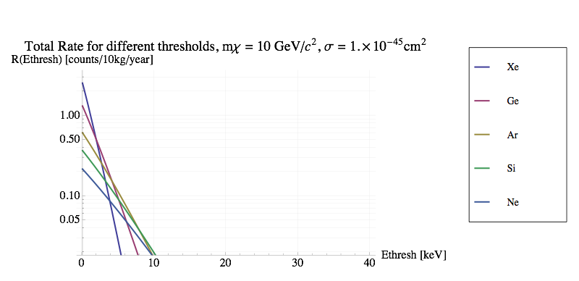
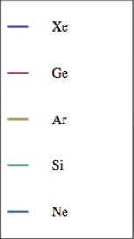
Signal from a 10 GeV WIMP
Xe
Ge
Si
Ar
Integrate above E
Ne
Background
Notes:
Probability of getting mu or lower number of events is
P = 1-e^(-mu) = .9 for 90% confidence.
That comes out to 2.3 events or lower for a zero background experiment. So for a zero background experiment with a given exposure, the cross section that predicts 2.3 events (when you saw none) is the 90% confidence cross section limit for that exposure.
So to have a 1e-45cm^2 sensitivity SCMS needs and exposure of 23 kg-year

Slide 6
Coherent Neutrino-Nucleus Elastic Scattering
Flavor-blind Standard Model process
 | E_{ν}=3MeV
Ge | 6.0x10⁻⁴¹cm²
Ar | 1.8x10⁻⁴¹cm²
Si | 7.4x10⁻⁴²cm²
Excellent tool to probe BSM Physics, but never been utilized due to lack of low threshold detectors
Integrated rate/kg-year
Can detect CENNS in ~ 1month
Recoil energy in eV
Notes:
Coherent scattering off nuclei is a neutral current process. Thus, any observation of an oscillation structure would indicate mixing solely to non-active neutrinos. Other methods, such as neutrino-electron scattering, must disentangle the mixing to sterile neutrinos from mixing to active neutrinos. The technique becomes even more powerful when combined with low energy mono-energetic sources. Oscillations to neutrinos at the eV mass scale would manifest themselves over the length of a few meters (for ∼ 1MeV neutrino energies)

Slide 7
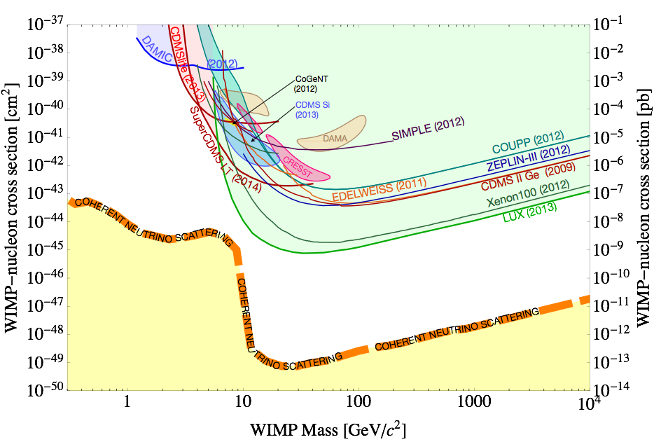
Two big question one solution

Slide 8
Toward single electron (e⁻ - h⁺) resolution Large mass detectors

Slide 9
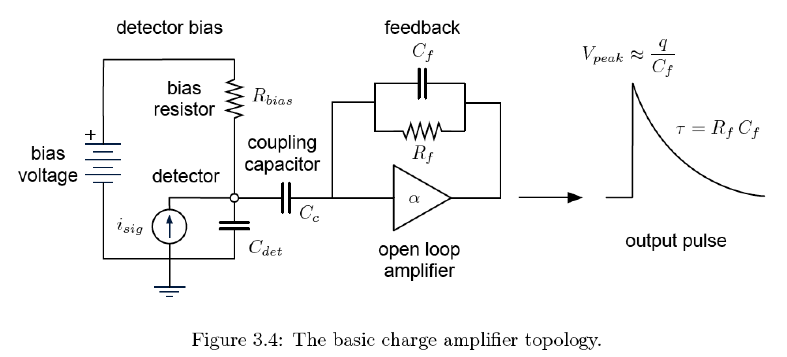
Direct Ionization measurement in SC detectors
e⁻
Measure Ionization directly with a charge amplifier.
Need Cold front end close to the detector : HEMT/FET.
S/N degrades with the input capacitance.
Limited by noise associated with high impedance readout:
  Microphonics
Best electronics RMS achieved with CDMS detectors:
h⁺
From Arran Phipps thesis, UC Berkeley, Spring 2016

Slide 10
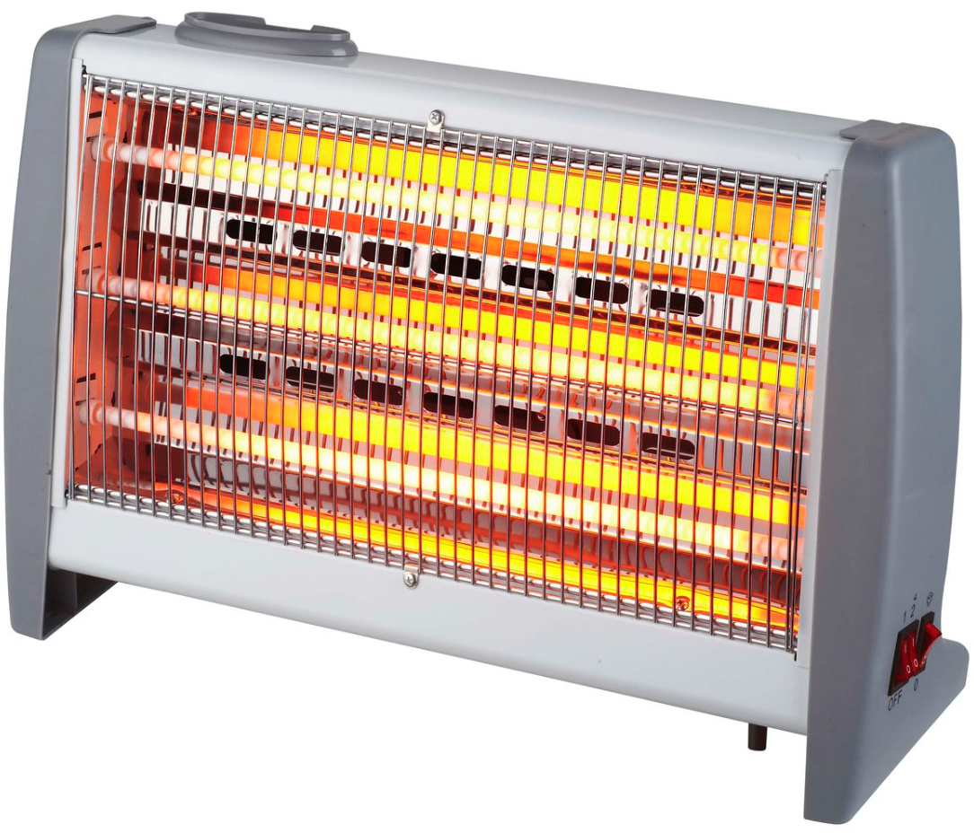
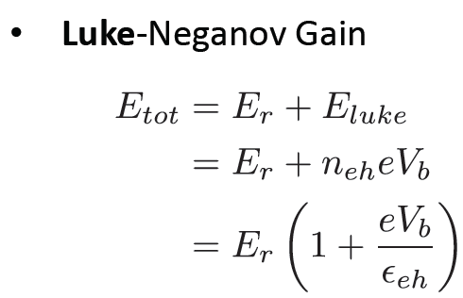
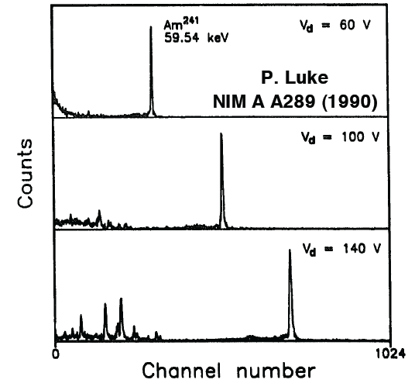
Indirect Ionization measurement using phonons
R
Power=V.I or Energy=V.Q
T
e⁻
h⁺
Phonon noise doesn’t scale with the ionization bias:
=>
S/N 
In theory one can increase Bias to reach Poisson fluctuation limit!
limitation: Ge Breakdown
Luke et al., Nucl. Inst. Meth. Phys. Res.A 289, 406 (1990)

Slide 11
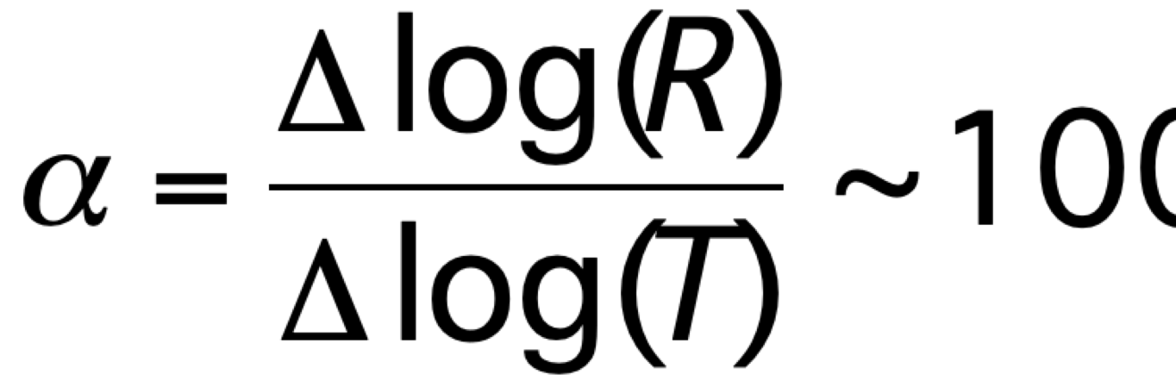
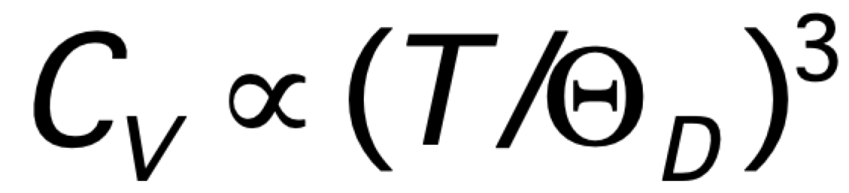
Calorimetery with large absorber mass:
A back of the envelope calculation!
Germanium at 300 K C_{V}=3200 J/kg·K and Θ_{D}=374 K
⇒ C_{V} at 0.02 K = 5e-10 J/kg·K
=3e6 keV/kg·K
1 kg Ge
T=0.02 K
2 μV
Therefore for a 1kg Ge absorber cooled down to 0.02 K, ΔT caused by a 10 keV deposit will be: ~3.3e-6 K
A thermometer attached to the absorber with α ~100:
R (Ω)
Superconductor Transition Edge Sensor
Signal ∝ΔI~ 40 nA
Noise~1pA/(Hz)^1/2
1.0
Typical for SQUID Amplifiers
Very good resolution
0.02
T (K)
Notes:
1
It may sound crazy that a tiny energy deposit 10 keV or a femto joul will change a measurable temperature.
At RT it is impossible to do this measurement but how about at very low T as we know that the specific heat of the crystals vary with power 3 of temperature. Here I gave the example for Ge if cooled down to very close to absolute zero 0.02 Kelvin and the specific heat changes from 3200 jool per kg per degree kelvin to 3 ten to the minus 10 . So a 10 keV event will raise the temperature of 1 kg of Ge by 3 micro Kelvin. This is still tiny change in temperature. But with very sensitive thermometer like a superconductor biased to it transition edge a slight raise in the temperature will significantly change the resistance in our example with dimensionless slope at the transition edge of about 100 which a realistic value, if biased with voltage supply the delta current will be 40 nA. If we compare this with typical noise of a SQUId amp being 1 pA then you can see that we have a very good resolution.

Slide 12
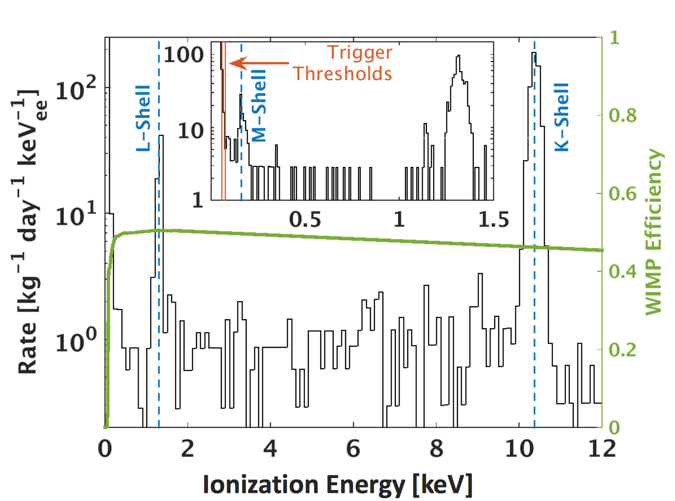
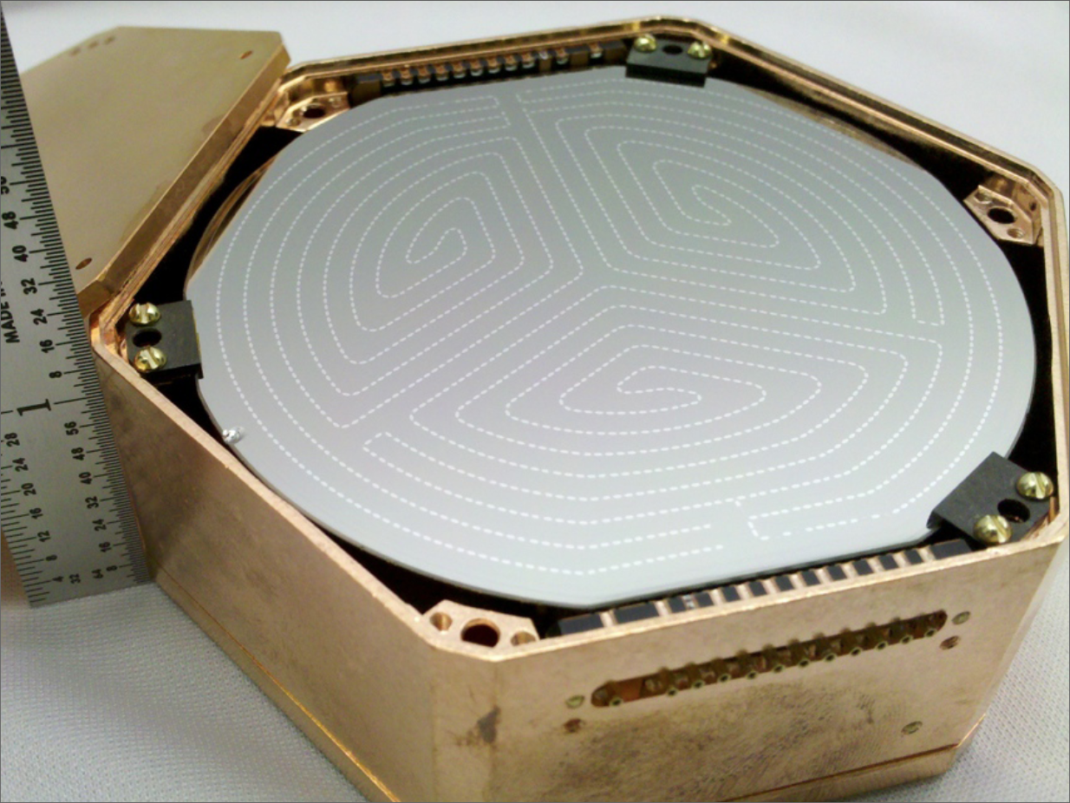
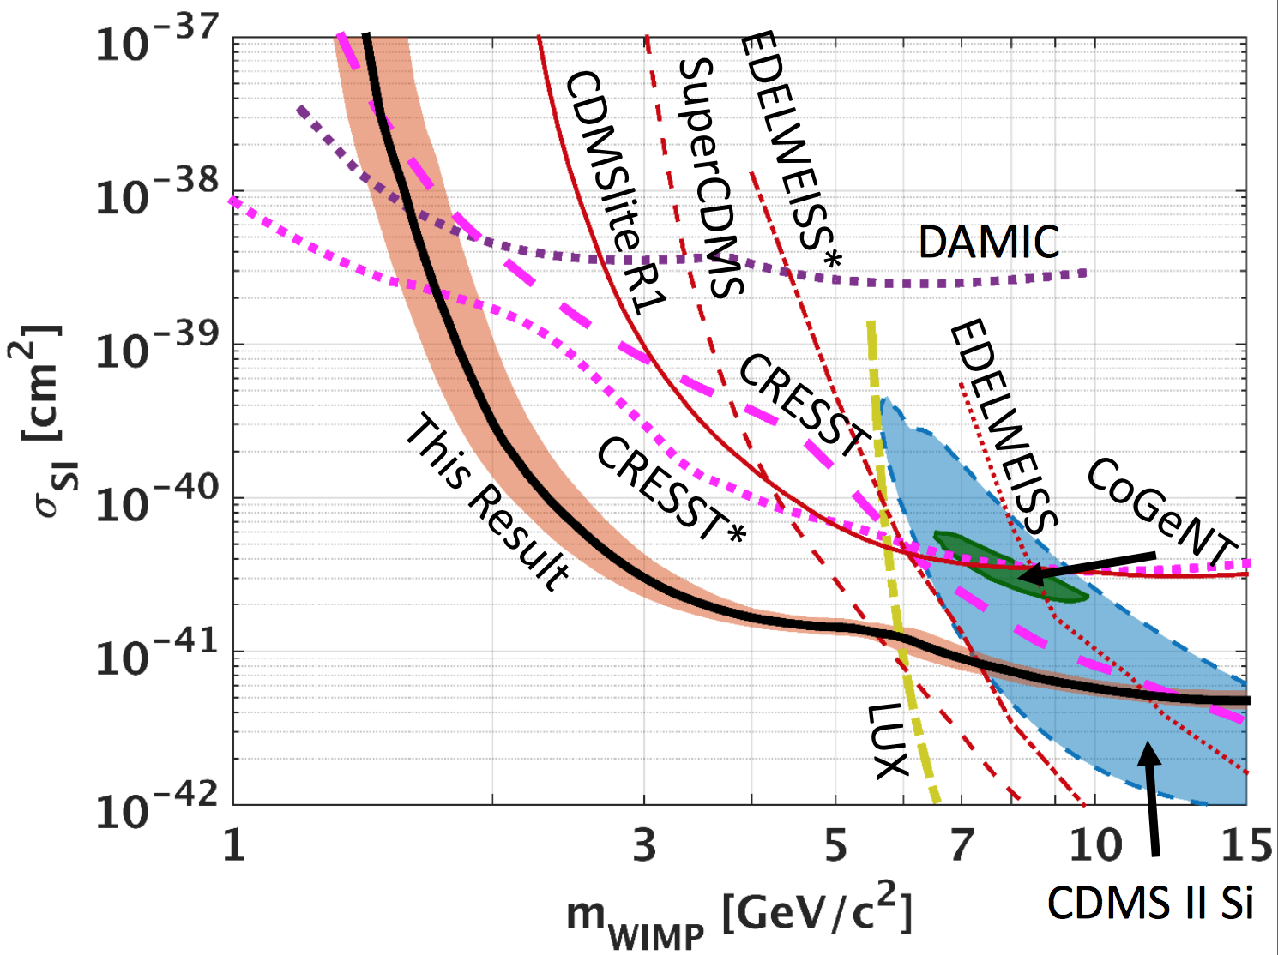
CDMSlite: CDMS with phonon gain
Use the Luke phonon amplification to indirectly measure ionization using very good phonon resolution.
One iZIP (0.625 kg) used for this data
~70 kg.day exposure
Impressive 14 eVee resolution for Vbias=69 Volts.
Limited to current leakage for V>70 Volts
Or E> 24 Volts/cm
Very low compared to standard 77K Ge detectors
Agnese, R. et al., Phys. Rev. Lett. 116 (2016)

Slide 13
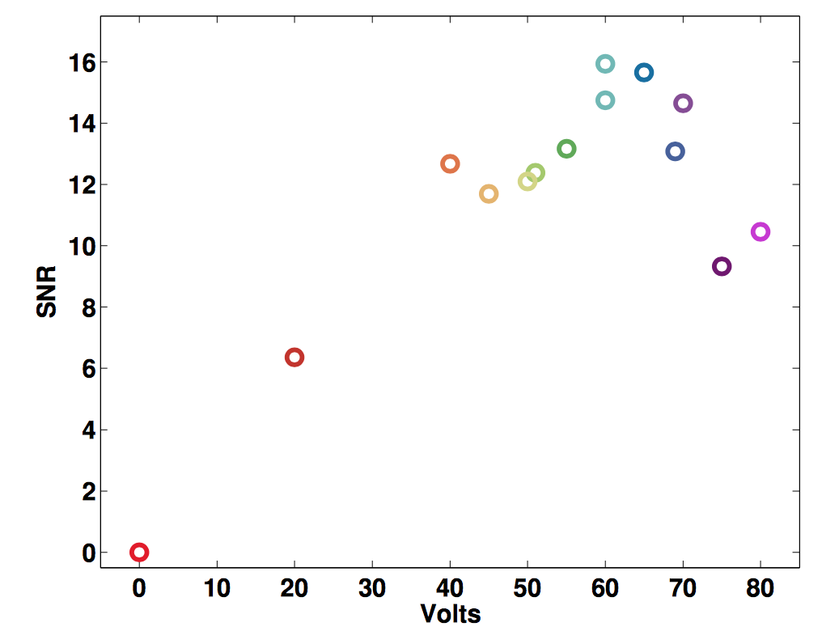
CDSMlite limitation: Breakdown?
Ritoban Thakur Ph.D. thesis

Slide 14
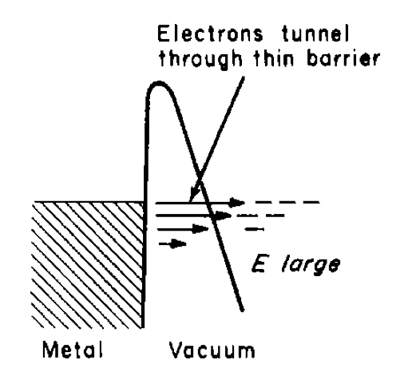
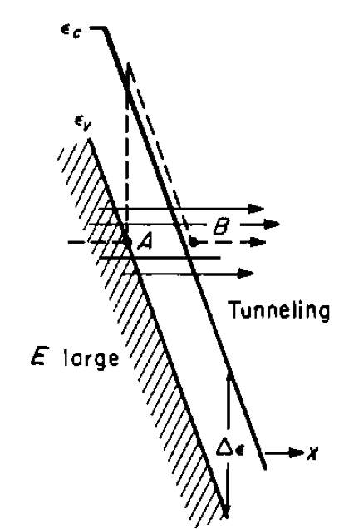
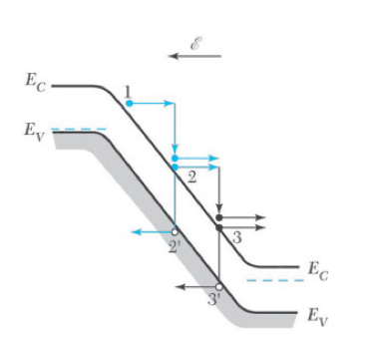
Need to study breakdown!
Injection through contact by tunneling
What causes the breakdown at such low fields?
Impact ionization on impurities:
  Ionized
  Neutral
Leakage through electrodes?
Conduction over detector free surface:
  Better surface treatment?
  Common problem if surface damaged.
J.P. McKelvey, Solid-state and semiconductor physics, Harper & Row, 1966.S.M.
Sze, Semiconductor devices: physics and technology, 2nd Ed., Wiley, 2002.
Avalanche

Slide 15
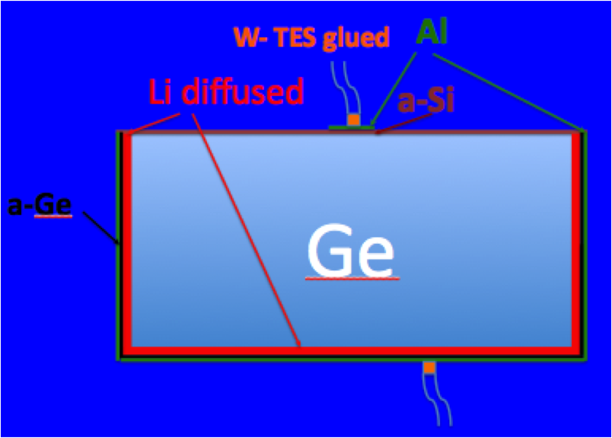
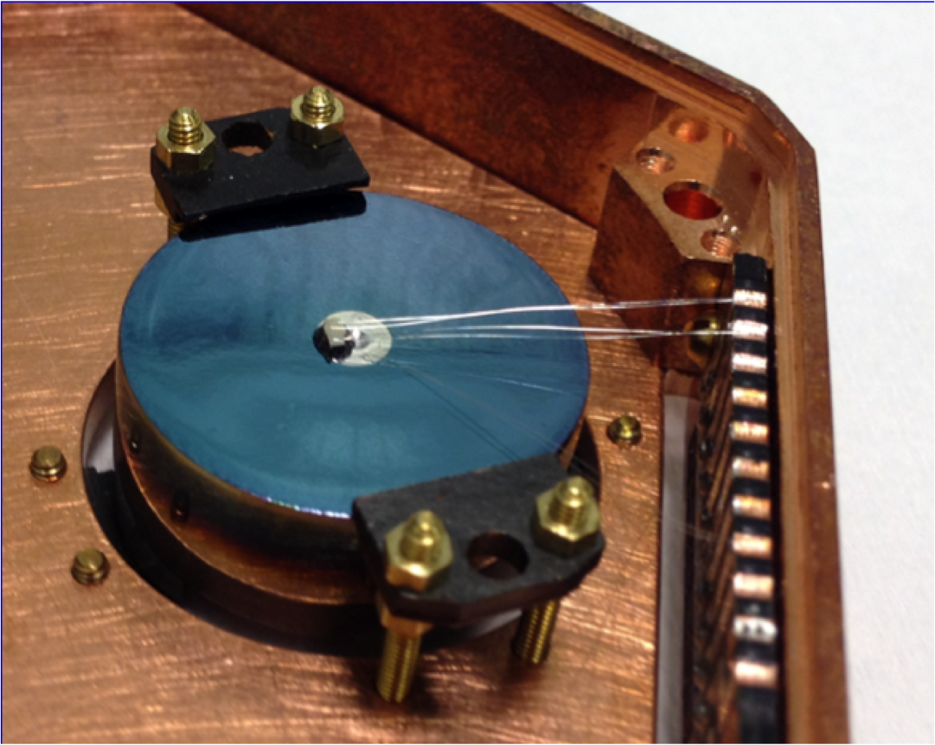
P-type Point Contact Ge at @T< 0.05 K
PPC are common design for 77K Ge gamma spectrometers.
Experiments using ultra pure Ge PPC: Majorana, CoGeNT,
LBNL provided a prototype Majorana PPC.
At UCB adhered a tungsten TES thermistor.

Slide 16
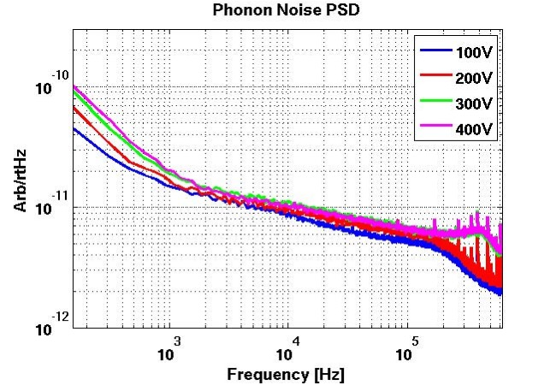
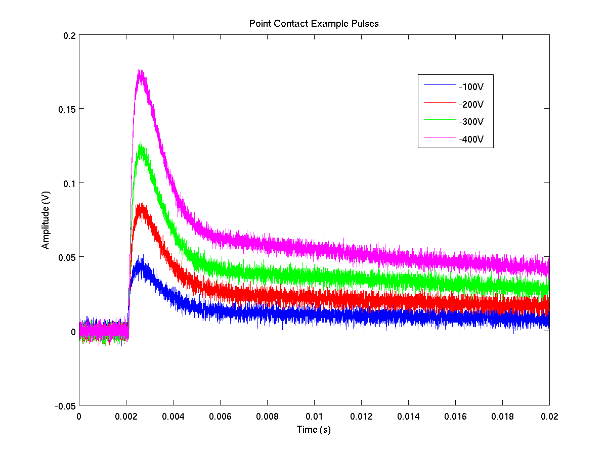
No Break down for V up to 400 Volts
N. Mirabolfathi, M. Amman, D. Faiez, P. N. Luke et al., J. Low T. Phys. 176, 209-215 (2014).

Slide 17
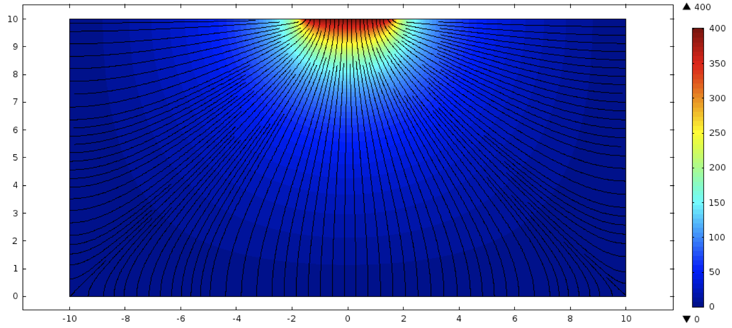
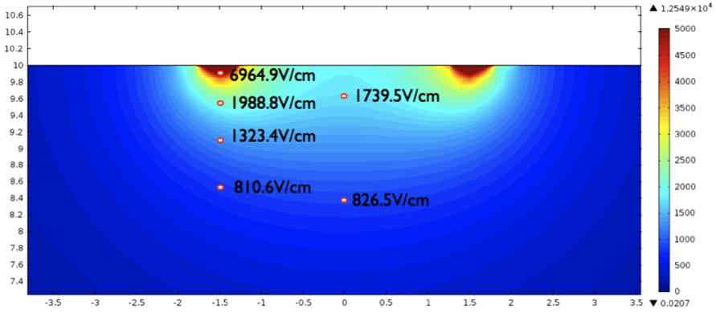
E Field in PPC @ V_{bias}=400Volts

Slide 18
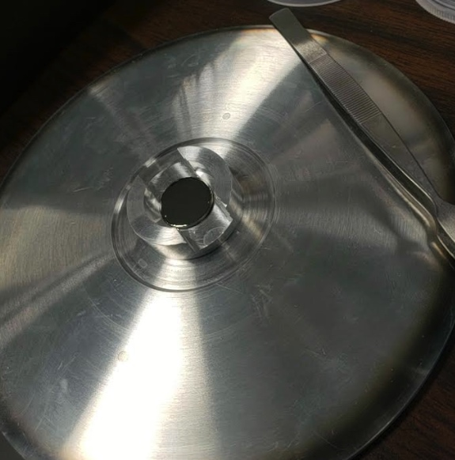
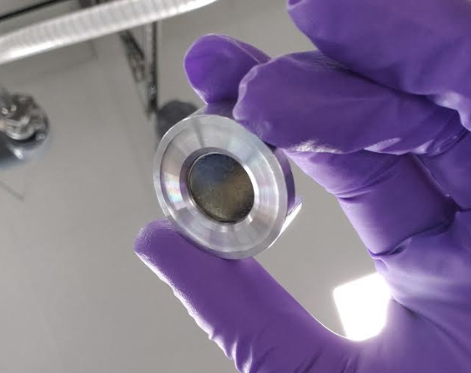
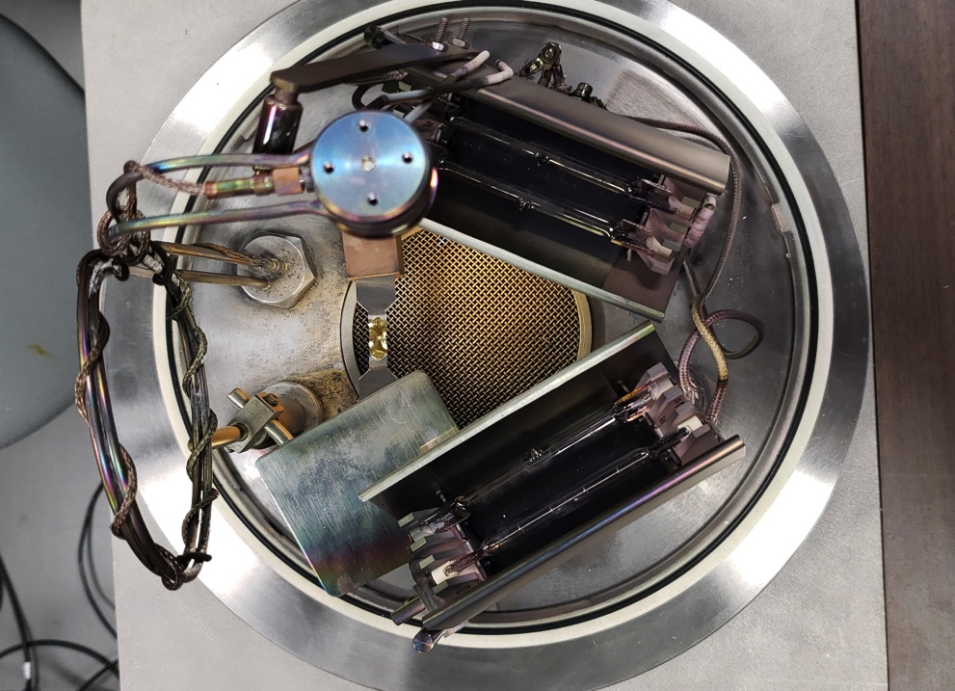
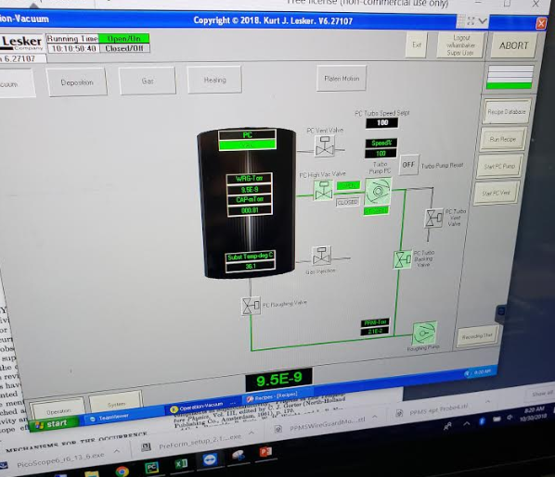
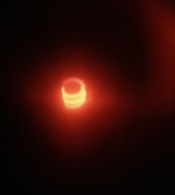
R&D “Mini PPC” process line
To give a fast-turnaround ability to experimentally test
  Ge quality and impact of impurity density/profile/type
  Contact DOE’s for true differential comparison of contact types on identical detector material
Process components include
  Shaping and polishing
  Li deposition and diffusion/drift
  Full contact lithography (optical, shadow mask, lift off, etc)
  Alternate contact material
  Alternate contact devices
Modeling and development (UNC and A&M)
  Combine new PPC process types, even simplification, with modeling
Shutter
Crystal Monitor
Filament
Heater/Lamp
Heater/Lamp
Germanium “Coins”

Slide 19
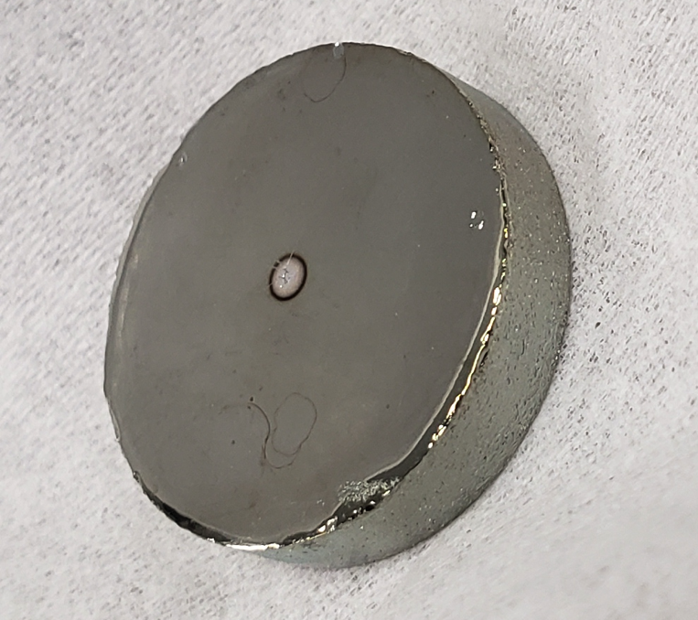
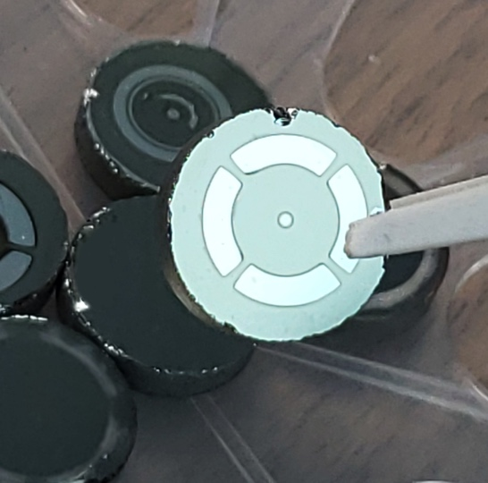
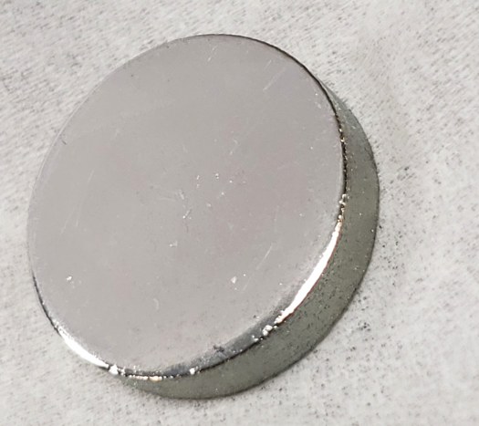
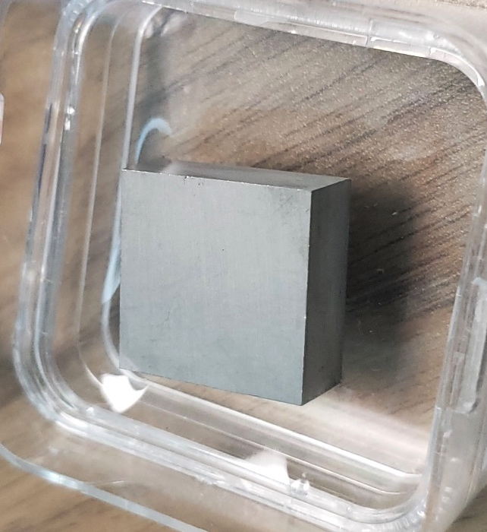
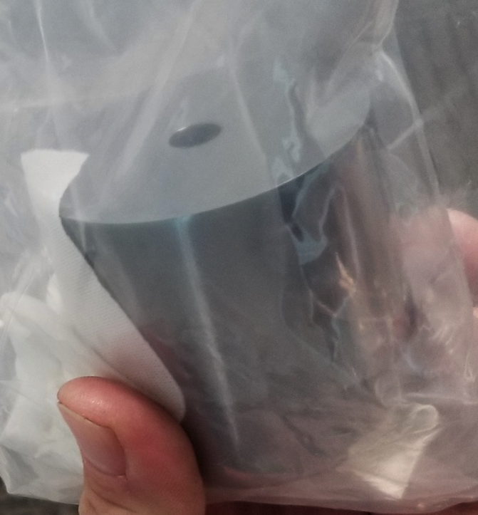
miniPPC Fabrication
First Detector (12-2-18)
  “Reclaimed reclaim” from CDMS II Ge, ~2x10¹⁰ cm⁻³
Mini PPC detectors current in line for full material qualification
  Industry Standard Ge, 1x10¹⁰ cm⁻³
  USD Ge, ~2x10¹⁰ cm⁻³
  other UHP Ge (Coaxial reclaims, cored and milled material)

Slide 20

CDMS symmetric contact geometry
Use W TES (T_{C}~75 mK ) phonon sensors
Both faces of the detector uniformly covered with sensors.
Simultaneously measures athermal phonons and ionization.
Design tailored for excellent background rejection.
Al
W
α-Si
Ge
In CDMSlite mode only readout one face phonon sensors. The other face used for biasing.

Slide 21
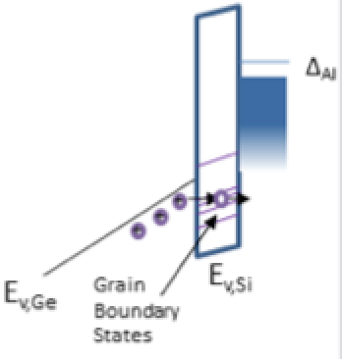
CDMSlite symmetric contact geometry
Al
W
α-Si
Ge

Slide 22
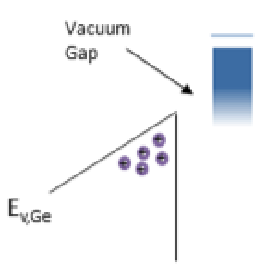
CDMSlite symmetric contact geometry
Al
W
α-Si
Ge
Vacuum
Al electrode

Slide 23
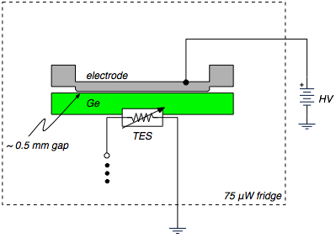
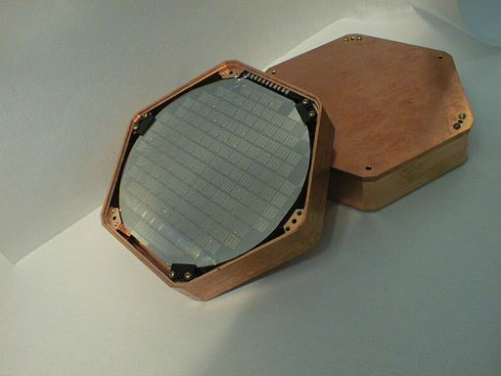
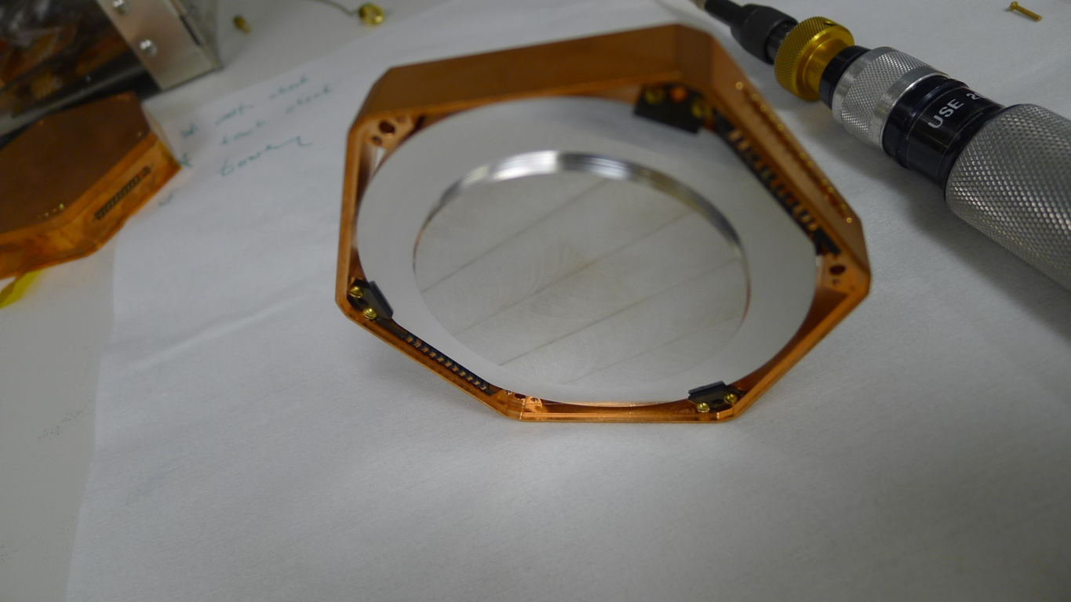
High Voltage athermal phonon readout: contact free biasing
One face of the detector processed similar to a CDMS II detector:
  fully covered by Four W based athermal phonon readouts.
The other face of the detector left free
Bias the detector through a gap ~ 0.5 mm
TAMU
Berkeley

Slide 24
Contact free asymmetric results
The phonon sensor always at ground potential.
Observed a strong leakage polarity dependence.
Significant leakage when biased negative.
  => Holes leak through the interface
Requires further studies on contact properties.

Slide 25
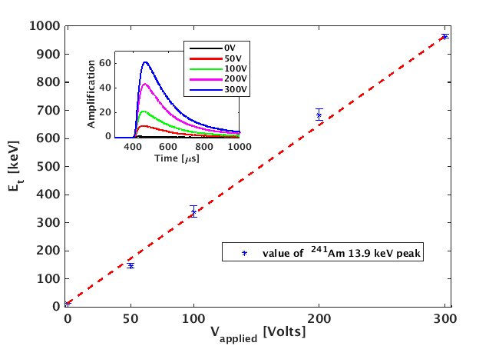
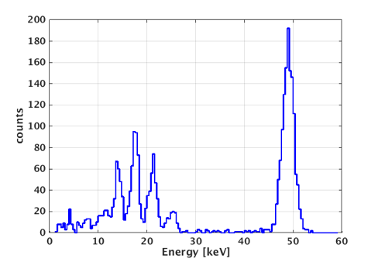
Contact Free performance
N. Mirabolfathi et al., Nucl. Instrum. Meth. A855, 88 (2017), arXiv:1510.00999.

Slide 26
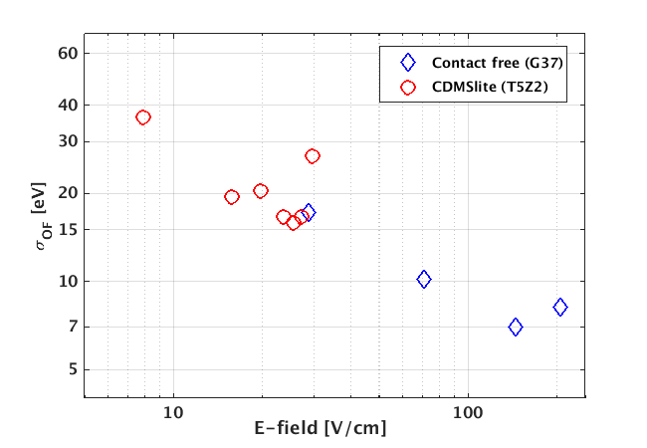
Baseline Resolution compared to CDMSlite
Given a fixed E_{critical}
1 cm Thick
2.5 cm Thick
=>
× 2.5 V_{max}
=>
× 2.5 Phonon gain
N. Mirabolfathi et al., Nucl. Instrum. Meth. A855, 88 (2017), arXiv:1510.00999.
Using this concept in CDMSlite iZIP absorber geometry, we expect to achieve:
σ < 2.8 eV_{ee}

Slide 27
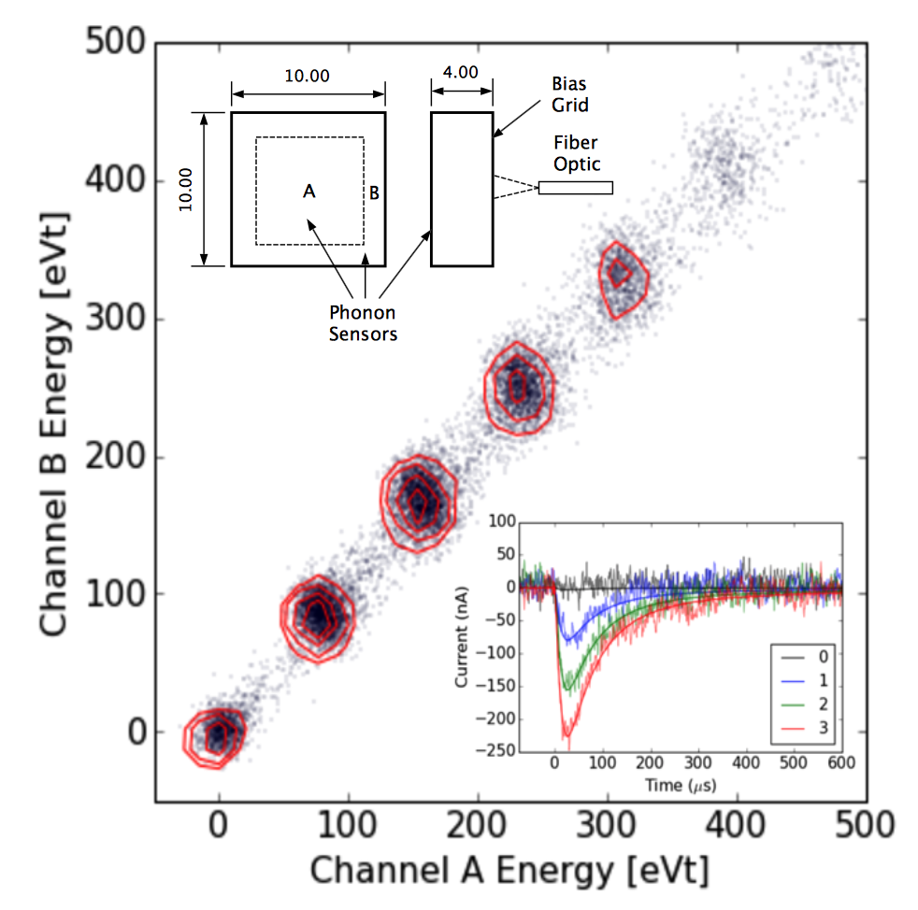


Stanford single electron phonon mediated detectors:
Use 1 cm ² 0.4 cm thick Si:
  ~ 1 g
Operate at 35 mK
Use CDMS QET design
CDMS HV technology
  Operate at 160 Volts.
Use monochromatic Laser light
  640 nm
Achieved ~0.1 e-h pair resoltion.
Clear single electron resolution!
R. K. Romani et al., Appl. Phys. Lett. 112, 043501 (2018);
https://doi.org/10.1063/1.5010699

Slide 28


Single electron resolution: "Skipper" CCD
Use CCD technology.
200 microns thick Si.
Operate at 140 K.
Multiple measurement of charge.
Achieve 0.068 e⁻ RMS.
Clear single e-h pair resolution!

Slide 29
Sub-Kelvin phonon mediated CCD
CCD’s advantage: transfer charge from the large surface area detector to a small area sense gate=>small C!
Room T CCD disadvantage: Requires depleted substrate => limited to small thickness.
Phonon mediate ionization measurement (CDMSlite) offers excellent S/N but limited to leakage!
Combine the two into a sub-Kelvin CCD
No need for depletion since the carriers are frozen
No need for HV since phonon amplifications occurs at each bias alternative cycle

Slide 30





First prototype
Ge Substrate

Slide 31
Electron-hole excitation threshold:
Nuclear recoils

Slide 32

NR ionization excitation threshold
e⁻
h⁺
DM or ν
High energy nuclear recoil ejects a Ge atom (Ion) from lattice and electronic stopping power.
Ionization mechanism for very low energy nuclear recoil interaction not well known.
Ionization threshold: Defect creation faster than recombination time h/Ge (Gap)~ 4 e -15 s.
=> Defect threshold is correlated to ionization excitation

Slide 33

Crystal defect creation threshold

Slide 34

Threshold: Angular anisotropy!
In collaboration with K. Nordlund et al. at U of Helsinki.
Density Function Theory (DFT) with Molecular dynamics.
  A lattice of 4096 atoms equilibrated to 0.04 K.
  Recoil one central nucleus starting from 2 and 1 eV and increment E_{r} with 1 eV steps until a stable defect is created.
  Find threshold for a stable displacement.
Repeat over 85,000 directions in Ge and 24,000 in Si.
  An 8 fold symmetry due to diamond structure.
  θ is the polar angle from <001> Φ is the azimuthal angle from <100> to <010>.
Clear appearance of low versus high displacement threshold from 10 to 50 eV.
F. Kadribasic, N. Mirabolfathi et al., Phys. Rev. Lett. 120, 111301 (2018)

Slide 35


Diurnal modulation
Convolve the angular threshold variation with the expected galactic halo WIMPs angular interaction rate:
Clear rate modulation for M_{WIMP}<1 GeV
Two advantages:
Condense matter detector: smaller volume for the same exposure
Sensitive to low WIMP masses
F. Kadribasic, N. Mirabolfathi et al., Phys. Rev. Lett. 120, 111301 (2018)

Slide 36
Conclusions
Significant progress made to develop ~eV scale, large semiconducting detectors.
  Based on phonon-based readout of the ionization signal.
  Multiple approaches, starting to understand limitations to applied electric fields.
  Single electron readout resolution.
  Directional information prospects.
Applications:
  Searches for dark matter
  Coherent neutrino scattering, physics beyond the standard model
  Others?

Slide 37


Fast crystal pre-screening: Contact-free
HV
Paper
Al electrode
Ge crystal: Bare and not polished
Al electrode

Slide 38
Crystal Defects:
ER/NR Discrimination with phonon signal alone!
DM or ν
For E_{R} above certain threshold, stable crystal defects such as a Frenkel Pairs are created.
Long lifetime defects i.e. much longer than the phonon signal time scale.
The energy stored in the pair won’t be recovered =>
  For E_{R}>E_{th} , we only measure E_{R}-E_{loss}.

Slide 39

Energy loss in defects

Slide 40


Effect of Energy Loss on DM spectrum
Convolve this energy loss with the expected recoil spectrum.
Clear features appear in the spectrum.
  The spectrum is no more a simple falling exponential!
This can be used to statistically confirm the nuclear recoil origin of the signal i.e. WIMPs
The spectrum should change depending on the crystallographic orientation of the detector=>Diurnal modulation?
We do not need ionization:
  No more limited to Semiconductor crystals.
Different lattice inter-atomic potential results in different location of the peaks.
  Another handle on discrimination against backgrounds.

Slide 41



Weakly
Interacting
Massive
Particles
Production = Annihilation (T≥m_{χ})
Production suppressed (T<m_{χ})
Freeze out
~exp(-m/T)
Comoving Number Density
1
10
100
1000
Weak scale cross-section => Relic density
m_{χ} / T (time )

Slide 42


A Beautiful Problem in Physics
40 Orders of Magnitude!

Slide 43
Dark Matter Direct Detection Current Status
SuperCDMS
LUX/Z

Slide 44

Direct detection challenges:
• Search sensitivity (low energy region <<100 keV)
Current Exp Limit < 1 evt/ 100kg/month, ~< 10⁻³ evt/kg/day
Goal < 1 evt/tonne/year, ~< 10⁻⁵ evt/kg/day
• Activity of typical Human
~10 kBq (10⁴ decays per second, 10⁹ decays per day)
• Environmental Gamma Activity in unshielded detector
10⁷ evt/kg/day (all values integrated 0–100 keV)
This can be reduced to ~10² evt/kg/day using 25 cm of Pb
Need large detectors with low threshold and excellent background rejection!

Slide 45

Signal from a 100 GeV WIMP
Xe
Ge
Si
Ar
Ne
Notes:
Probability of getting mu or lower number of events is
P = 1-e^(-mu) = .9 for 90% confidence.
That comes out to 2.3 events or lower for a zero background experiment. So for a zero background experiment with a given exposure, the cross section that predicts 2.3 events (when you saw none) is the 90% confidence cross section limit for that exposure.
So to have a 1e-45cm^2 sensitivity SCMS needs and exposure of 23 kg-year
XENON100 results are around 13 kg-year

Slide 46

Signal from a 20 GeV WIMP
Xe
Ge
Si
Ar
Ne
Notes:
Probability of getting mu or lower number of events is
P = 1-e^(-mu) = .9 for 90% confidence.
That comes out to 2.3 events or lower for a zero background experiment. So for a zero background experiment with a given exposure, the cross section that predicts 2.3 events (when you saw none) is the 90% confidence cross section limit for that exposure.
So to have a 1e-45cm^2 sensitivity SCMS needs and exposure of 23 kg-year

Slide 47
Ionization via Nuclear Recoil (NR)

Slide 48



