Slide 1

Simulations and Advanced HPGe Detector R&D
PIRE-GEMADARC Meeting, Knoxville
December 2018
David Radford

Slide 2
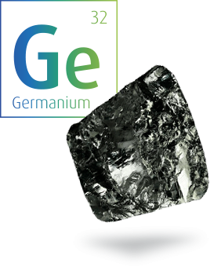
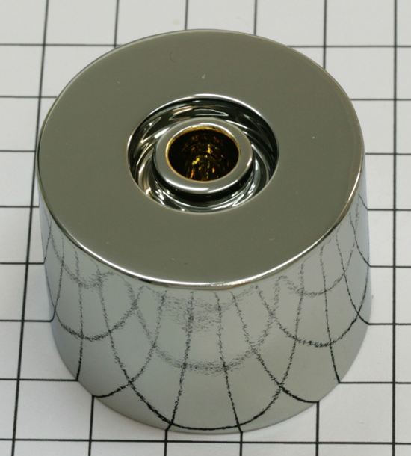

Outline
Some examples of simulations used in detector R&D efforts
  LEGEND: Large inverted-coax detectors
  New detector geometries
  Understanding passivated surfaces: alpha backgrounds and PSA discrimination
  Signals from lithium-drifted n+ contacts
Simulation codes
  MJD_fieldgen and MJD_siggen
  Precision tests and validation

Slide 3
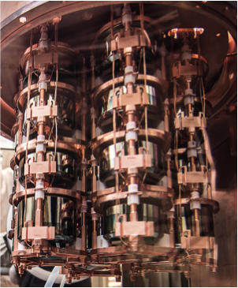
Neutrinoless Double Beta Decay
MJD and GERDA

Slide 4
Point Contact Detectors: Advantages
Weighting potential is highly localized, and large range in drift times
Gives superb separation of single-hit and multi-hit events based on point-contact signal shape
  Important for 0νββ, where events of interest are single-site
Small capacitance, giving very low series noise and low energy thresholds
  Application in searches for dark matter, CEvNS, etc.

Slide 5
Size Limits of PPCs & BEGes?
The average size of the BEGes in GERDA is 0.66 kg.
The average size of the PPCs in MJD is 0.85 kg.
If we had larger detectors, we could have fewer detector holders, cables, front ends, …
So why are PPCs and BEGes so small?
  Required maximum depletion voltages
  Required minimum electric field strength
    Too low a field can lead to charge trapping and poor resolution
To illustrate, let’s simulate the depletion of some detectors

Slide 6
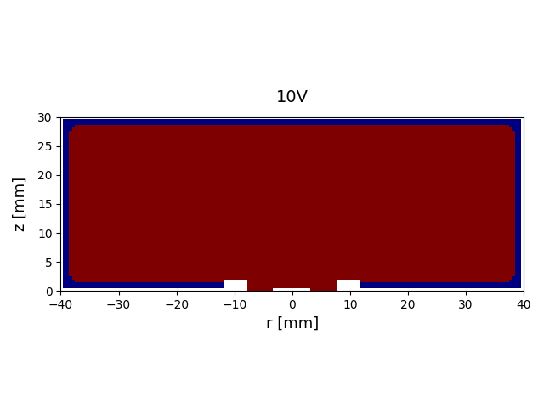
Depletion
BEGe: Diameter 8cm, length 3 cm
Impurity ρ = 0.7 x 10¹⁰ cm⁻³
100 V steps
Depletion: 1200V
p-n junction

Slide 7
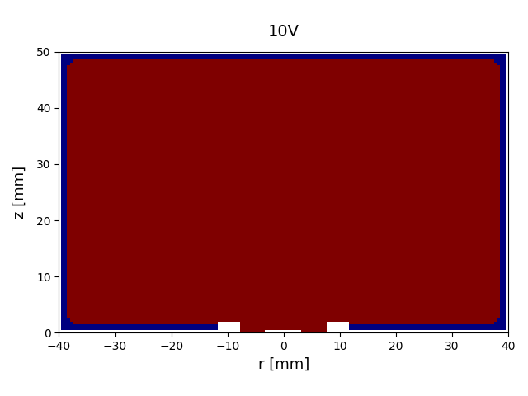
Depletion
BEGe: Diameter 8cm, length 5 cm
Impurity ρ = 0.7 x 10¹⁰ cm⁻³
100 V steps
Depletion: 5200 V

Slide 8
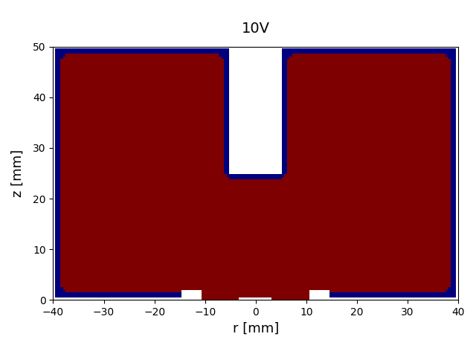
Depletion
Diameter 8cm, length 5 cm, 1 x 2.5 cm hole (0.8% of crystal mass)
Impurity ρ = 0.7 x 10¹⁰ cm⁻³
100 V steps
Depletion: 1400 V
p-n junction

Slide 9
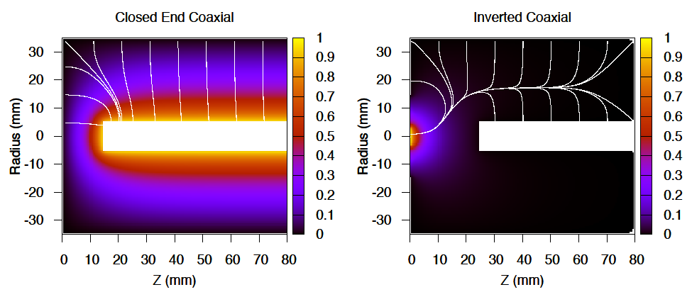
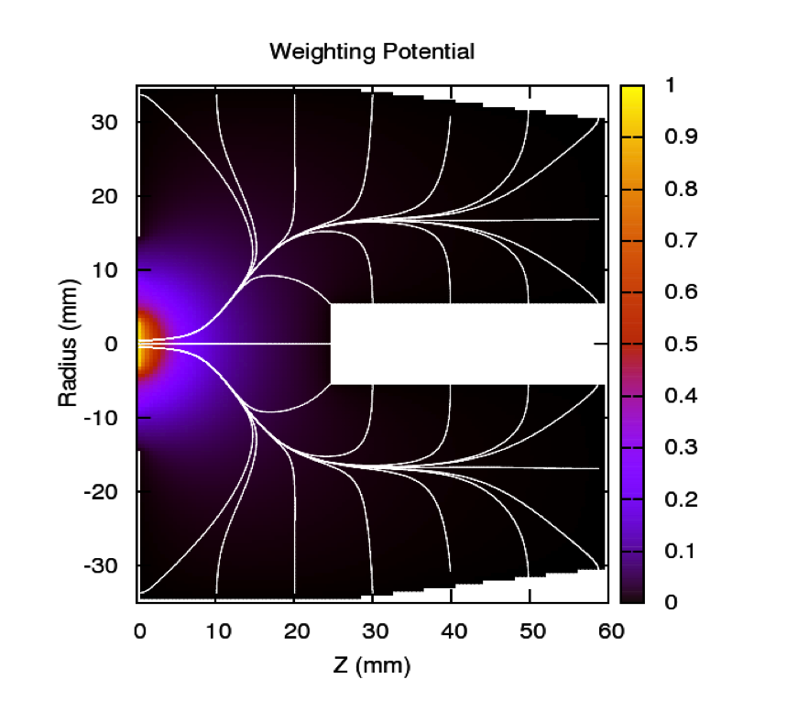
“Inverted Coaxial” Point Contact Detectors
Same small contact, low capacitance and threshold as a PPC or BEGe
Same or better PSA for Single Site / Multi Site Event discrimination
But allows for much larger masses
Very different drift paths
Adopted for LEGEND
Closed-end Coaxial Inverted Coaxial
Notes:
9

Slide 10
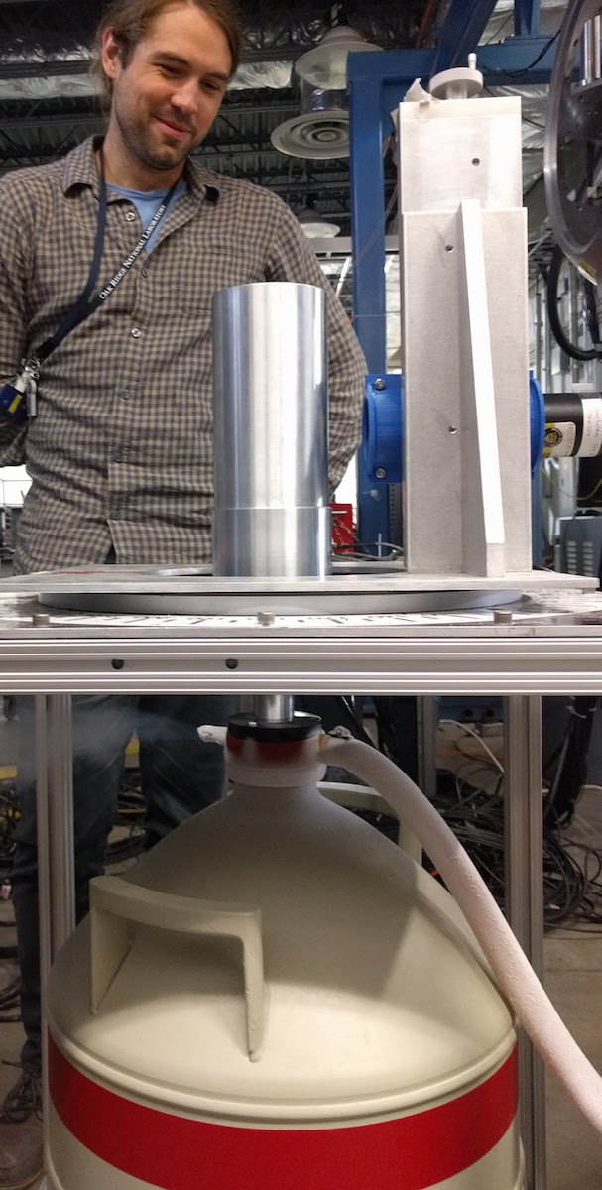
Larger Inverted-Coaxial Point-Contact Detectors
Five enriched ICPC detectors already procured for LEGEND-200, 1.8 kg each
Even larger masses would reduce background by reducing number of cables, preamplifier front ends, mounts
  Also reduces surface-to-volume ratio
  Simplifies construction
Significant impact on cost per kg active mass
  Detector costs, electronics, cabling, DAQ, …
  Even assuming 2.0-kg detectors rather than MJD PPCs yields estimated savings of more than $40M for LEGEND-1000
ORNL LDRD Project: Increase both radius and length of detector to determine optimal mass
Optimization of geometry/mass/yield/performance trade-offs

Slide 11
Tuning the Geometry
For each individual crystal, use simulations to optimize detector and usage of boule material
  Depletion voltage < 4500 V
  Minimum bulk electric field > 200 V/cm
For a given impurity profile, tune:
Crystal length (and diameter)
Well depth and diameter
Li (ditch) diameter
P+ contact diameter

Slide 12
Tuning the Geometry
For each individual crystal, use simulations to optimize detector and usage of boule material
Tapering
  Improves longitudinal field beside the hole
  Outside
  Inside hole
    Removes a lot less material

Slide 13
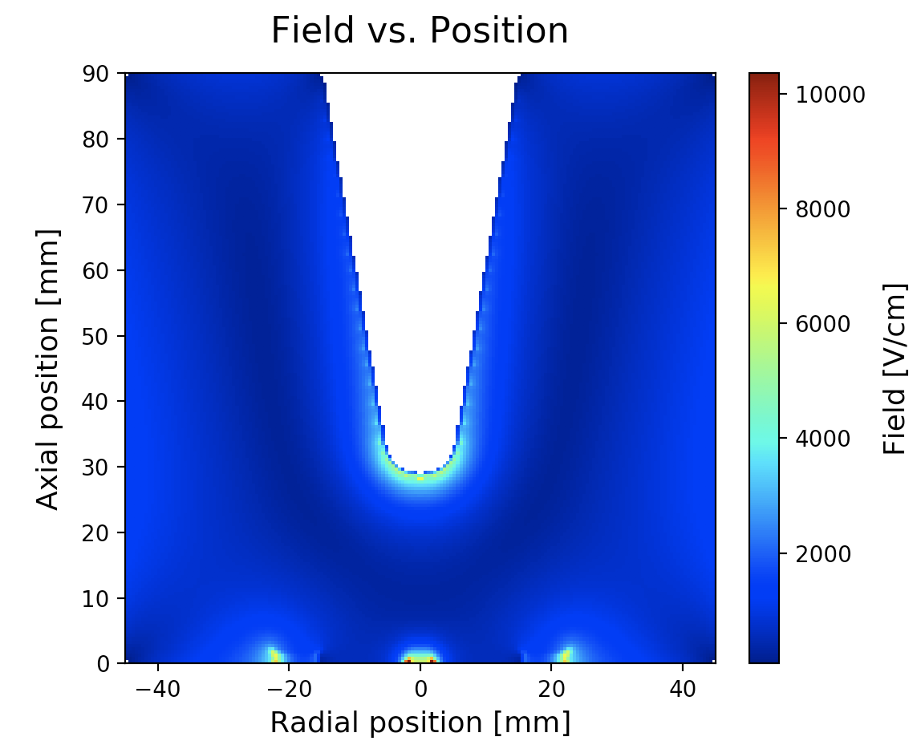
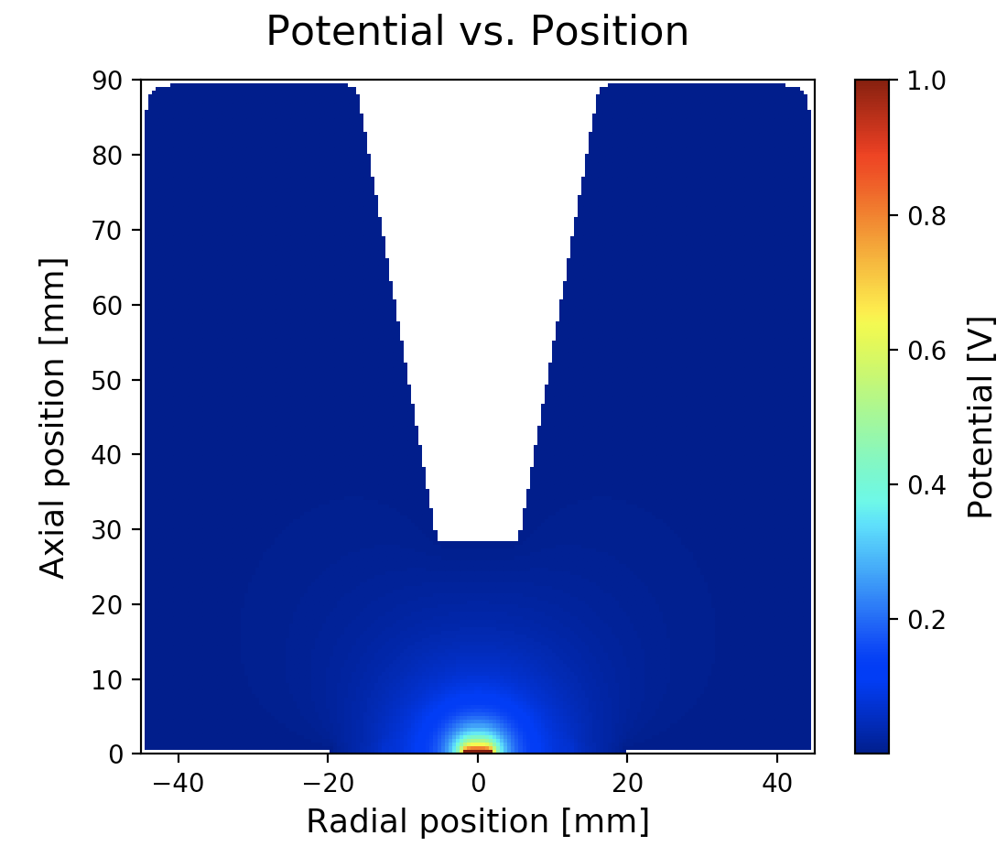
3-kg Detector from Mirion
90.5 mm x 90.5 mm
60-mm well tapered at 10 degrees
Depletion voltage ~2500V
Operating Voltage = 3500V
Field
Weighting Potential

Slide 14
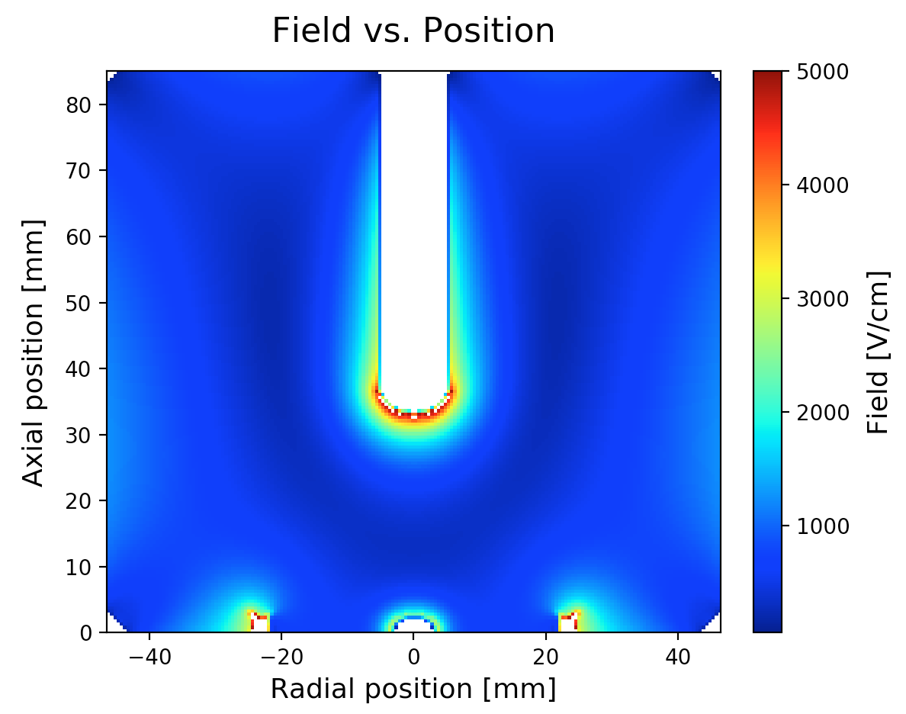
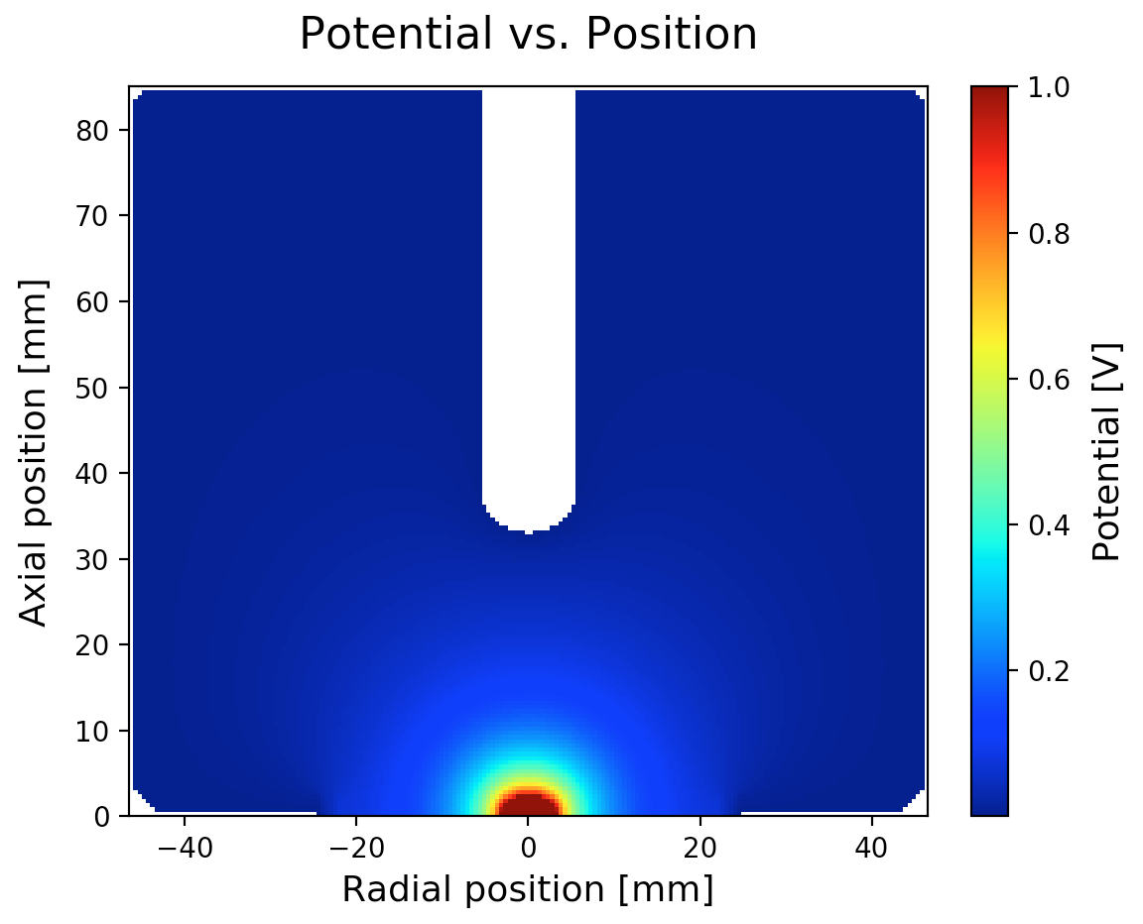
3-kg Prototype from ORTEC
93 mm x 85 mm, no taper
Depletion voltage 2800 V (simulated 3600 V)
Field
Weighting Potential

Slide 15
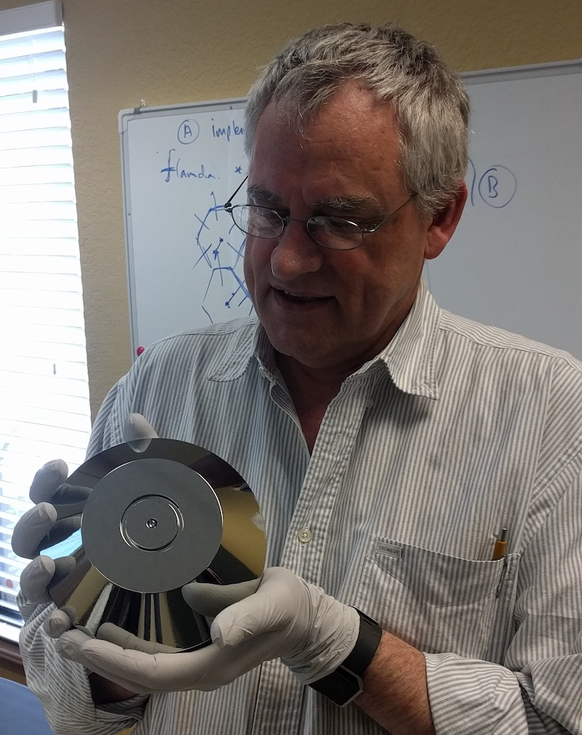
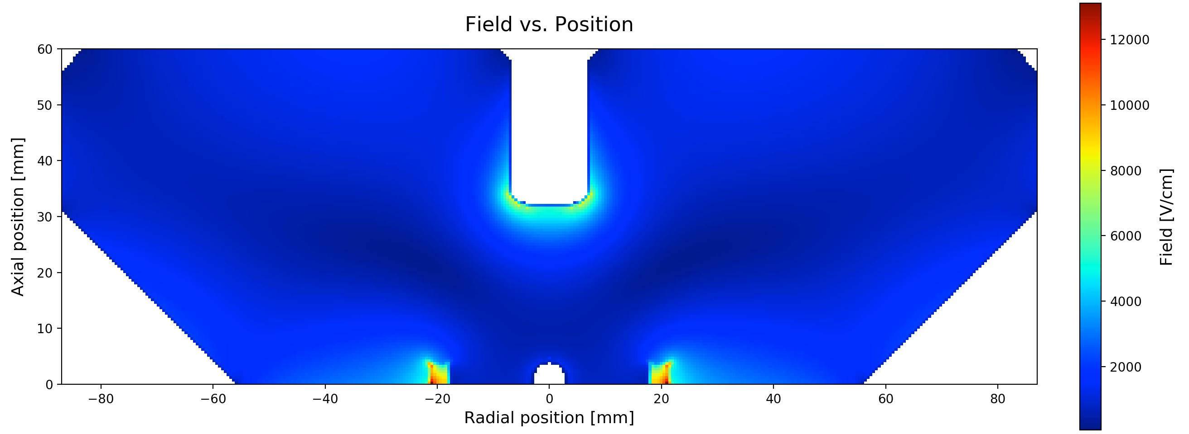
6-kg Detector from PHDs
Currently being reworked (high leakage current)
170 mm x 60 mm
Almost a factor of two larger mass than any previous single-crystal detector
Calculated depletion: 4400 V
Practice crystal for test of grinding, etching, etc.

Slide 16
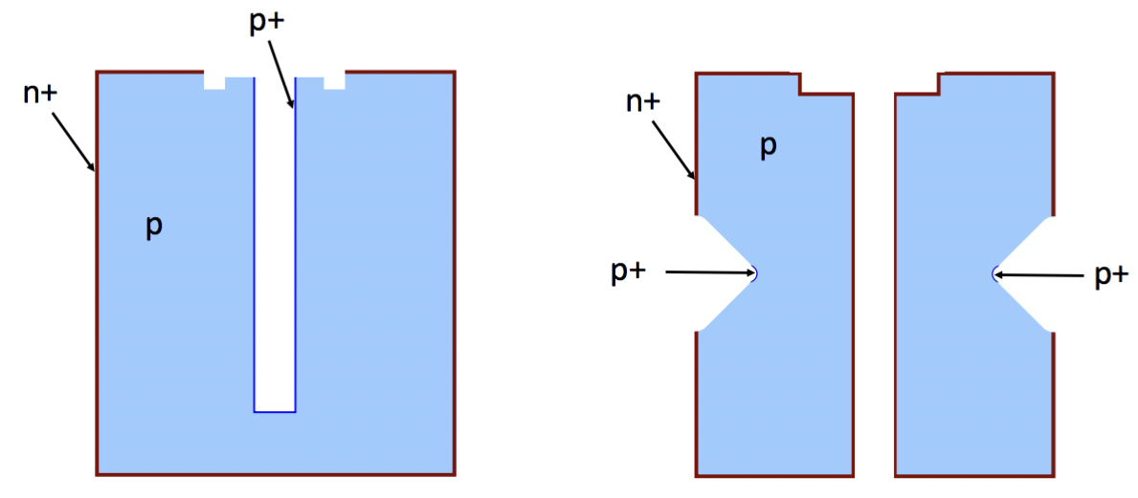
Modification of Enriched Coaxial Detectors?
Five semi-coaxial detectors from the Heidelberg-Moscow experiment are currently in use by GERDA
  11.3 kg total mass.
MSE background rejection by neural network; would be nice to use point-contact-style A/E
Central well is too deep for conversion into the ICPC design
Melting down detectors to re-use enriched material could lead to a loss of up to 1/3 of detector mass
Might it be possible to convert them to a new detector design?
We can explore this possibility with simulations
Acknowledgement: Anna Reine

Slide 17
Ring-contact Detectors?

Slide 18
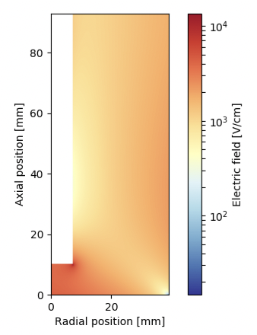
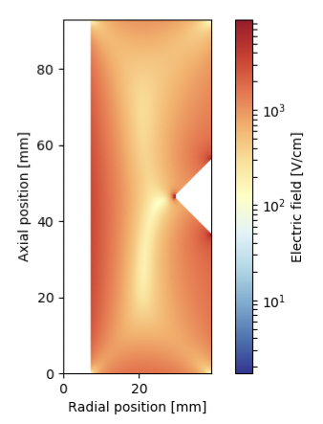
Ring-contact Detectors?
Semicoax:
Calculated depletion: 3500 V
Bias voltage simulated: 4000 V
Ring detector:
Calculated depletion: 1800 V
Bias voltage simulated: 2300 V
Electric fields
Acknowledgement: Anna Reine

Slide 19
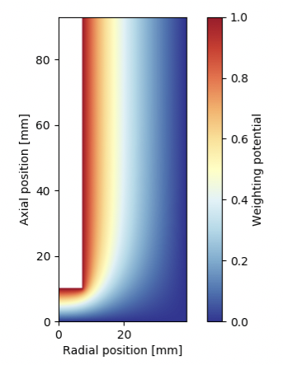
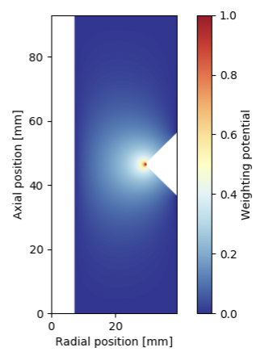
Ring-contact Detectors?
Weighting Potentials
Acknowledgement: Anna Reine

Slide 20
Ring-contact Detectors?
Simulated signals look very promising for a much more sensitive PSA
Still many aspects of the geometry that can be optimized
Planning to test this type of modification with a natural Ge coax

Slide 21
Surface Events
Rare-event searches are prone to backgrounds arising from energy depositions at the detector surfaces
  E.g. Super-CDMS surface patterning
  LEGEND: Alpha and beta backgrounds
Li n+ contacts
Passivated surfaces
Implanted p+ contacts
Notes:
Push futher into lower yield experiments. FRIB low beam intensity reasonable cross sections vs high beam intensity low cross section

Slide 22
Understanding Alpha Backgrounds in MJD Detectors
Before cuts, background in MJD at 2MeV is dominated by alphas
Detector is sensitive to alphas only at passivated and p+ surfaces
Notes:
Push futher into lower yield experiments. FRIB low beam intensity reasonable cross sections vs high beam intensity low cross section

Slide 23
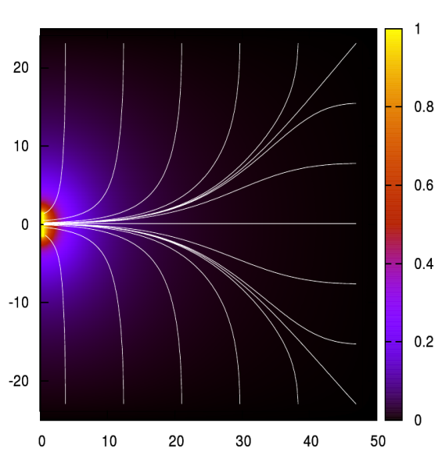
Alpha Signal Generation
Why more alphas at ~ 2 MeV than at full energy?
  Related to behavior of charges on the passivated surface
  And to the “Weighting Potential” that defines signal induced at the readout contact as the charges move inside the detector
WP used for signal calculation
Total collected electron charge goes as
energy * WP(r_{int})
Total collected hole charge goes as
energy * (1.0 – WP(r_{int}))
Notes:
Push futher into lower yield experiments. FRIB low beam intensity reasonable cross sections vs high beam intensity low cross section

Slide 24
Alpha Signal Generation
Why more alphas at ~ 2 MeV than at full energy?
  Related to behavior of charges on the passivated surface
  And to the “Weighting Potential” that defines signal induced at the readout contact as the charges move inside the detector
Calculated WP at the passivated surface, for a MJD PPC detector
Notes:
Push futher into lower yield experiments. FRIB low beam intensity reasonable cross sections vs high beam intensity low cross section

Slide 25
Signal Generation
Alpha range is very short; charges are produced only very close to detector surface
If we have field lines intersecting the passivated surface, then either the holes or electrons will be drawn to the surface where they have greatly reduced mobility
  2D mobility is less than bulk
  Surface roughness
  Charge trapping
In my simulations, I model this by adding (n-type) surface charge at passivated surface
Modified drift paths
Notes:
Push futher into lower yield experiments. FRIB low beam intensity reasonable cross sections vs high beam intensity low cross section

Slide 26
Signal Generation
MC calculation of surface mobility
P. Mullowney et al., NIM A662 (2012) 33
Modified drift paths
Notes:
Push futher into lower yield experiments. FRIB low beam intensity reasonable cross sections vs high beam intensity low cross section

Slide 27
Signal Generation
Remember,
Collected hole charge goes as
energy * (1.0 – WP(r_{int}))
Collected electron charge normally goes as
energy * WP(r_{int})
but now goes to ~ zero
So we collect only the hole charge, which is reduced as we approach the p+ contact
Modified drift paths
Notes:
Push futher into lower yield experiments. FRIB low beam intensity reasonable cross sections vs high beam intensity low cross section

Slide 28
Alpha Simulations
siggen using Ponama1 fields
  50.5 mm long
  34.5 mm radius
Scanned radius of passivated surface
Drift times up to 561 ns (at r = 30 mm)
Notes:
Push futher into lower yield experiments. FRIB low beam intensity reasonable cross sections vs high beam intensity low cross section

Slide 29
Alpha Simulations
siggen using Ponama1 fields
  50.5 mm long
  34.5 mm radius
Scanned radius of passivated surface
Drift times up to 561 ns (at r = 30 mm)
Simulated collected hole charge goes as (1.0 – WP(r))
1.0 – WP(r)
Notes:
Push futher into lower yield experiments. FRIB low beam intensity reasonable cross sections vs high beam intensity low cross section

Slide 30
Measured drift times
ORNL codes
DS5b background runs
1.0 to 3.0 MeV
  All single-site events
  Alphas (cut by “DCR”) (explained below)
Peaked at short drift times, i.e. close to the p+ contact
Notes:
Push futher into lower yield experiments. FRIB low beam intensity reasonable cross sections vs high beam intensity low cross section

Slide 31
The Bushing – Most Likely Culprit
It seems that the alphas are concentrated at low energies and short drift times
Implies small radius
  Certainly very different from r² distribution
Relatively few alphas at full energy, which would come either from the p+ contact or from large radii
Pin
Detector
Teflon Bushing
Notes:
Push futher into lower yield experiments. FRIB low beam intensity reasonable cross sections vs high beam intensity low cross section

Slide 32
DCR-Cut Events, Enriched
Alpha events exhibit “Delayed Charge Recovery”; an extra slow component of charge collection that modifies the effective preamp signal decay time
Allows for an efficient and effective PSA discrimination to discard these events
  Critically important for MJD and LEGEND
Pole-zero-corrected signals
2100-3000 keV, enriched detectors Plots by Ben Jasinski Dec 2015
Notes:
Push futher into lower yield experiments. FRIB low beam intensity reasonable cross sections vs high beam intensity low cross section

Slide 33
DCR-Cut Events, Enriched
Now hypothesized as due to trapping and then slow release of a fraction of the charges from the passivated surface layer
  ~ 6 μs
  Does the release time and/or fraction depend on passivation technology (aGe?)
Pole-zero-corrected signals
2100-3000 keV, enriched detectors Plots by Ben Jasinski Dec 2015
Notes:
Push futher into lower yield experiments. FRIB low beam intensity reasonable cross sections vs high beam intensity low cross section

Slide 34
Surface Scanning with Alphas

Slide 35
Surface Scanning with Alphas

Slide 36
Surface Scanning with Alphas
DCR ~ slope of preamp decay

Slide 37
Alpha Simulations with siggen
Simulations by S. Mertens

Slide 38
Alpha Simulations with siggen
Simulations by S. Mertens

Slide 39
Slow Signals from the Li Transition Layer
Interactions in Li surface result in energy-degraded events
Charge diffusion creates a much longer pulse rise-time
Events are an important background for low-energy program
Has strong impact on active volume / efficiency for 0νββ peak
Notes:
39

Slide 40
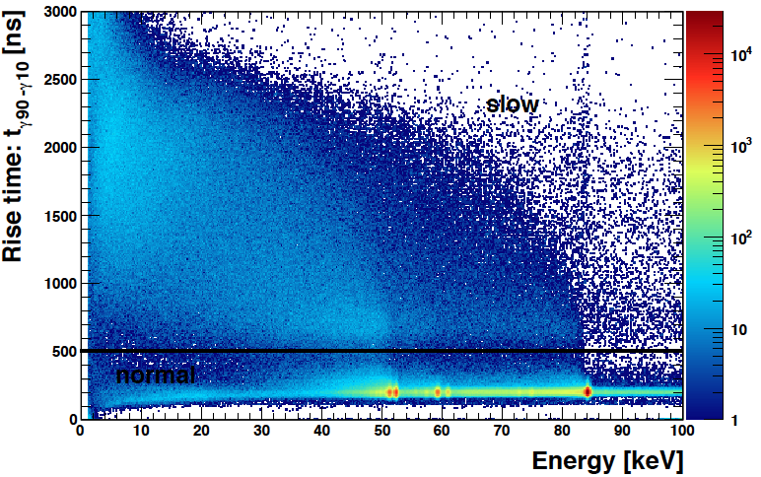
Rise-Time vs. Energy
Dustin Combs
¹⁷⁰Tm data

Slide 41
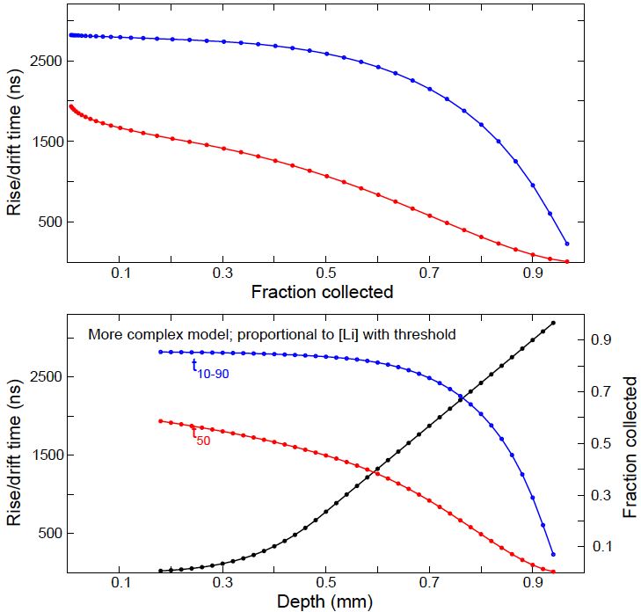
Slow Signals from the Li Transition Layer
Paddy Finnerty, Graham Giovanetti
Not part of standard siggen
Developed physical model of the Li “dead layer” and “transition layer”
  “Recombination zone” close to the surface
  “Diffusion zone” from there to the bulk
Surface
Recombination
Diffusion
Collection
Notes:
41

Slide 42
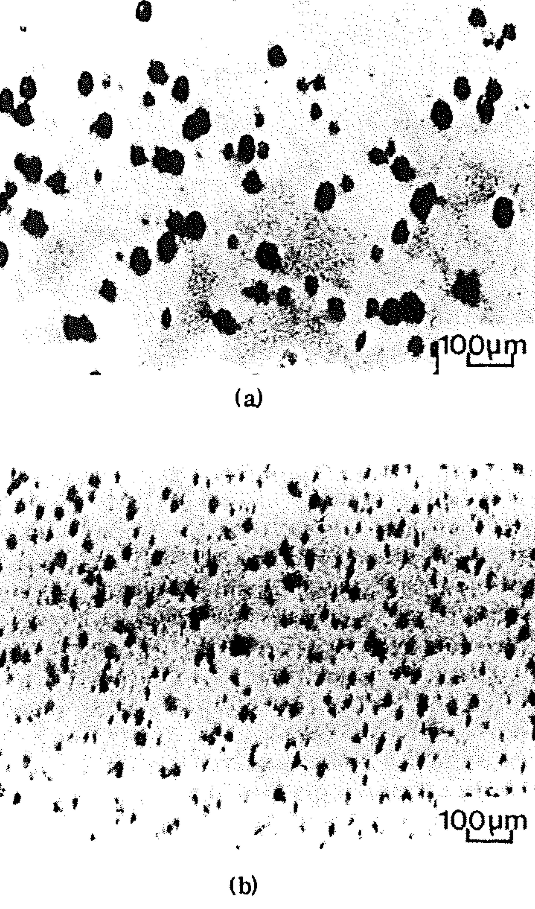
Li Precipitates
Surprisingly (to me), the recombination lifetime of holes in bulk Ge is of the order of seconds
Observed recombination time (μs) requires metallized surface or recombination centers
One good candidate for recombination centers is Lithium Precipitates, formed by precipitation of supersaturated Li
Forms a natural candidate for the origin of the “recombination zone” at the surface of the Li contact
Thanks: Larry Darken
X-ray transmission topograph of dislocation-free Ge crystal after Li precipitation

Slide 43
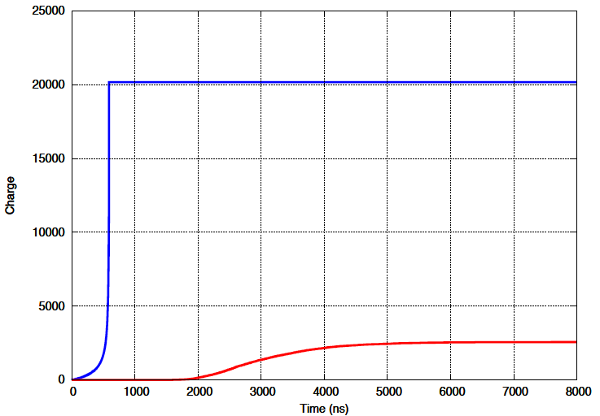
Slow Signals from the Li Transition Layer
With Paddy Finnerty, Graham Giovanetti
Convolute diffusion result with normal siggen output to get degraded signal shape
Bulk
Li contact
- Slow and small
Charge
Time
Notes:
43

Slide 44
Signal Simulation Codes
How well can we calculate the signals generated by Ge detectors?
Simulations are based fundamentally on the Shockley-Ramo theorem
  Parameterized to account for differences between detectors
  Include charge cloud size, charge diffusion during drift, self-repulsion
  Also include an empirical representation of the electronics transfer function
Accurately simulating the waveforms from any specific detector with this model requires the input of over a dozen parameters. Some are well understood, but others are measured poorly or not at all
Ben Shanks (UNC/ORNL) has explored Bayesian machine learning to fit these parameters and reproduce measured signals to fantastic precision
Notes:
44
44

Slide 45
MJD_fieldgen
Calculation of electric and weighting potentials
Stand-alone program
2D relaxation, using cylindrical symmetry
Automatic adaptive grid to speed up calculation
Properly handles undepleted volumes
  Only code I know of that does this
  Iteratively finds undepleted voxels and sets their space charge to zero
  Can calculate signals and capacitances for undepleted detectors
Calculates capacitance of readout contacts
Notes:
45

Slide 46
Capacitance Curves
MJD_fieldgen calculation of capacitance vs. voltage
- Calculation (static) always higher than measurement (dynamic)
ORTEC PPC PONaMa-1
Different impurity profiles
Measured
Notes:
46

Slide 47
Capacitance Curves
MJD_fieldgen calculation of capacitance vs. voltage
Notes:
47

Slide 48
MJD_siggen
Calculation of signals
Mobilities
Temperature dependence
Crystal orientation
Charge cloud size, diffusion, repulsion
Intended for use as a library
Easy to calculate sums of MSE signals from GEANT, for example
Example codes and simple interactive test program provided
Notes:
48

Slide 49
Signals Calculated Near and Above Depletion
800 to 900 V in steps of 20 V
Notes:
49

Slide 50
Signal Simulation Validation?
Use high-energy single-site signals from a MJD PPC detector
Notes:
50
50

Slide 51
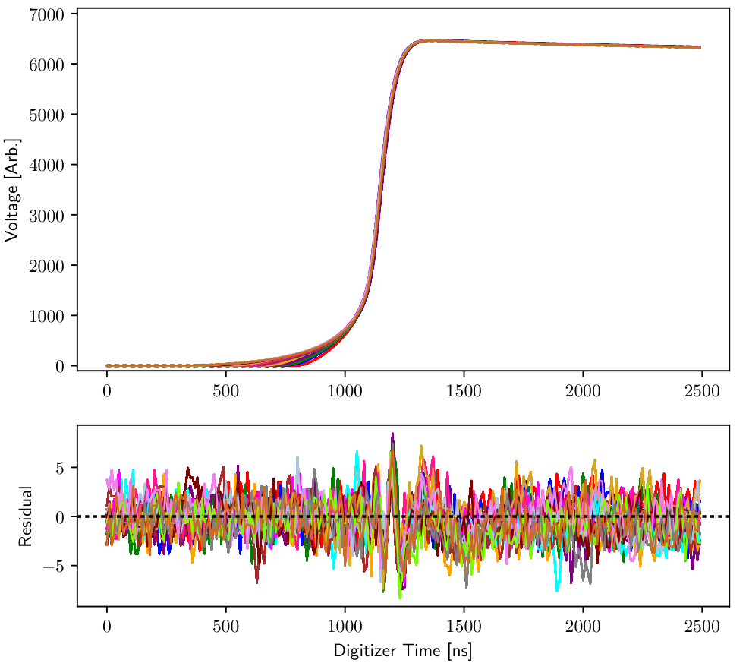
Signal Simulation
Ben Shanks
(UNC / ORNL)
Bayesian fitting of parameters
Reproduction of signals almost at level of noise
< 1 ppt
Notes:
51
51

Slide 52
Conclusions
Field calculations and signal simulations play a crucial in detector optimization for LEGEND
Can do well-validated, very precise modelling of bulk signals
Reliability now good enough to confidently develop novel designs before producing prototypes
  Minimum field, depletion voltage, signal shapes
  e.g. ICPC detectors with masses up to 6 kg should work in principle
  Ring detectors, …
Now have reasonable understanding of surface channels and their effect on MJD alpha backgrounds
Have a physical model for signals from Li n+ contacts

Slide 53
Acknowledgements
  The Majorana, GERDA and LEGEND collaborations
    Especially many students and postdocs
  Canberra/Mirion, ORTEC/AMETEK, and PHDs Co.
  I-Yang Lee (LBNL)
  Karin Lagergren (ORNL)
  Ren Cooper (ORNL, LBNL)
  Ben Shanks (UNC, ORNL)

Slide 54
Backup

Slide 55
Precise Signal Simulation requires:
Weighting potential
  Depends only on detector dimensions
Electric Field
  Depends on impurity profile within the crystal
    Hall probe measurements (relatively high uncertainty)
    Measured depletion voltage(s)
Carrier drift velocity in germanium
  Depends sensitively on electric field and crystal orientation, temperature
Charge cloud size
    Depends on energy of interaction, electric field, drift time
Charge trapping during drift
Shaping introduced by charge-sensitive preamplifier and WF digitizer
  Many factors, but in general, different for each detector
  Cross-talk (both differential and integral) between segments in segmented detectors
Notes:
55
55

Slide 56
MJD_fieldgen and MJD_siggen
There are other codes on the market, e.g.:
- GERDA, AGATA : ADL
- FEniCS
These are used for many excellent simulations…
But I will discuss only a few features of some codes developed at ORNL
Notes:
56

Slide 57
MJD_fieldgen and MJD_siggen
Config file
Detector geometry
Impurity profile
Grid size
Temperature
File names
Charge cloud options
…
fieldgen
Electric potential
Weighting potential(s)
GEANT
Input interaction locations (energies)
siggen
(stester)
Signals
Notes:
57

Slide 58
MJD_fieldgen
Calculation of electric and weighting potentials
Stand-alone program
2D relaxation, using cylindrical symmetry
  Simplest boundary condition for passivated surface; parallel field
  Does not try to include material outside the crystal
Automatic adaptive grid (coarse -> finer -> finest) to speed up calculation
Properly handles undepleted volumes
  Only code I know of that does this
  Iteratively finds undepleted voxels and sets their space charge to zero
  Can calculate signals and capacitances for undepleted detectors
Calculates capacitance of readout contacts
Notes:
58

Slide 59
MJD_siggen
Calculation of signals
Mobilities
Temperature dependence
Crystal orientation
Charge cloud size, diffusion, repulsion
Intended for use as a library
Easy to calculate sums of MSE signals from GEANT, for example
Example codes and simple interactive test program provided
Notes:
59

Slide 60
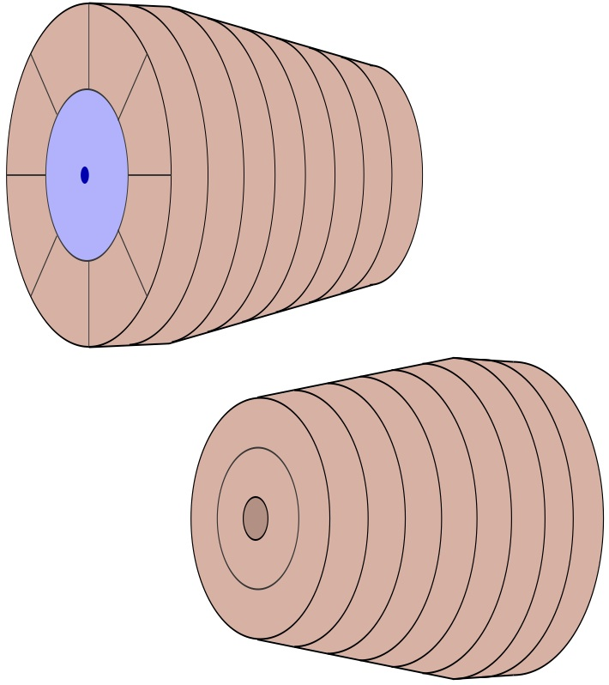
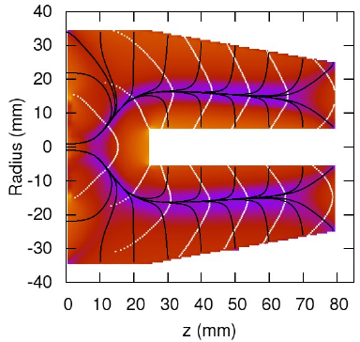
ORNL Segmented Point-Contact Design
Total of 19 segments, 20 signals
Central hole from front face to 25 mm from PC
Longitudinal ring-style segments and pie-slice azimuthal segments separate the longitudinal and azimuthal directions
R.J. Cooper et al., NIM A 665 (2012) 25
PC
9-16
1-8
17-18
19
Notes:
60
60
FOR GAMMA_RAY TRACKING

Slide 61
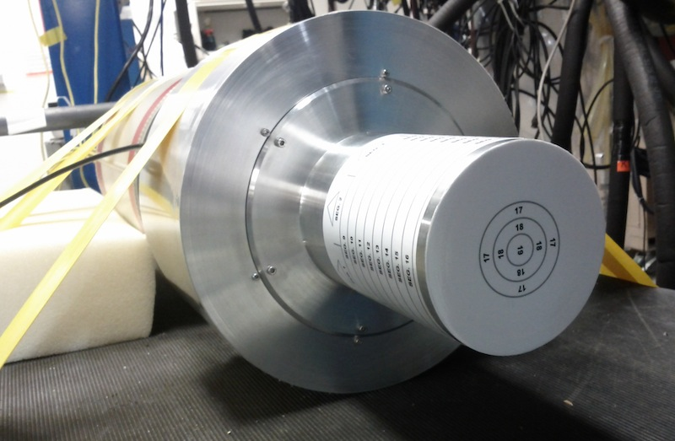
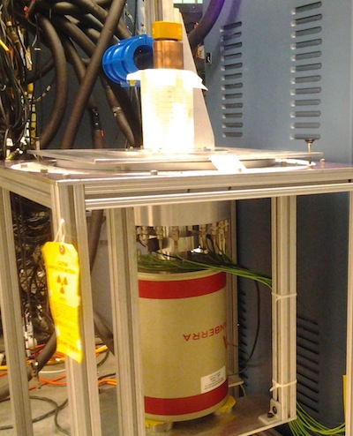
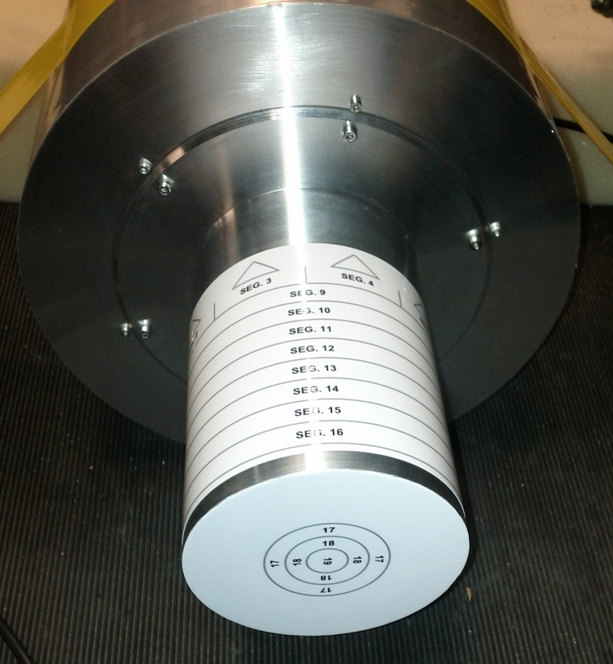
Segmented Prototype
  Produced by Canberra France – talk by Gabriela Ilie
  7 cm diameter, 8 cm long, 10-degree taper over 6 cm of length
  N-type crystal (chosen by manufacturer for segmentation reasons)
  A beautiful detector that taught me a great deal…
Notes:
61
61

Slide 62
Segment Signal Calculations
Weighting Potentials
Seg 9
Seg 11
Seg 15
PC
Seg 10
Seg 14
Seg 16
Seg 19
Notes:
62
62

Slide 63
Performance: Calculated Signals
Results of first test
Simulation parameters not optimized
  Impurity profile, temp.
  Preamplifier response
Not yet added:
  Differential cross-talk
  Finite size of charge cloud
Notes:
63
63

Slide 64
Drift Time: Azimuthal Scan
  Collimated Am source scanned around the circumference of the detector
  Scan along an azimuthal segment boundary, gives precise start-of-drift time
  Data values are highly reproducible (~ 1 ns)
    Determine crystal axis to ~ 0.5 degrees
Good fit requires adjusting both the electron mobilities (from literature) and directional asymmetry
Notes:
64
64

Slide 65
Simulation Concept
Try a new approach based on
    finite-element depth binning,
    numerical hole density functions,
    time-step diffusion, and
    depth-dependent recombination and charge-collection probabilities (per time step)
Assume initial hole density localized to a single depth bin
Use diffusion model that reproduces expected Gaussian width that goes as
σ = sqrt(2Dt) t = time, D = diffusion constant
Einstein equation relates diffusion speed D to mobility μ by
D = μkT/e

Slide 66
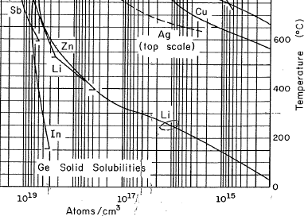
Solid Solubility: Li in Ge
300 °C : 4 x 10¹⁶ cm⁻³
Room temp: 10¹⁴ cm⁻³
Temperature (°C)
Li
10¹⁹ 10¹⁸ 10¹⁷ 10¹⁶ 10¹⁵
Atoms/cm³

Slide 67
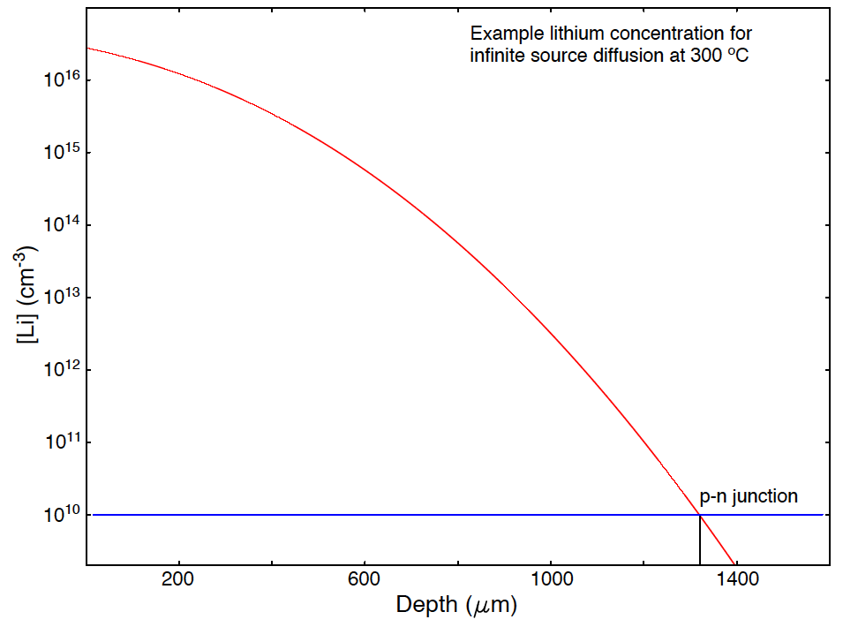
Li Concentration: Toy Li Diffusion
Saturation at 300C
+
Saturation at room temp
-

Slide 68
Li Precipitates
Observed recombination time (μs) requires metallized surface or recombination centers
One good candidate for recombination centers is Lithium Precipitates, formed by precipitation of supersaturated Li
Forms a natural candidate for the origin of the “recombination zone” at the surface of the Li contact
Thanks: Larry Darken
X-ray transmission topograph of dislocation-free Ge crystal after Li precipitation

Slide 69
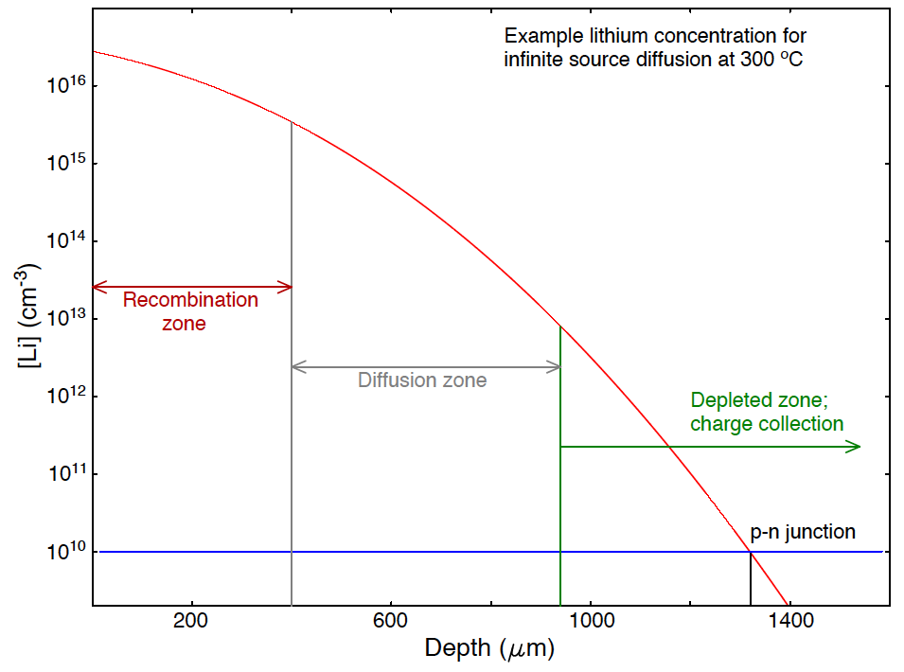
After Detector Depletion

Slide 70
Example Simulation Results

Slide 71
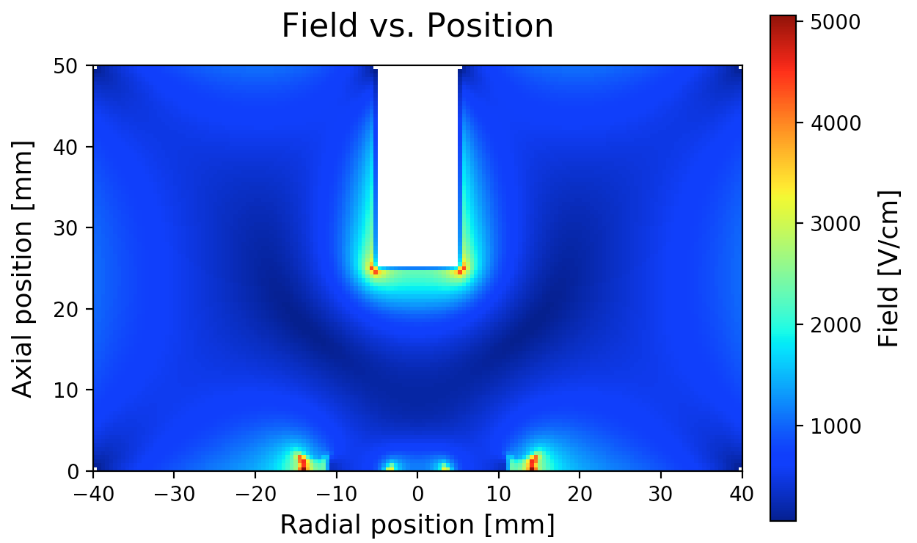
Depletion
Diameter 8cm, length 5 cm, 1 x 2.5 cm hole (0.8% of crystal mass)
Impurity ρ = 0.7 x 10¹⁰ cm⁻³
100 V steps
Depletion: 1400 V
Field at V_{depl} + 500V

Slide 72
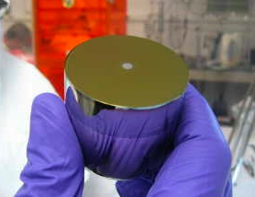
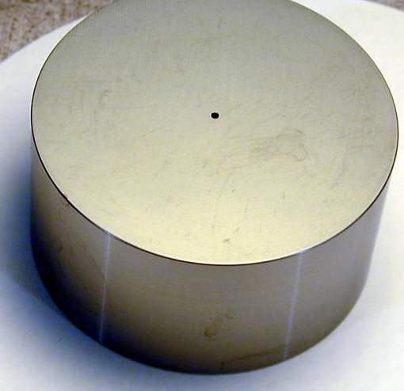
Point Contact Detectors
n+
p+
p
P-type Point Contact
BEGe

Slide 73
Three Large Prototype ICPCs from US Vendors
Two purchased by ORNL
  3 kg from ORTEC
  6 kg from PHDs
One purchased by LANL
  3 kg from Mirion
Some smaller natural detectors also purchased, also some by European collaborators
Detailed characterization planned
  Energy resolution, charge trapping corrections, field dependence
  PSA performance for rejection of multi-site events
  Validation of simulations
  [Alpha scans of passivated surfaces]
Optimization of geometry/mass/yield/performance trade-offs?

Slide 74
3-kg Prototype from ORTEC
Delivered Sept 2017
Results already presented in Dec 2017 at LBNL meeting
85 mm long, 93 mm diameter (over most of length), no taper
  Outside diameter is not perfectly cylindrical
Depletion voltage 2800 V (simulated 3600 V)
Recommended operating bias 3500 V
Calculated capacitance 2.8 pF
Leakage current ~ 60 pA
ORTEC measured 2.6 keV FWHM @ 1.33 MeV, 0.4 keV pulser

Slide 75
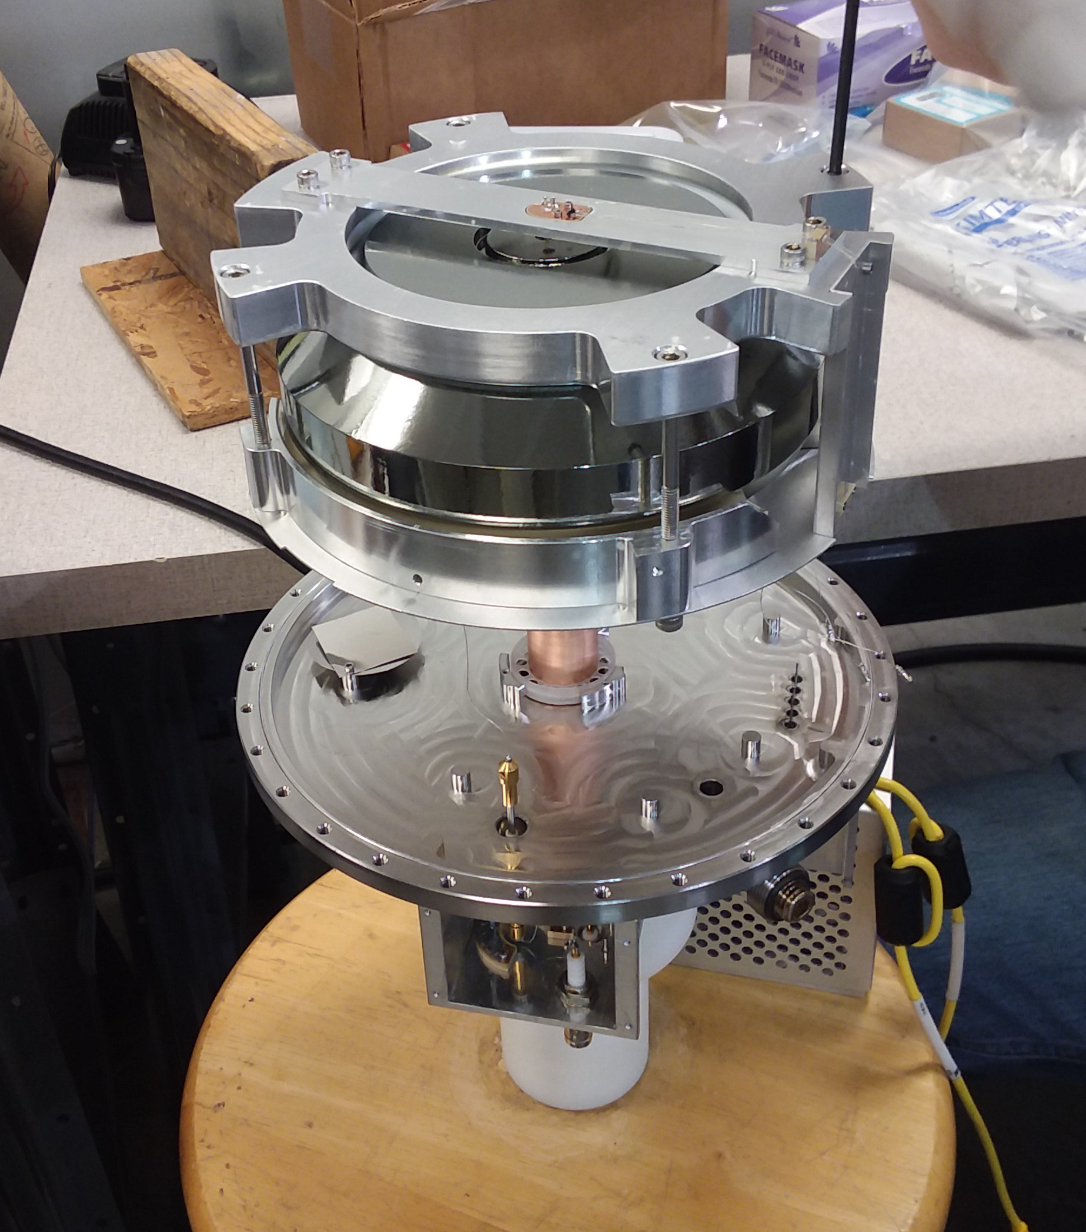
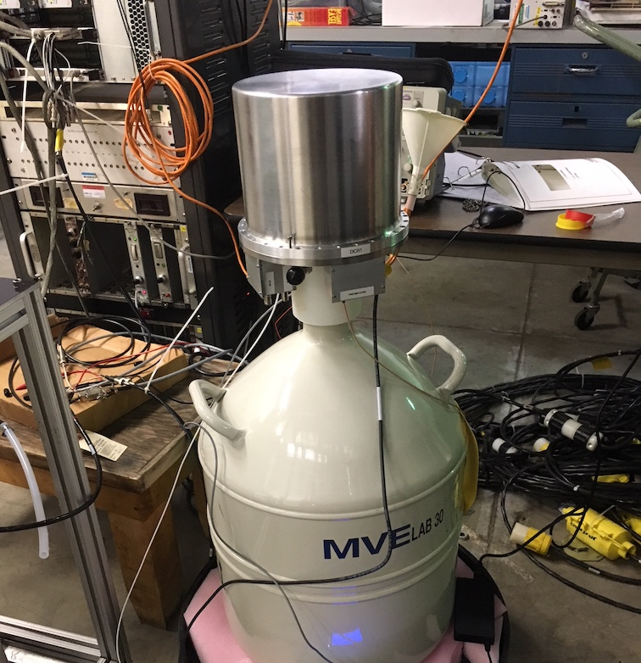
6-kg Detector from PHDs

Slide 76
3-kg Prototype from ORTEC
Acceptable A/E performance: 6.6% SEP for 90% DEP acceptance
But energy resolution not as good as other detectors, even after first-order charge trapping correction
DEP
SEP

